Slide 1
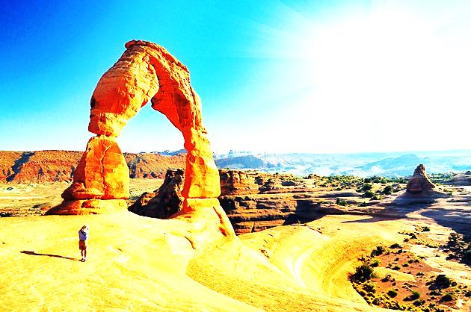
Why Study Hospitality & Travel?
Utah’s #1 Industry is Tourism
14 Million Tourists
$9.4 Billion in 2015
Utah is a gathering place of great diversity.
We will all work in a global economy.
Utah’s bi-lengual skills lead the nation.
Many students will serve in the military, foreign service, or missions.
A better understanding of world cultures helps us become better citizens at home.

