Slide 1
Hospitality & Tourism Review

Slide 2
COURSE DESCRIPTION: The Hospitality and Tourism course provides the student with an understanding of one of the largest industries in Utah and the world. Specific applications include marketing, promoting, and selling the product of airlines, international travel, ground transportation, cruising, hotel and lodging, restaurants, and tours. Students will learn the importance of hospitality and tourisms impact on the economy.

Slide 3
Standard 1: Students will develop an understanding of the importance of hospitality and tourism marketing. Objective 1: Students will understand key terms within the hospitality and tourism industry. a. Define: hospitality industry, tourism industry, service, sustainability, perishability, intangibility and changeability. b. Define service as a product. c. Define: Egocentrism, Ethnocentrism, Ecotourism, and Multiculturism. d. Discuss the importance of a strong infrastructure. e. Identify the 4 segments of the Hospitality and Tourism Industry: Lodging, Food Service, Transportation, and Entertainment. f. Understand the concept of the 24-hour clock, time zones, and the International Date Line.

Slide 4
The Language of Hospitality
Egocentrism - having or regarding the self or the individual as the center of all things.
Ethnocentrism - the belief in the inherent superiority of one's own ethnic group or culture.
Ecotourism – is about uniting conservation, communities, and sustainable travel.
Multiculturalism - is the co-existence of diverse cultures, where culture includes racial, religious, or cultural groups and is manifested in customary behaviors, cultural assumptions and values, patterns of thinking, and communicative styles.

Slide 5
Objective 2: The students will understand the impact of hospitality and tourism on the economy. a. Discuss the social, cultural, economic, and environmental impacts of travel. b. Explain the product life cycle. c. Explain the ripple effect on an economy from tourism. d. Define inflation and staycation. e. Be able to convert money from an exchange rate. f. Discuss the impact of technology on the hospitality and tourism industry.

Slide 6
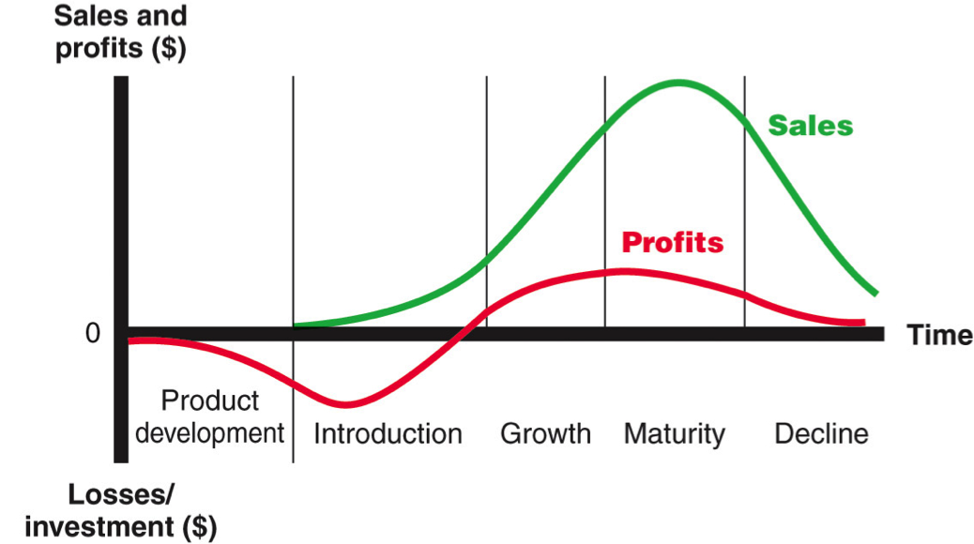
Product Life Cycle

Slide 7
Objective 3: Understand basic marketing principles a. Define: Marketing, target market, segmentation, and the marketing mix

Slide 8
Marketing
The process of communicating the value (features and benefits) of a product (a good or service) for the purpose of selling that product to customers at a profit.

Slide 9
Market Segmentation (Target Market)
Market segmentation is a way of analyzing a market by specific characteristics in order to create a target market:
1. Demographics – Age, Gender, Income Level, Ethnic background, Education
2. Geographics – Regional, National, Global
3. Phychographics – Lifestyles, Personalities, Trends
4. Product Benefits – Consumers’ Needs & Wants

Slide 10
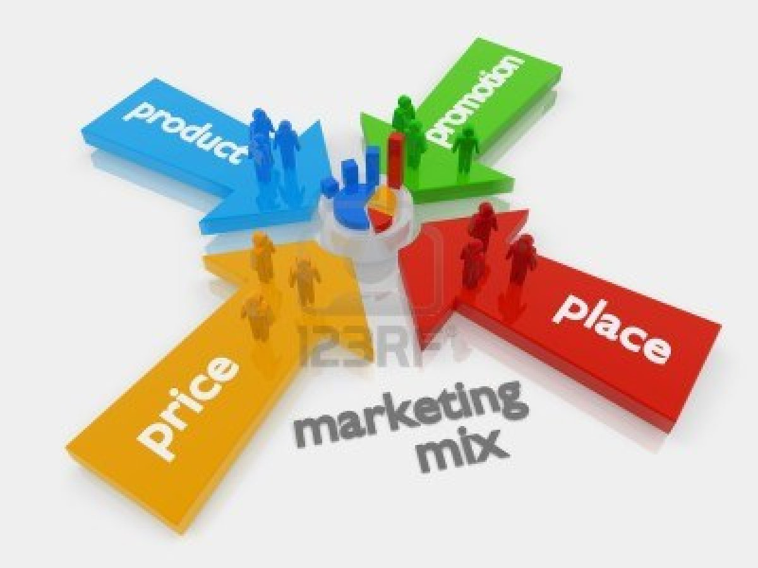
Marketing Mix (The 4 P’s of Marketing)
Product
Price
Place
Promotion

Slide 11
Objective 4: Understand the importance of customer service in hospitality and tourism. a. Define customer service and its vital role in the industry. b. Know and Implement the 3 main objectives of the hospitality and tourism into practical applications (implementation can occur through DECA role plays). i. Make the guests feel welcomed ii. Make sure the products and services work for the guest. iii. Make sure the operation continues to provide quality services and makes a profit.

Slide 12
Customer Service & Hospitality
Customer Service - The provision of service to customers before, during and after the purchase, or meeting and exceeding all customer requirements.
3 Roles of Hospitality –
Make sure the guests feel welcomed.
Make sure the products and services work for the guests
Make sure the operation continues to provide quality services, and makes a profit

Slide 13
Standard 2: The students will develop an understanding of the lodging industry and destination marketing. Objective 1: The students will understand market segmentation for the lodging industry. a. Classify hotels according to their types. b. Discuss yield management. c. Identify variables that affect room rates.

Slide 14
The Lodging Industry
Hotel Classifications:
1. Size (Number of Rooms)
2. Target Markets: Business, Airport, Suite, Extended Stay, Serviced Apartments, Resorts, Bed & Breakfast, Time Share, Casinos, Conventions & Conferences.
Yield Management: a variable pricing strategy, based on understanding, anticipating and influencing consumer behavior in order to maximize revenue or profits from a fixed, perishable resource.
Room Rate Variables:
Size of Room / Number of Beds
Season of the Year
Type of Hotel (Business, Convention, Resort, Extended Stay, etc.)

Slide 15
Objective 2: The students will understand the concept of destination marketing. a. Define: destination, destination marketing, resort, time shares, and commission. b. Discuss the concept of seasonality. c. Discuss the concept of supply and demand. d. Explain elasticity of demand and its effect on the economy and tourism. e. Explain loyalty programs in relation to the 4 P’s. f. Explain how the 4 p’s effect lodging.

Slide 16
Lodging (Cont.)
Destination Marketing: Promoting the features and benefits of a specific destination and helping the long-term development of communities through a travel and tourism strategy.
Seasonality: a characteristic of a time series in which the data experiences regular and predictable changes which recur every calendar year. Any predictable change or pattern in a time series that recurs or repeats over a one-year period can be said to be seasonal.

Slide 17
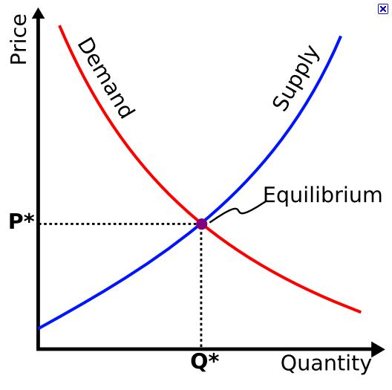
Equilibrium or Market Clearing Price

Slide 18
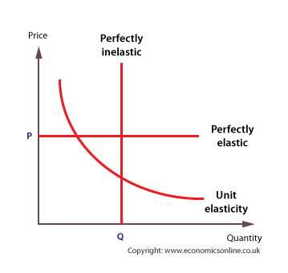
Price Elasticity

Slide 19
Marketing Mix (The 4 P’s of Marketing)
Product
Price
Place
Promotion

Slide 20
Objective 3: The students will be able to identify basic hotel operations. a. Explain front-of-the-house, back-of-the-house, concierge, rooms, and Food & Beverage (F&B) divisions.

Slide 21
More Hospitality Terms
Front-of-house: the areas of a hotel or restaurant open to the public or public view, such as the lobby, bar, and dining room.
Back-of-house: referring to the kitchen area of a restaurant or hotel, and staff who work in the kitchen and hotel.
Concierge - a hotel employee whose job is to assist guests by arranging tours, making theater and restaurant reservations, etc.
Food & Beverage - Any product intended for human consumption and sold for a profit in the Hospitality industry.

Slide 22
Standard 3: The student will develop an understanding of the different types of transportation used in international and domestic tourism.

Slide 23
International and Domestic Transportation
Airline Industry
Cruise Industry
Train / Rail Industry
Rent-a-car
Bus Industry

Slide 24
Objective 1a: The students will understand the importance of aviation to the hospitality/tourism industry. a. Discuss the aviation industry. b. Discuss how the hub and spoke system works. c. Describe airline boarding procedures and security methods. d. Identify the career opportunities and necessary training required to work in the airline industry. Objective 1b: The students will understand how the 4 P’s affect the airline industry. a. Identify major aircraft in use. b. Discuss Frequent Flyer Programs. c. Understand the difference between airline fare classifications. d. Know major airport city codes. e. Understand how airline fees and in-flight services affect customer’s purchase behaviors.

Slide 25
Types of Aircraft
Airbus Aircraft
Airbus A310 It is the development of the first Airbus aircraft A300. Airbus A310 has been in use for medium and long range routes since 1983.
Airbus A320 Family The most successful program of Airbus includes a number of middle range airplanes A318, A319, A320 and A321. Since 1988 more than 3 000 aircraft of this family have been delivered to airlines all over the world.
Airbus A330 A two engine variant of a long range A340 designed for 12 000 km flights. It has been produced in some modifications since 1994.
Airbus A340 A number of modifications of a long range aircraft which are able to carry passengers for 16 000 km.
Airbus A380 The newest commercial aircraft of Airbus – a giant A380 is made for transcontinental routes between the largest airports of the world.
Boeing Aircraft
Boeing-717 The aircraft was renamed into Boeing 717 when McDonnell Douglas were purchased by Boeing in 1997. It became the last model of short and middle range airplanes DC-9 and MD-80/90 produced since 1960s.
Boeing-737 The most numerous passenger aircraft in the world. The first airplanes went into sky in 1967. The aircraft has passed through some serious modifications and is still the most popular and modern.
Boeing 747 It performed the first flight in 1969. It is the main airplane for transcontinental routes. Boeing Corporation continues to improve it and launches modern models.
Boeing 757 It is made for distances of 4 000 – 6 000 km. It has been produced since 1983 and is successfully operated in the USA, Europe and Asia.
Boeing 767 It is a long range aircraft for thin passenger traffic routes. The most of 767 aircraft operate services between Europe and America.
Boeing 777 It is a long range aircraft entering production in 1995. It is made for high density routes and flies to the largest international airports.

Slide 27
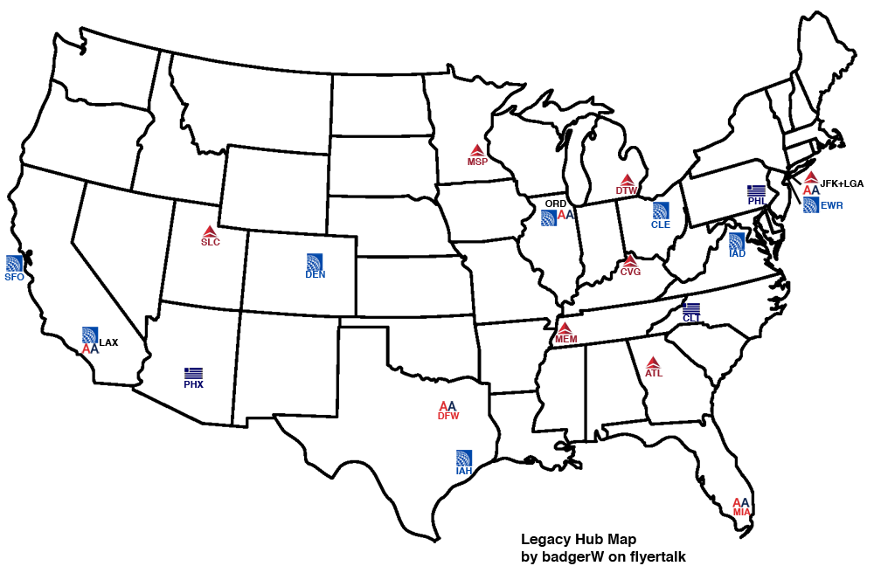

Slide 29
Aviation Terms
Aviation -
Hub & Spoke System -
Boarding & Security -
Career Opportunities -
Types of Aircraft –
Frequent Flyer Programs -
Airline Fare Classification
Airport City Codes –
Fees & In-flight Services -

Slide 30
International Airport City Codes
Hartsfield Jackson Atlanta International | United States | ATL | 95,462,867
Beijing Capital International | China | PEK | 81,929,359
London Heathrow | United Kingdom | LHR | 70,037,417
Tokyo International | Japan | HND | 66,795,178
Chicago O’Hare International | United States | ORD | 66,633,503
Los Angeles International | United States | LAX | 63,688,121
Charles de Gaulle International | France | CDG | 61,611,934
Dallas Fort Worth International | United States | DFW | 58,591,842
Soekarno-Hatta International | Indonesia | CGK | 57,772,762
Dubai International | United Arab Emirates | DXB | 57,684,550
Frankfurt am Main International | Germany | FRA | 57,520,001
Hong Kong International Kai Tak | Hong Kong | HKG | 56,057,751
Denver International | United States | DEN | 53,156,278
Suvarnabhumi | Thailand | BKK | 53,002,328
Singapore Changi International | Singapore | SIN | 51,181,804
Amsterdam Schiphol | Netherlands | AMS | 51,035,590
John F Kennedy International | United States | JFK | 49,291,765
Guangzhou Baiyun International | China | CAN | 48,548,430
Madrid Barajas International | Spain | MAD | 45,176,978
Atatürk International | Turkey | IST | 45,124,831

Slide 31
Domestic Airport City Codes
Hartsfield Jackson Atlanta International | Atlanta | ATL | 95,513,828 | 92,389,023 | 0.97%
Chicago O’Hare International | Chicago | ORD | 66,633,503 | 66,701,241 | 1.00%
Los Angeles International | Los Angeles | LAX | 63,688,121 | 61,862,052 | 0.97%
Dallas Fort Worth International | Dallas-Fort Worth | DFW | 58,621,369 | 57,832,495 | 0.99%
Denver International | Denver | DEN | 53,156,278 | 52,849,132 | 0.99%
John F Kennedy International | New York | JFK | 49,291,765 | 47,644,060 | 0.97%
San Francisco International | San Francisco | SFO | 44,399,885 | 40,927,786 | 0.92%
Charlotte Douglas International | Charlotte | CLT | 41,228,372 | 39,043,708 | 0.95%
McCarran International | Las Vegas | LAS | 40,799,830 | 40,560,285 | 0.99%
Phoenix Sky Harbor International | Phoenix | PHX | 40,421,611 | 40,591,948 | 1.00%
George Bush Intercontinental Houston | Houston | IAH | 39,891,444 | 40,128,953 | 1.01%
Miami International | Miami | MIA | 39,467,444 | 38,314,389 | 0.97%
Orlando International | Orlando | MCO | 35,288,887 | 35,426,006 | 1.00%
Newark Liberty International | Newark | EWR | 34,014,027 | 33,697,492 | 0.99%
Seattle Tacoma International | Seattle | SEA | 33,223,111 | 32,823,220 | 0.99%
Minneapolis-St Paul International/Wold-Chamberlain | Minneapolis | MSP | 33,170,960 | 33,118,499 | 1.00%
Detroit Metropolitan Wayne County | Detroit | DTW | 32,241,731 | 32,406,159 | 1.01%
Philadelphia International | Philadelphia | PHL | 30,252,816 | 30,839,175 | 1.02%
General Edward Lawrence Logan International | Boston | BOS | 29,349,759 | 28,932,808 | 0.99%
La Guardia | New York | LGA | 25,707,784 | 24,122,478 | 0.94%

Slide 32
Objective 2a: The students will develop an understanding of the various types of ground transportation that exist and the role they play in the hospitality and tourism industry. a. List the various types of ground transportation that exist. b. Identify major car-rental companies. c. Explain rental car policies and procedures. d. Compare and contrast ground transportation and rail service in the United States with that of other countries. e. Identify the career opportunities and necessary training required to work in the ground transportation industry.

Slide 33
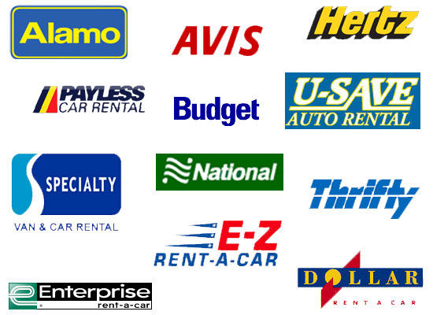
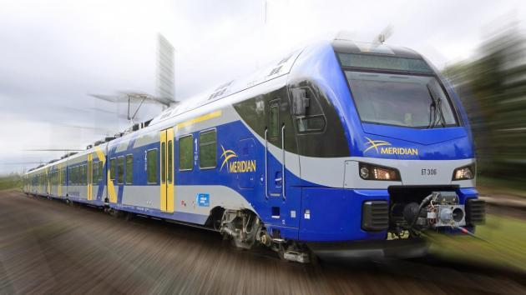
Ground Transportation
1. Types of Ground Transportation -
Rental Car Companies -
Rental Car Policies & Procedures –
Rail Service Comparison -
Career Opportunities -

Slide 34
Objective 2b: The students will understand how the 4 P’s affect ground travel. a. Discuss shuttle service & car rental options. b. Charter bus tours. Objective

Slide 35
Ground Transportation
Shuttle Service –
2. Rental Cars -
Charter Buses –
Train / Rail -

Slide 36
3a: The students will demonstrate knowledge of the cruise industry. a. Define: embarkation, debarkation, and port-of-call. b. Identify principal cruise lines. c. Explore different cruising areas around the world. d. Research activities available both on and off the ship. e. Identify the career opportunities and necessary training required to work in the cruise industry.

Slide 37
Cruise Industry
Terminology
Embarkation - Departure
Debarkation - Return
Port-of-call -
Principal Cruise Lines -
Primary Cruise Areas -
Activities -
Employment Opportunities -
Top 10 Cruise Lines
Oceania Cruises
MSC Cruises
Crystal
Hebridean Island Cruises
Lidbland Expeditions
Sea Dream Cruises
Silversea Cruises
Viking River Cruises
Disney Cruise Lines
Regent Seven Seas Cruises

Slide 38
Objective 3b: The students will understand how the 4 P’s affect the cruise industry. a. Explain shore excursions. b. Discuss ship layouts and cabin options. c. Theme cruise. d. Pricing of Cruises.

Slide 39
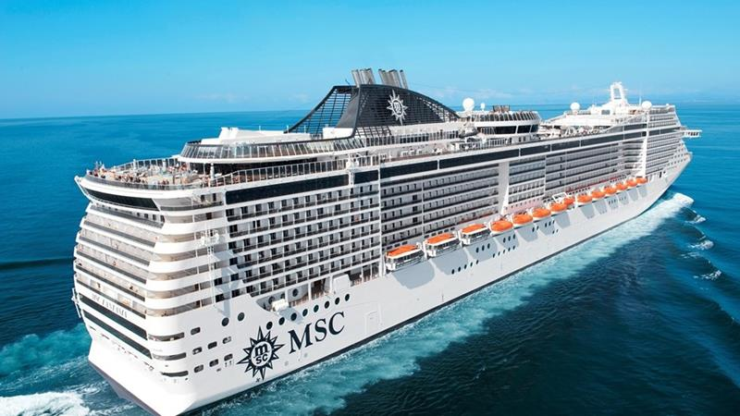
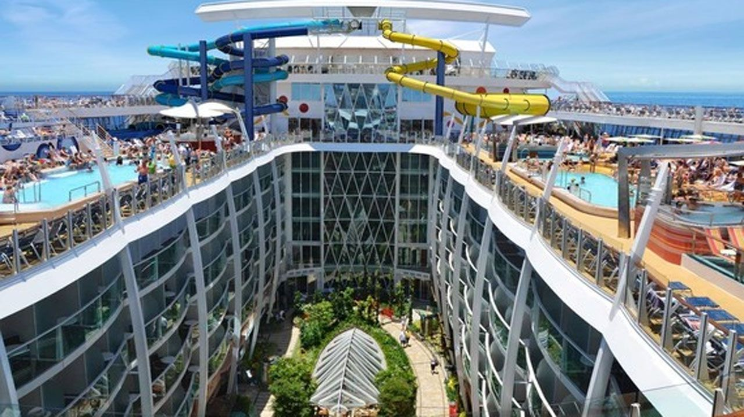

Slide 40
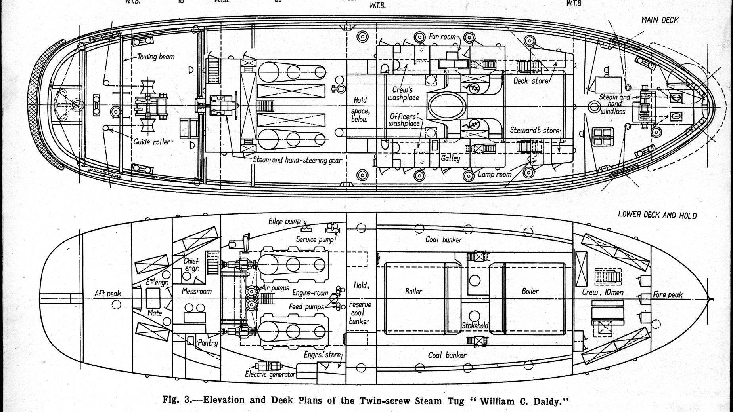
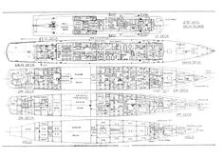
Port
Stern
Bow
Visit page | View image | Save | View saved
Deck plans of the British monitor 'Roberts' (1915) | Ship ...
www.pinterest.com236 × 167Search by image
Blueprints Boats, Deck Plans, Boat Blueprints, Crossword Puzzle, Cutter Deck, Crossword
Images may be subject to copyright.Send feedback
Starboard

Slide 41
Cruise Industry Terminology
Shore Excursions / Ports of Call -
Ship Layouts / Cabin Options -
Theme Cruises -
U. S. Customs / Duty Free -

Slide 42
Objective 4: Develop an understanding of the difference between domestic and international travel. a. Identify the difference between domestic and international travel b. Detail the documentation needed for travel abroad. c. Identify travelers’ health concerns d. Discuss U.S. Customs and duty-free items.

Slide 43
What is the Temperature? Celsius and Fahrenheit
Fahrenheit Celsius
At what temperature does water freeze? 32 degrees 0 degrees
At what temperature does water boil? 212 degrees 100 degrees
At what temperature dose paper burn? 451 degrees 450 degrees
What is the temperature outside? 75 degrees 24 degrees

Slide 44
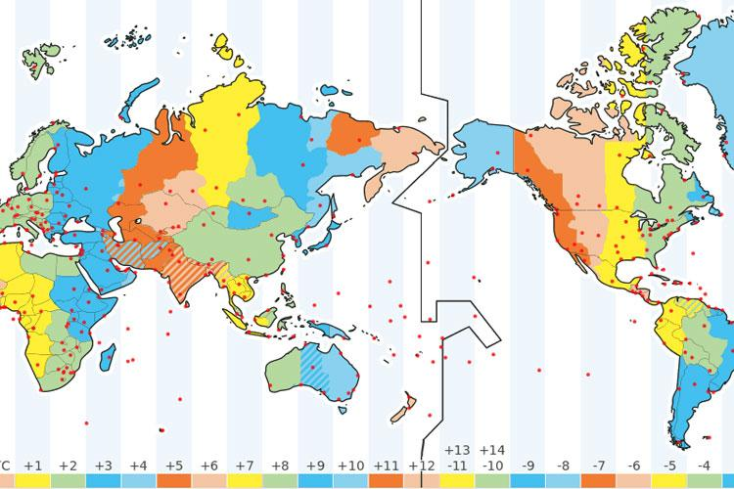
International Date Line

Slide 45
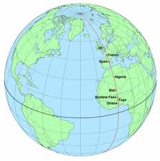
Greenwich, England
Greenwich is notable for its maritime history and for giving its name to the Greenwich Meridian (0° longitude) and Greenwich Mean Time. The town became the site of a royal palace, the Palace of Placentia from the 15th century, and was the birthplace of many Tudors, including Henry VIII and Elizabeth I. The World Clock is in Greenwich, England. We set our watches by Greenwich Time, adjusted to our specific Time Zone.

Slide 46
2 Time Systems
12 Hour Clock
12:00 am (Midnight)
1:00 am
2:00 am
3:00 am
4:00 am
5:00 am
6:00 am
7:00 am
8:00 am
9:00 am
10:00 am
11:00 am
12:00 pm (noon)
1:00 pm
2:00 pm
3:00 pm
4:00 pm
5:00 pm
6:00 pm
7:00 pm
8:00 pm
9:00 pm
10:00 pm
11:00 pm
24 Hour Clock
0:00
1:00
2:00
3:00
4:00
5:00
6:00
7:00
8:00
9:00
10:00
11:00
12:00
13:00
14:00
15:00
16:00
17:00
18:00
19:00
20:00
21:00
22:00
23:00
Some countries use the 12 Hour Clock, and others use the 24 Hour Clock. The 24 Hour Clock is also called Military Time.

Slide 47
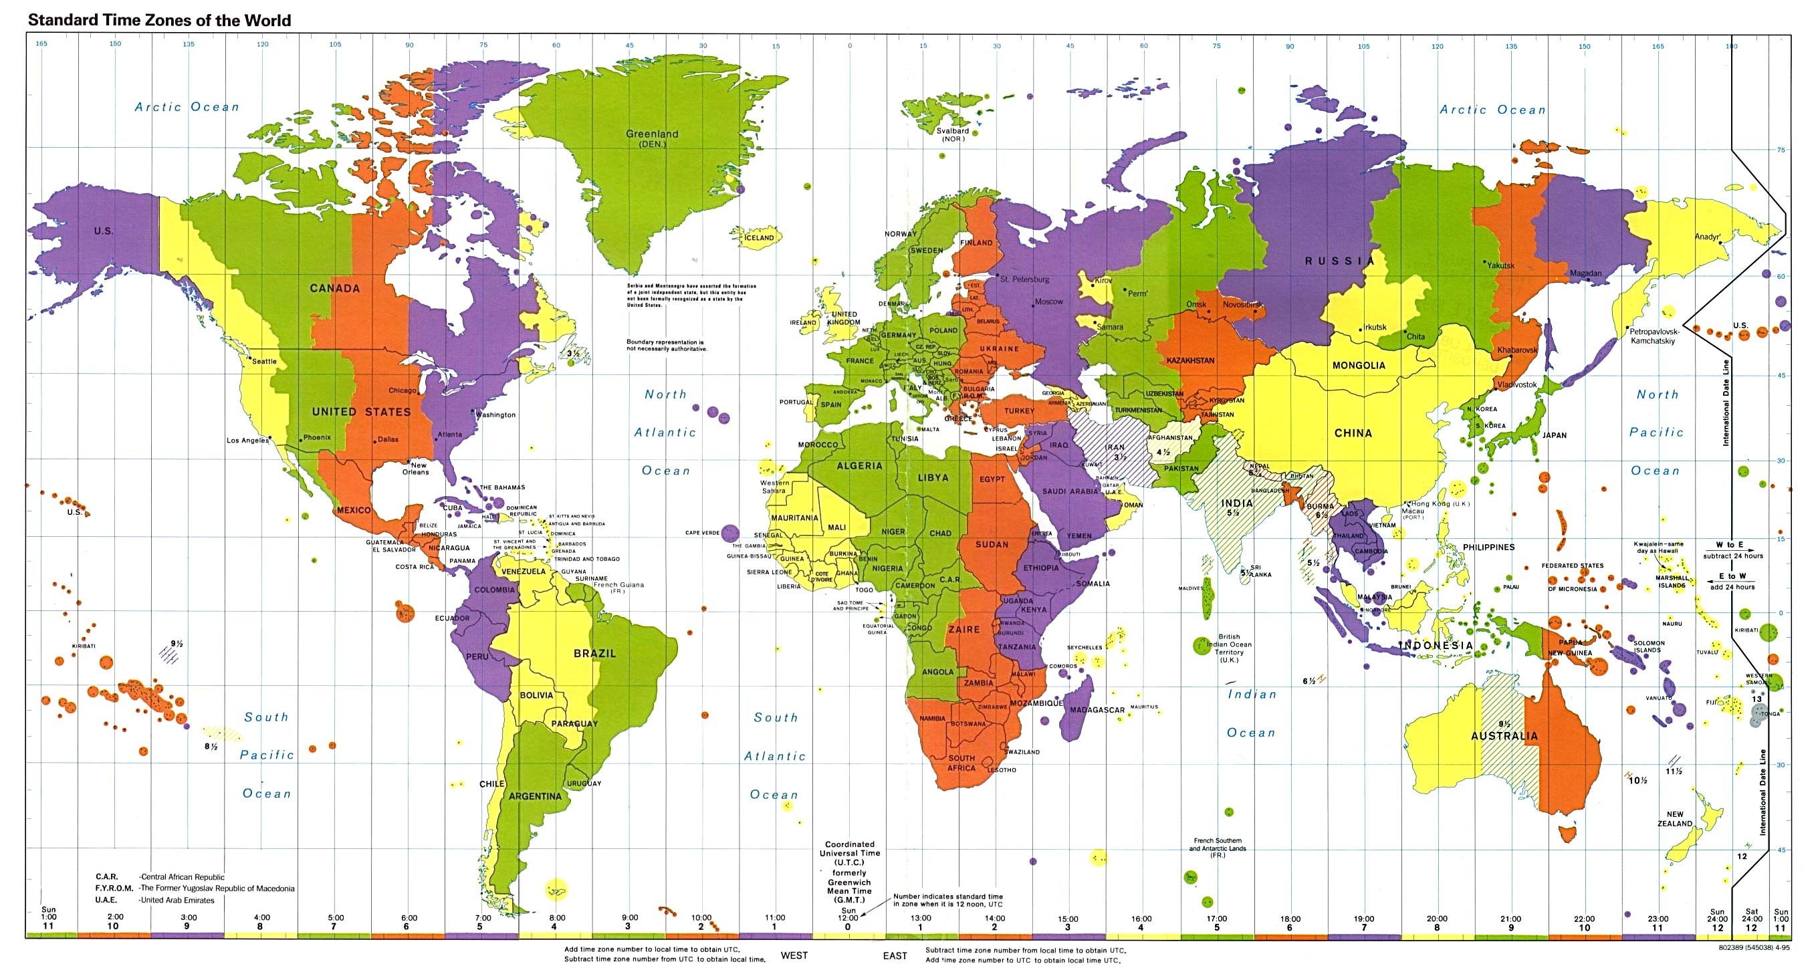
Time Zones

Slide 48
Standard 4: Students will develop an understanding of the different aspects of the restaurant industry. Objective 1: Understand the key terms and functions of a restaurant business. a. Define restaurant. b. Describe Quick-Service and Full-Service, and casual dining. c. Understand basic restaurant terminology including, eating and dining markets.

Slide 49
Restaurant Terminology
Restaurant - a place of business where a large selection of food and beverages can be selected from a menu.
Quick-Service - or Fast Food is a specific type of restaurant characterized both by its fast food cuisine and by minimal table service.
Full-Service -
Casual Dining - are primarily chain restaurants, such as Chipotle Mexican Grill and Panera Bread.
Eating Markets - a place where we can get food and beverages for considerable price or value.
Dining Markets - a place where experience, comfort and service according to needs of customers is offered, where we can expect more individual care.

Slide 50
Objective 2: Identify different jobs, careers, and opportunities in the restaurants.

Slide 51
Restaurant Career Opportunities
Baker
Banquet manager
Bartender
Beverage manager
Broiler cook
Bus person
Catering manager
Counter server
Dining room manager
Executive chef
Expediter
Food and beverage director
Foodservice directory (health care)
Fry/sauté cook
General manager (fullservice)
General manager (quick service)
Human resources manager
Kitchen manager
Maître d'hotel
Pantry cook
Pastry chef
President/CEO
Public relations manager
Server
Soup and sauce cook
Sous chef
Wine steward

Slide 52
Standard 5: Students will explore the hospitality and tourism industry in Utah. Objective 1: Identify National Parks in Utah.

Slide 53
Utah’s National Parks & Monuments
Utah’s 5 National Parks:
Arches
Canyonlands
Capitol Reef
Bryce Canyon
Zion
Utah’s National Monuments
& Landmarks:
Ashley National Forest
Cedar Breaks National Monument
Dinosaur National Monument
Dixie National Forest
Fishlake National Forest
Flaming Gorge
Glen Canyon
Golden Spike
Grand Staircase / Escalante National Monument
Hovenweep National Monument
Lake Powell
Manti La Sal National Forest
Monument Valley
Natural Bridges National Monument
Rainbow Bridge National Monument
Timpanogos Cave National Monument
Uinta Wasatch Cache National Forest

Slide 54
Objective 2: Discuss seasonality in Utah and Consumer Motivation for travel in Utah.

Slide 55
Utah Seasonality
Fall - Hunting, Fishing, Sightseeing, Hiking, Conferences, Trade Shows
Winter - Skiing, Snowboarding, Cross Country Skiing, Snowmobiling, Sight Seeing, Hunting, Ice Skating, Sundance Film Festival, Conferences, Trade Shows
Spring - Sightseeing, Fishing, Hiking, Conferences, Trade Shows
Summer - Fishing, White Water Rafting, Hiking, Mountain Biking, Mountain Climbing, Zip Lines, Alpine Slides, Shakespeare Festival, Water Skiing, Jet Skiing, Conferences, Trade Shows, Sundance Outdoor Theater

Slide 56
Objective 3: Examine different special events offered throughout the state. (i.e. Ski Resorts, Desert Activities, Sundance, Shakespeare Festival, and the economic impact of the 2002 Winter Olympics and the lasting effects.)

Slide 57
Utah Events & Activities
Sundance Film Festival
Cedar City Shakespeare Festival
U. S. Winter Olympics Training Center
Ski Resorts
Brian Head
Beaver Mountain
Brighton
Snowbird
Park City
Deer Valley
Nordic Valley
Alta
Powder Mountain
Snowbasin
Sundance
Solitude
Eagle Point

