Slide 1
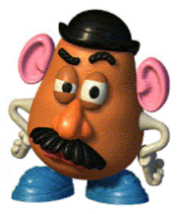
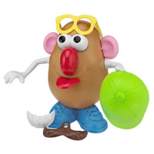
There are three kinds of taters
in the world.
Participa-Tater
Those who make
things happen.
Spec-Tater
Those who watch
things happen.
Tater
(aka Couch Potato)
Those who say,
“What happened?”

