Slide 1
Chapter 15 Managing Communication
MGMT7

Slide 2
15-1 explain the role that perception plays in communication and communication problems
15-2 describe the communication process and the various kinds of communication in organizations
15-3 explain how managers can manage one-on-one communication effectively
15-4 describe how managers can manage organization-wide communication effectively

Slide 3
Perception
The process by which individuals attend to, organize, interpret, and retain information from their environments.
15-1

Slide 4
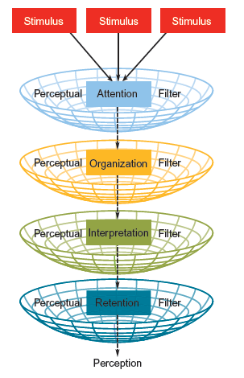
Basic Perception Process
15-1

Slide 5
Perception Problems
Selective perception
Closure
15-1

Slide 6
Perceptions of Others
Attribution theory: we all have a basic need to understand and explain the causes of other people’s behavior
internal attribution
external attribution
Defensive bias
Fundamental attribution theory
15-1

Slide 7
Self-Perception
Self-serving bias
The tendency to overestimate our value by attributing success to ourselves and failures to others or the environment
15-1

Slide 8
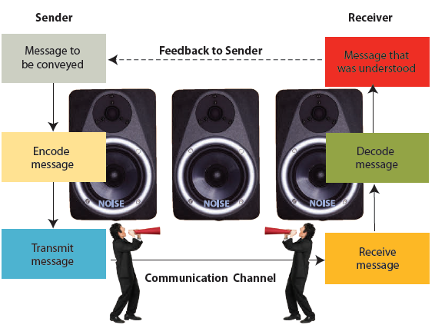
The Interpersonal Communication Process
© 2014 Cengage Learning
15-2

Slide 9
Noise
Anything that interferes with the transmission of the intended message.
The sender isn’t sure what message to communicate.
The message is not clearly encoded.
The wrong communication channel is chosen.
The message is not received or decoded properly.
The receiver doesn’t have the experience or time to understand the message.
15-2

Slide 10
Formal Communication Channel
The system of official channels that carry organizationally approved messages and information.
Downward communication
Upward communication
Horizontal communication
© 2014 Cengage Learning
15-2

Slide 11
Informal Communication Channel
The transmission of messages from employee to employee outside of formal communication channels.
15-2

Slide 12
Managing Grapevines
Worst thing to do is withhold information
Keep employees informed about possible changes and strategies
Do not overlook the grapevine as a tremendous source of information and feedback
15-2

Slide 13
Coaching
Communicating with someone for the direct purpose of improving the person’s on-the-job performance.
Mistakes managers make
Waiting for a problem before coaching
Waiting too long before talking to employee about problem
15-2

Slide 14
Counseling
Communicating with someone about non-job-related issues.
Managers should not be clinicians
Discuss specific performance problems
Listen if the employee shares personal issues
Recommend that employees call the company’s Employee Assistance Program (EAP)
15-2

Slide 15
Nonverbal Communication
Any communication that doesn’t involve words; almost always accompanies verbal communication and may either support or contradict it.
Kinesics
Paralanguage
15-2

Slide 16
Communication Medium
The method used to deliver a message.
Oral communication
Written communication
15-3

Slide 17
Active Listening
Assuming half the responsibility for successful communication by actively giving the speaker nonjudgmental feedback that shows you’ve accurately heard what he or she said.
Clarify responses
Paraphrase
Summarize
15-3

Slide 18
Empathetic Listening
Understanding the speaker’s perspective and personal frame of reference and giving feedback that conveys that understanding to the speaker.
Show desire to understand
Reflect the speaker’s emotions
15-3

Slide 19
Giving Feedback
Destructive feedback
Constructive feedback
15-3

Slide 20
Improving Transmission
Email
Online discussion forums
Televised/videotaped speeches and meetings
Voice messaging
15-4

Slide 21
Improving Reception
Company hotlines
Survey feedback
Frequent informal meetings
Surprise visits
Blogs
15-4

