Slide 1
Chapter 14 Leadership
MGMT7

Slide 2
14-1 explain what leadership is
14-2 describe who leaders are and what effective leaders do
14-3 explain Fiedler’s contingency theory
14-4 describe how path-goal theory works
14-5 explain the normative decision theory
14-6 explain how visionary leadership (i.e., charismatic or transformational leadership) helps leaders achieve strategic leadership

Slide 3
Leaders vs. Managers
Doing the right thing
“What should we be doing?”
Vision, mission, goals, objectives
Challenge the status quo
Long-term view
Expand people’s options and choices
Inspire and motivate people to find their own solutions
Concerned with ends, what gets done
Doing things right
“How can we do what we’re already doing better?”
Productivity and efficiency
Preservers of status quo
Short-term view
Limit others’ choices
Sole problems so that others can do their work
More concerned with means, how things get done
14-1

Slide 4
Leadership
Trait Theory
Initiating structure
Consideration
14-2

Slide 5
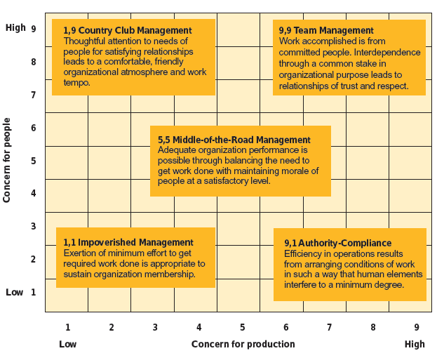
Blake/Mouton Leadership Grid
© 2014 Cengage Learning
14-2

Slide 6
Fiedler’s Contingency Theory
In order to maximize work group performance, leaders must be matched to the right leadership situation.
Leaders are effective when the work group they lead performs well.
Leaders are generally unable to change their leadership styles, and they will be more effective when their styles are matched to the proper situation.
The favorableness of a situation permits the leader to influence the behavior of group members.
14-3

Slide 7
Situational Favorableness
14-3

Slide 8
Matching Leadership Styles to Situations
© 2014 Cengage Learning
14-3

Slide 9
Leadership Styles
Directive
Supportive
Participative
Achievement-oriented
14-4

Slide 10
Contingencies
Subordinate Contingencies
Perceived ability
Experience
Locus of control
Internals vs. Externals
Environmental Contingencies
Task structure
Formal authority system
Primary work group
14-4

Slide 11
14-5

Slide 12
14-5

Slide 13
Visionary Leadership
Creates a positive image of the future that motivates organizational members and provides direction for future planning and goal setting.
14-6

Slide 14
Charismatic Leadership
The behavioral tendencies and personal characteristics of leaders that create an exceptionally strong relationship with followers.
Articulate a clear vision for the future that is based on strongly held values or morals
Model those values by acting in a way consistent with the vision
Communicate high performance expectations to followers
Display confidence in followers’ abilities to achieve the vision
14-6

Slide 15
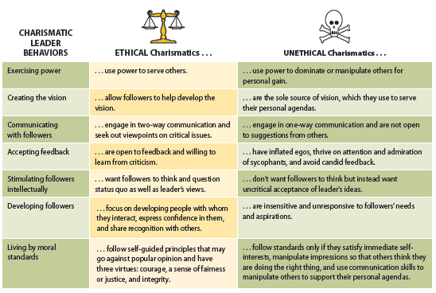
Ethical and Unethical Charismatics
© 2014 Cengage Learning
14-6

Slide 16
Components of Transformational Leadership
Charismatic leadership or idealized influence
Inspirational motivation
Intellectual stimulation
Individualized consideration
14-6

Slide 17
Transactional Leadership
Based on an exchange process in which followers are rewarded for good performance and punished for poor performance.
14-6

