Slide 1
Chapter 11 Managing Human Resource Systems
MGMT7

Slide 2
11-1 explain how different employment laws affect human resource practice
11-2 explain how companies use recruiting to find qualified job applicants
11-3 describe the selection techniques and procedures that companies use when deciding which applicants should receive job offers
11-4 describe how to determine training needs and select the appropriate training methods
11-5 discuss how to use performance appraisal to give meaningful performance feedback
11-6 describe basic compensation strategies and discuss the four kinds of employee separations

Slide 3
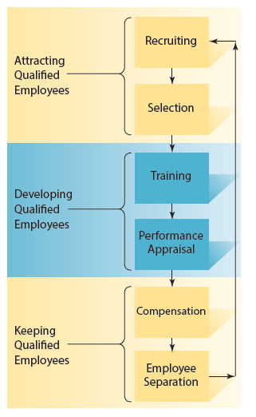
The Human Resource Management Process
© 2014 Cengage Learning

Slide 4
Major Federal Employment Laws
Equal Pay Act of 1963
Title VII of the Civil Rights Act of 1964
Age Discrimination in Employment Act of 1967
Pregnancy Discrimination Act of 1978
Americans with Disabilities Act of 1990
Civil Rights Act of 1991
Family and Medical Leave Act of 1993
Uniformed Services Employment and Reemployment Rights Act of 1994
11-1

Slide 5
What Should Managers Do?
Respond immediately
Write a clear sexual harassment policy
Establish clear reporting procedures
Be aware of local and state laws and enforcement agencies
11-1

Slide 6
Job Analysis and Recruiting
A purposeful, systematic process for collecting information on the important work-related aspects of a job.
Work activities
Tools and equipment used to do to the job
Context in which the job is performed
The personnel requirements for performing the job
11-2

Slide 7
Results of Job Analysis
Job description
a written description of the basic tasks, duties, and responsibilities required of an employee holding a particular job
Job specification
a summary of the qualifications needed to successfully perform a job
11-2

Slide 8
Recruiting
Internal Recruiting
Job posting
Career path
External Recruiting
Advertising
Employee referrals
Walk-ins
Outside organizations
Employment services
Special events
Internet job sites
11-2

Slide 9
Selection
Selection
the process of gathering information about job applicants to decide who should be offered a job
Validation
the process of determining how well a selection test or procedures predict future job performance
11-3

Slide 10
Topics to Avoid in an Interview
Children
Age
Disabilities
Physical characteristics
Name
Citizenship
Lawsuits
Arrest records
Smoking
AIDS/HIV
11-3

Slide 11
References and Background Checks
Employment references
contacting previous employers or coworkers to learn more about the candidate
Background checks
used to verify accuracy of information that applicants provide about themselves
11-3

Slide 12
Selection Tests
Specific ability tests
Cognitive ability tests
Biographical data (biodata)
Work sample tests (performance tests)
Assessment centers
in-basket exercise
leaderless group discussion
11-3

Slide 13
Interviews
Unstructured interviews
Structured interviews
Semistructured interviews
11-3

Slide 14
Training and Training Needs
Training
providing opportunities for employees to develop the job-specific skills, experience, and knowledge they need to do their jobs or improve their performance
Needs assessment
the process of identifying and prioritizing the learning needs of employees
11-4

Slide 15
Evaluating Training
Reactions
Learning
Behavior
Results
11-4

Slide 16
Accurately Measuring Job Performance
Objective performance measures
measures of performance that are easily and directly counted or quantified (output, scrap, sales, etc)
Subjective performance measures
require that someone judge or assess a worker’s performance
11-5

Slide 17
Rater Training
Frame-of-reference training
a group of trainees learns how to do performance appraisals by watching a video of an employee at work and then evaluating the person’s performance
a trainer shares his or her evaluations, and trainees’ evaluations are compared with experts’
expert explains his or her evaluation
process repeated until the differences are minimized
11-5

Slide 18
Sharing Performance Feedback
360-degree feedback
feedback comes from four sources: the boss, subordinates, peers and coworkers, and the employees themselves
11-5

Slide 19
Improving Performance Reviews
Separate developmental feedback from administrative feedback
Performance appraisal feedback sessions should be based on employee self-appraisals
What people do with the feedback matters; it helps if people discuss their performance feedback with others, and discuss it with people who provided it
11-5

Slide 20
Compensation Decisions
Pay-level decisions
Pay-variability decisions
Pay-structure decisions
11-6

Slide 21
Employment Separation
A broad term covering the loss of an employee for any reason.
Involuntary separation
Voluntary separation
11-6

Slide 22
Employee Turnover
The loss of employees who choose to leave the company.
Functional turnover
Dysfunctional turnover
11-6

