Slide 1
Chapter 10 Managing Teams
MGMT7
© 2014 Cengage Learning

Slide 2
10-1 explain the good and bad of using teams
10-2 recognize and understand the different kinds of teams
10-3 understand the general characteristics of work teams
10-4 explain how to enhance work-team effectiveness

Slide 3
The Advantages of Teams
Teams improve…
Customer satisfaction
Product and service quality
Product development speed and efficiency
Employee job satisfaction
Cross-training
Decision making
10-1

Slide 4
The Disadvantages of Teams
Initially high turnover
Social loafing
Groupthink
Minority domination
10-1

Slide 5
When to Use and When Not to Use Teams
© 2014 Cengage Learning
10-1

Slide 6
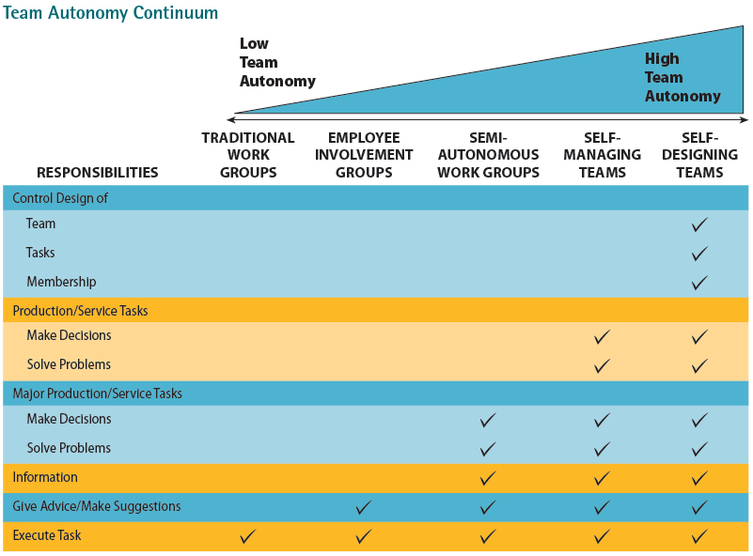
Team Autonomy Continuum
10-2

Slide 7
Special Kinds of Teams
Cross-functional teams
Virtual teams
Project teams
10-2

Slide 8
Work Team Characteristics
Team norms
Team cohesiveness
Team size
Team conflict
Stages of team development
10-3

Slide 9
Having a Good Fight
Work with more, not less, information
Develop multiple alternatives to enrich debate
Establish common goals
Inject humor into the workplace
Maintain a balance of power
Resolve issues without forcing a consensus
10-3

Slide 10
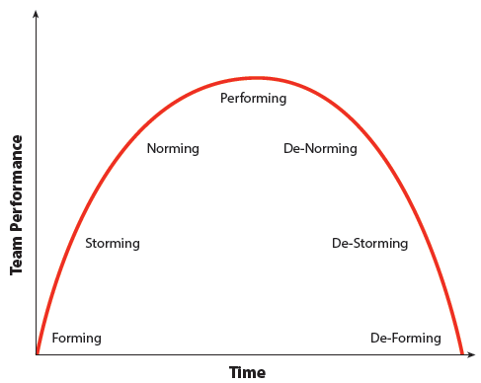
Stages of Team Development
© 2014 Cengage Learning
10-3

Slide 11
Setting Team Goals and Priorities
Increasing a team’s performance is inherently more complex than just increasing one person’s performance.
Challenging team goals affect how hard team members work.
10-4

Slide 12
Stretch Goals
Extremely ambitious goals that workers don’t know how to reach.
Teams must have a high degree of autonomy
Teams must be empowered with control over resources
Structural accommodation
Bureaucratic immunity
10-4

Slide 13
Selecting People
Individualists
put their own welfare and interests first
Collectivists
put group interests ahead of self
Team level
the average level of ability, experience, personality, or any other factor on a team
Team diversity
variances or differences in ability, personality, or any other factor on a team
10-4

Slide 14
Team Training
Interpersonal skills
Decision making skills
Problem solving skills
Conflict resolution skills
Technical training
10-4

Slide 15
Team Compensation
Skill-based pay
pay employees for learning additional skills or knowledge
Gainsharing
companies share the financial value of performance gains with their workers
Nonfinancial rewards
vacations, T-shirts, awards, certificates
10-4

