Slide 1
Chapter 9 Designing Adaptive Organizations
MGMT7

Slide 2
Structure and Process
Organizational structure
Organizational process

Slide 3
Departmentalization
Functional
Product
Customer
Geographic
Matrix
9-1

Slide 4
Chain of Command
Chain of command
Unity of command
9-2

Slide 5
Authority
Line authority
Staff authority
Line function
Staff function
9-2

Slide 6
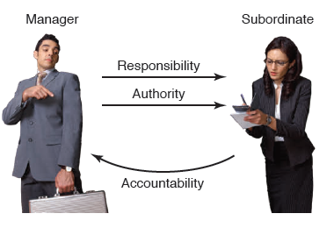
Delegation
9-2

Slide 7
Degree of Centralization
Centralization of authority
Decentralization
Standardization
9-2

Slide 8
Job Specialization
Job comprises a smaller part of a larger task
Easy to learn
Low variety
High repetition
9-3

Slide 9
Job Rotation, Enlargement, Enrichment
Rotation
Enlargement
Enrichment
9-3

Slide 10
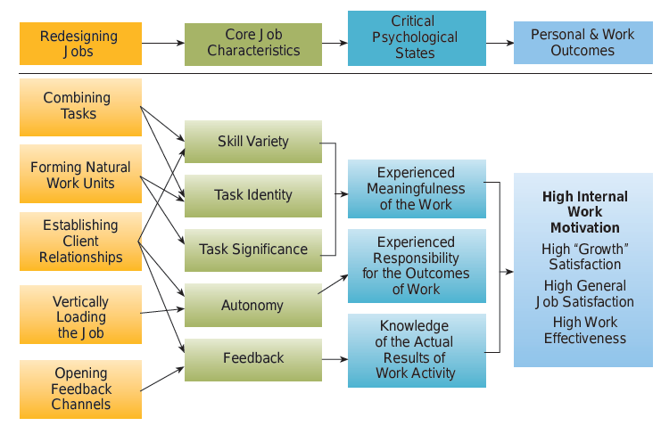
Job Characteristics Model
9-3
© 2014 Cengage Learning

Slide 11
Internal Motivation
Experience work as meaningful
Experience responsibility for work outcomes
Knowledge of results
9-3

Slide 12
Core Job Characteristics
Skill variety
Task identity
Task significance
Autonomy
Feedback
9-3

Slide 13
To Increase Internal Motivation
Combine tasks
Natural work units
Establish client relationships
Vertical loading
Open feedback channels
9-3

Slide 14
Intraorganizational Processes
The collection of activities that take place within an organization to transform inputs into outputs that customers value.
9-4

Slide 15
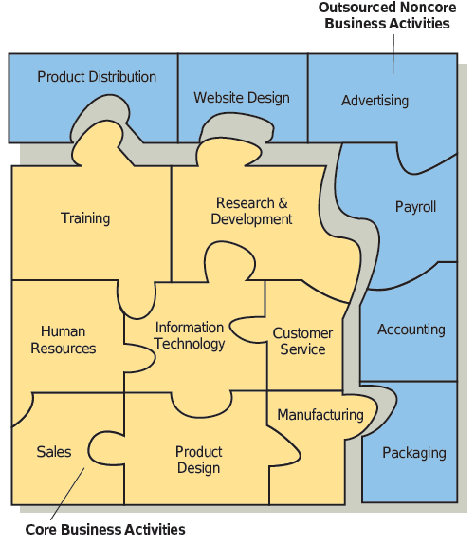
Modular Organization
9-5
© 2014 Cengage Learning

Slide 16
Empowerment
Empowering workers
Empowerment
9-4

Slide 17
Interorganizational Processes
A collection of activities that occur among companies to transform inputs into outputs that customers value.
9-5

Slide 18
Modular Organizations
Advantages
reduced costs
Disadvantages
loss of control
noncore activities that are outsourced may become source of advantage
suppliers to whom work is outsourced can become competitors
9-5

Slide 19
Virtual Organizations
Advantages
shared costs
fast and flexible
Disadvantages
difficult to control quality of work done by partners
requires tremendous managerial skills
9-5

