Slide 1
Chapter 7 Innovation and Change
MGMT7

Slide 2
7-1 explain why innovation matters to companies
7-2 discuss the different methods that managers can use to manage innovation in their organizations effectively
7-3 discuss why not changing can lead to organizational decline
7-4 discuss the different methods that managers can use to better manage change as it occurs

Slide 3
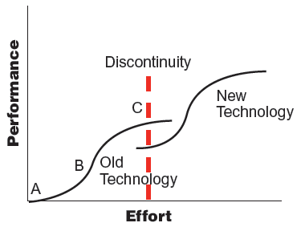
S-Curves and Technological Innovation
7-1

Slide 4
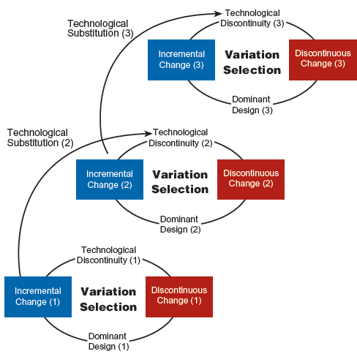
Innovation Streams: Technology Cycles over Time
7-1
© 2014 Cengage Learning

Slide 5
Managing Innovation
During discontinuous change, companies must find a way to anticipate and survive technological changes.
Companies must also manage incremental change and innovation.
7-2

Slide 6
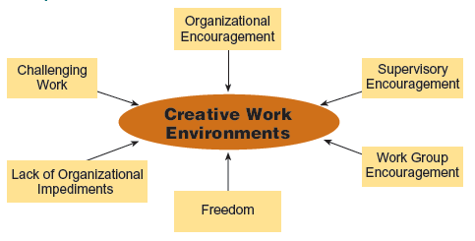
Components of Creative Work Enviroments
7-2
© 2014 Cengage Learning

Slide 7
Experiential Approach
Design iteration
Product prototype
Testing
Milestones
Multifunctional teams
7-2

Slide 8
Compression Approach
Generational change
Supplier involvement
Shorten the time of individual steps
Overlapping steps
7-2

Slide 9
The Risk of Not Changing
Organizational declines occurs when companies don’t anticipate, recognize, neutralize, or adapt to the internal and external pressures that threaten their survival.
Blinded stage
Inaction stage
Faulty action stage
Crisis stage
Dissolution stage
7-3

Slide 10
Forces
Change forces
lead to differences in the form, quality, or condition of an organization over time
Resistance forces
caused by self-interest, misunderstanding, and distrust
7-4

Slide 11
Resistance to Change
Self-interest
Misunderstanding and distrust
General intolerance for change
7-4

Slide 12
Organizational Change Process
Unfreezing
Change intervention
Refreezing
7-4

Slide 13
Managing Resistance to Change
Educate employees
Communication change-related information
Have those affected by change participate in planning and implementing
Let employees discuss and agree on who will do what after change
Coercion
7-4

Slide 14
Mistakes Managers Make
Not establishing a great enough sense of urgency
Not creating a powerful enough coalition
Lacking a vision
Undercommunicating the vision by a factor of 10
Not removing obstacles to the new vision
Not systematically planning for and creating short-term wins
Declaring victory too soon
Not anchoring changes in the corporation’s culture
7-4

Slide 15
Change Tools and Techniques
Results-driven change
supplants emphasis on activity with focus on quickly measuring and improving results
General Electric Workout
three-day meeting that generates solutions to specific business problems
7-4

Slide 16
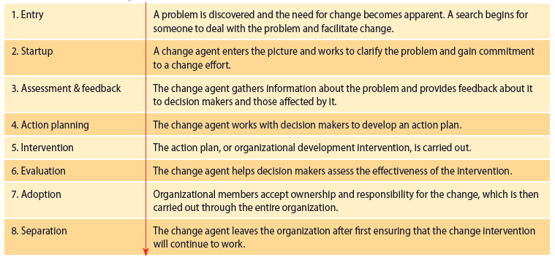
General Steps for Organizational Development Interventions
7-4
© 2014 Cengage Learning

Slide 17
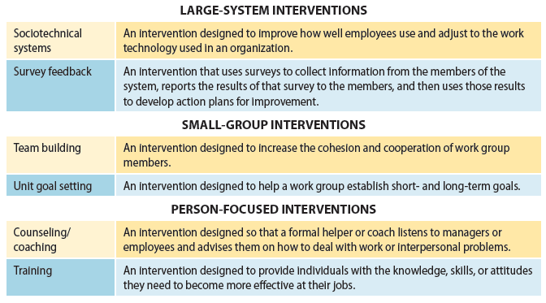
Different Kinds of Organizational Development Interventions
7-4
© 2014 Cengage Learning

