Slide 1
Chapter 6 Organizational Strategy
MGMT7

Slide 2
6-1 specify the components of sustainable competitive advantage and explain why it’s important
6-2 describe the steps involved in the strategy-making process
6-3 explain the different kinds of corporate-level strategies
6-4 describe the different kinds of industry-level strategies
6-5 explain the components and kinds of firm-level strategies

Slide 3
Competitive Advantage
Resources
assets, capabilities, processes, employee time, information, and knowledge that an organization controls.
Competitive advantage
providing greater value for customers than competitors can
Sustainable competitive advantage
when other companies cannot duplicate the value a firm is providing to customers
6-1

Slide 4
Sustainable Competitive Advantage
Resources must be…
Valuable
Rare
Imperfectly imitable
Nonsubstitutable
6-1

Slide 5
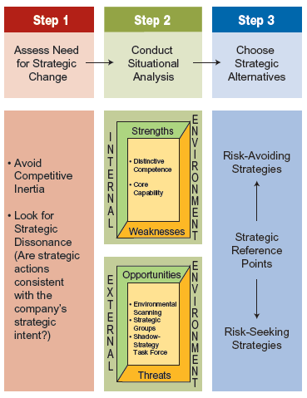
Three Steps of the Strategy-Making Process
6-2

Slide 6
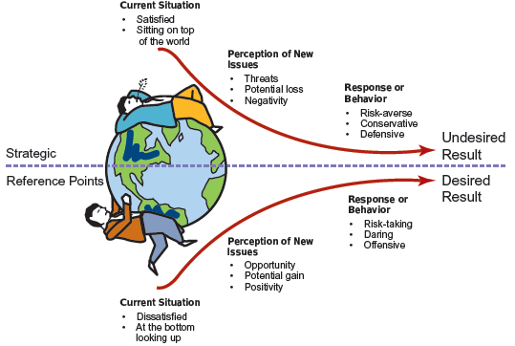
Strategic Reference Points
6-2

Slide 7
Corporate Level Strategy
“What business or businesses are we in or should we be in?”
6-3

Slide 8
Portfolio Strategy
A corporate-level strategy that minimizes risk by diversifying investment among various businesses or product lines.
Companies can grow through:
acquisitions
unrelated diversification
6-3

Slide 9
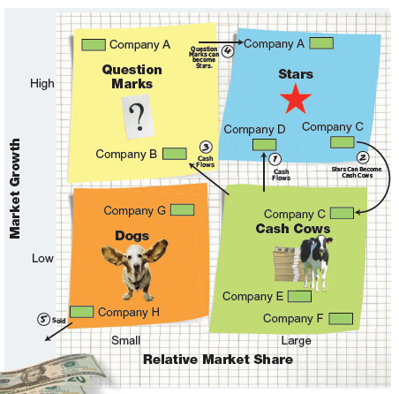
Boston Consulting Group Matrix
6-3

Slide 10
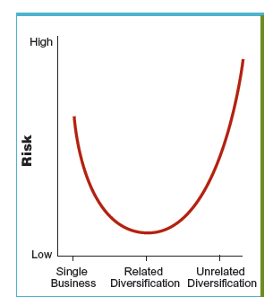
U-Shaped Relationship between Diversification and Risk
6-3

Slide 11
Grand Strategies
Broad strategic plans used to help an organization achieve its strategic goals
Growth strategy
Stability strategy
Retrenchment strategy
make significant cuts
recovery
6-3

Slide 12
Industry-Level Strategies
“How should we compete in this industry?”
6-4

Slide 13
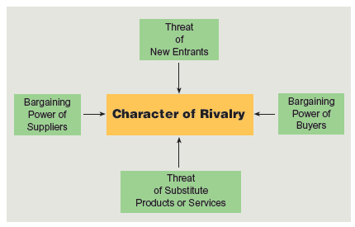
Porter’s Five Industry Forces
6-4

Slide 14
Positioning Strategies
Cost leadership
Differentiation
Focus
6-4

Slide 15
Adaptive Strategies
Defenders
Prospectors
Analyzers
Reactors
6-4

Slide 16
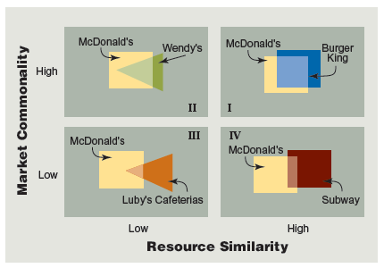
A Framework of Direct Competition
6-5

Slide 17
Strategic Moves of Direct Competition
Attack
a competitive move designed to reduce a rival’s market share or profits
Response
a countermove, prompted by a rival’s attack, designed to defend or improve a company’s market share or profit
6-5

