Slide 1
Chapter 5 Planning and Decision Making
MGMT7

Slide 2
5-1 discuss the benefits and pitfalls of planning
5-2 describe how to make a plan that works
5-3 discuss how companies can use plans at all management levels, from top to bottom
5-4 explain the steps and limits to rational decision making
5-5 explain how group decisions and group decision-making techniques can improve decision making

Slide 3
Benefits of Planning
Intensified effort
Persistence
Direction
Creation of task strategies
5-1

Slide 4
Pitfalls of Planning
Impedes change and prevents or slows adaptation
Creates a false sense of certainty
Detachment of planners
5-1

Slide 5
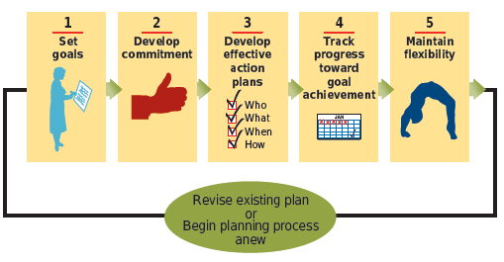
How to Make a Plan That Works
5-2

Slide 6
Setting Goals
S.M.A.R.T. Goals
Specific
Measurable
Attainable
Realistic
Timely
5-2

Slide 7
Developing Commitment to Goals
Goal commitment
the determination to achieve a goal
Set goals collectively
Make the goal public
Obtain top management’s support
5-2

Slide 8
Developing Effective Action Plans
An action plan lists…
Specific steps (how)
People (who)
Resources (what)
Time period (when)
…for accomplishing a goal
5-2

Slide 9
Tracking Progress
Proximal goals and distal goals
Performance feedback
5-2

Slide 10
Maintaining Flexibility
Options-based planning
keep options open by making, small simultaneous investments in many alternative plans.
Slack resources
a cushion of resources, like extra time or money, that can be used to address and adapt to unanticipated changes.
5-2

Slide 11
Starting at the Top
Strategic plans
make clear how the company will serve customers and position itself against competitors in the next 2 to 5 years
Purpose statement
a statement of a company’s purpose or reason for existing
Strategic objective
a more specific goal that unifies company-wide efforts, stretches and challenges the organization, and possess a finish line and a time frame.
5-3

Slide 12
Bending in the Middle
Tactical plans
specify how a company will use resources, budgets, and people to accomplish specific goals related to its strategic objective
time frame: 6 months to 2 years
Management by Objectives (MBO)
discuss possible goals
collectively set goals
jointly develop tactical plans
meet regularly to review progress
5-3

Slide 13
Finishing at the Bottom
Operational plans
Single-use plans
Standing plans
policies
procedures
rules and regulations
Budgets
5-3

Slide 14
Steps to Rational Decision Making
Define the problem
Identify decision criteria
Weight the criteria
Generate alternative courses of action
Evaluate each alternative
Compute the optimal decision
5-4

Slide 15
Limits to Rational Decision Making
In theory, fully rational decision makers maximize decision by choosing the optimal solution.
In practice, limited resources make it nearly impossible to maximize decisions.
5-4

Slide 16
Advantages of Group Decision Making
Groups do a better job than individuals at
Defining the problem
Generating alternative solutions
5-5

Slide 17
Pitfalls of Group Decision Making
Groupthink
Takes considerable time
Strong willed members
5-5

Slide 18
Structured Conflict
C-type (cognitive) conflict
focuses on problem- and issue-related differences of opinion
willingness to examine, compare, reconcile differences to produce the best possible solution
A-type (affective) conflict
emotional reaction that can occur when disagreements become personal
hostility, anger, resentment, distrust, cynicism, apathy
5-5

Slide 19
Creating C-Type Conflict
Devil’s advocacy
Nominal Group Technique
Delphi Technique
Brainstorming/Electronic brainstorming
5-5

