Slide 1
Chapter 4 Ethics and Social Responsibility
MGMT7

Slide 2
4-1 identify common kinds of workplace deviance
4-2 describe the U.S. Sentencing Commission Guidelines for Organizations and explain how they both encourage ethical behavior and punish unethical behavior by businesses
4-3 describe what influences ethical decision making
4-4 explain what practical steps managers can take to improve ethical decision making
4-5 explain to whom organizations are socially responsible
4-6 explain for what organizations are socially responsible
4-7 explain how organizations can choose to respond to societal demands for social responsibility
4-8 explain whether social responsibility hurts or helps an organization’s economic performance

Slide 3
Workplace Deviance
Ethical behavior
conforms to a society’s accepted principles of right and wrong.
Workplace deviance
unethical behavior that violates organizational norms about right and wrong.
4-1

Slide 4
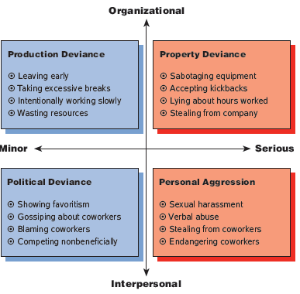
Types of Workplace Deviance
4-1

Slide 5
Who, What, and Why
Who
nearly all companies: nonprofits, partnerships, labor unions, unincorporated organizations, incorporated organizations, pension funds, trusts, joint stock companies
What
offenses defined by federal laws: invasion of privacy, price fixing, fraud, theft, embezzlement, etc.
Why
The purpose of the guidelines is not just to punish companies after violations, but to encourage companies to prevent violations before they happen.
4-2

Slide 6
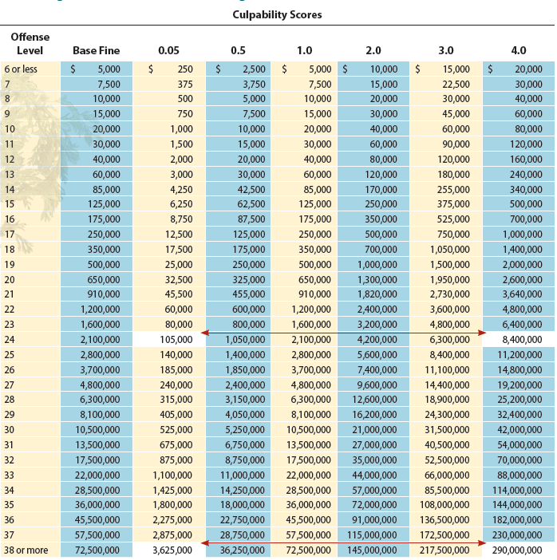
Offense Levels, Base Fines, Culpability Scores, and Possible Total Fines under the US Sentencing Commission Guidelines for Organizations
4-2

Slide 7
Influences on Ethical Decision Making
Ethical intensity
Moral development
Ethical principles
4-3

Slide 8
Principles of Ethical Decision Making
Principle of long-term self interest
Principle of personal virtue
Principle of religious injunctions
Principle of government requirements
Principle of utilitarian benefits
Principle of individual rights
Principle of distributive justice
4-3

Slide 9
Selecting and Hiring Ethical Employees
Overt integrity tests
Personality-based integrity tests
4-4

Slide 10
Codes of Ethics
A company must communicate its code inside and outside the company.
Management must develop practical ethical standards and procedures specific to the company’s line of business.
4-4

Slide 11
Objectives of Ethics Training
Develop employees’ awareness of ethics
Achieve credibility with employees
Teach employees a practical model of ethical decision making
4-4

Slide 12
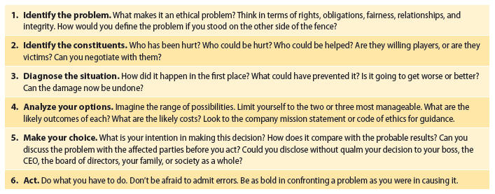
A Basic Model of Ethical Decision Making
4-4
© 2014 Cengage Learning

Slide 13
Ethical Climate
Organizational culture is key to fostering ethical decision making.
Management needs to be active in and committed to the ethics program.
Encourage managers and employees to report ethical violations (whistleblowing)
4-4

Slide 14
To Whom Are Organizations Socially Responsible?
Shareholder model
the only social responsibility that businesses have is to maximize profits
Stakeholder model
management’s most important responsibility is not just maximizing profits, but the firm’s long term-survival.
4-5

Slide 15
Stakeholder Model of Corporate Social Responsibility
People or groups who are interested in and affected by the organization’s actions.
Primary stakeholders
Secondary stakeholders
4-5

Slide 16
For What Are Organizations Socially Responsible?
Economic responsibility
Legal responsibility
Ethical responsibility
Discretionary responsibility
4-6

Slide 17
Social Responsiveness Strategies
Reactive
Defensive
Accommodative
Proactive
4-7
© 2014 Cengage Learning
Notes:
17

Slide 18
Social Responsibility and Economic Performance
There is no tradeoff between being socially responsible and economic performance.
It usually does pay to be socially responsible.
There is no guarantee that socially responsible companies will be profitable.
4-8

