Slide 1
Chapter 3 Organizational Environments and Culture
MGMT7

Slide 2
3-1 discuss how changing environments affect organizations
3-2 describe the four components of the general environment
3-3 explain the five components of the specific environment
3-4 describe the process that companies use to make sense of their changing environments
3-5 explain how organizational cultures are created and how they can help companies be successful

Slide 3
Environmental Change
The rate at which a company’s general and specific environments change.
Stable
slow rate of change
Dynamic
fast rate of change
3-1

Slide 4
Punctuated Equilibrium Theory
Stability
Dynamic Change
Dynamic Change
Dynamic Change
Stability
3-1

Slide 5
Environmental Complexity
Simple
Complex
Resource scarcity
Uncertainty
3-1

Slide 6
Environments
General environment
the economy, technological, sociocultural, and
political/legal trends that indirectly affect all companies
Specific environment
unique to a firm’s industry
directly affects the way its conducts daily business
3-2

Slide 7
General Environment
Economy
Technology
Sociocultural component
Political/legal component
3-2

Slide 8
Specific Environment
Customers
Competitors
Suppliers
Industry regulations
Advocacy groups
3-3

Slide 9
Federal Regulatory Agencies and Commissions
Consumer Product Safety Commission
Department of Labor
Environmental Protection Agency
Equal Employment Opportunity Commission
Federal Communications Commission
Federal Reserve System
Federal Trade Commission
Food and Drug Administration
National Labor Relations Board
Occupational Safety and Health Administration
Securities and Exchange Commission
3-3
© 2014 Cengage Learning

Slide 10
Environmental Scanning
Searching the environment for important events or issues that might affect an organization
Managers scan the environment to reduce uncertainty.
Organizational strategies affect environmental scanning.
Environmental scanning contributes to organizational performance
3-4

Slide 11
Interpreting Environmental Factors
Threat or opportunity?
Threat
managers typically take steps to protect the company from further harm
Opportunity
managers consider strategic alternatives for taking advantage of those events to improve performance
3-4

Slide 12
Creation and Maintenance of Organizational Cultures
Primary source of organizational culture is the company founder.
Organizational culture is sustained by…
organizational stories
organizational heroes
3-5

Slide 13
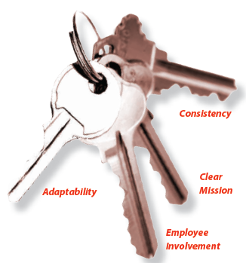
Keys to an Organizational Culture
3-5
© 2014 Cengage Learning

Slide 14
Three Levels of Organizational Culture
3-5
© 2014 Cengage Learning

Slide 15
Changing Organizational Cultures
Behavioral addition
Behavioral substitution
Change visible artifacts
Hiring people with values and beliefs consistent with desired culture
3-5

