Slide 1
Chapter 2 History of Management
MGMT7

Slide 2
2-1 explain the origins of management
2-2 explain the history of scientific management
2-3 discuss the history of bureaucratic and administrative management
2-4 explain the history of human relations management
2-5 discuss the history of operations, information, systems, and contingency management

Slide 3
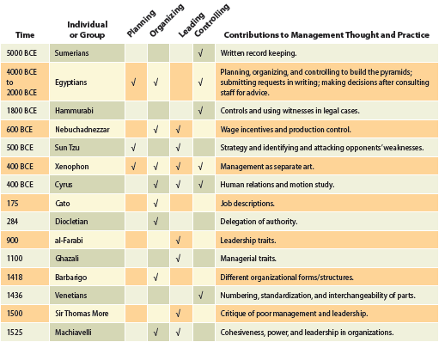
Management Ideas and Practices throughout History
2-1

Slide 4
Why We Need Managers Today
During the Industrial Revolution…
Availability of power enabled low-paid, unskilled labor to replace high-paid skilled artisans
Job carried out in large, formal organizations rather than fields, homes, or small shops
2-1

Slide 5
Scientific Management
The thorough study and testing of different work methods to identify the best, most efficient ways to complete a job.
2-2

Slide 6
Taylor’s Four Principles of Scientific Management
2-2
© 2014 Cengage Learning

Slide 7
Frank and Lillian Gilbreth
Motion study
breaking each task or job into separate motions and then eliminating those that are unnecessary or repetitive
Typically yielded production increases of 25 to 300 percent.
2-2

Slide 8
Henry Gantt
Gantt Chart
visually indicates what tasks must be completed at which times in order to complete a project
One of the first to recommend that companies train and develop workers
“A scientific investigation in detail of each piece of work, and the determination of the best method and the shortest time in which the work can be done. “
“A teacher capable of teaching the best method and the shortest time.”
“Reward for both teacher and pupil when the latter is successful.”
2-2

Slide 9
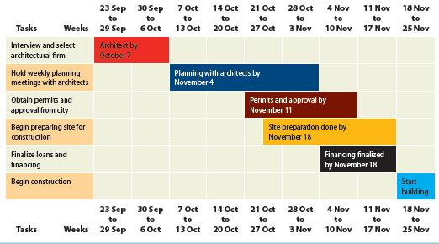
Gantt Chart
2-2
© 2014 Cengage Learning

Slide 10
Fayol’s Fourteen Principles of Management
Division of work
Authority and responsibility
Discipline
Unity of command
Unity of direction
Subordination of individual interests to the general interest
Remuneration
Centralization
Scalar chain
Order
Equity
Stability of tenure of personnel
Initiative
Esprit de corps
2-3

Slide 11
Constructive Conflict: Mary Parker Follett
Conflict – “the appearance of difference, difference of opinions, of interests”
Integrative conflict resolution
have both parties indicate their preferences and then work together to find an alternative that meets the needs of both
2-4

Slide 12
Hawthorne Studies: Elton Mayo
Human factors related to work were found to be more important than physical conditions or design of work.
Workers not just extensions of machines, and financial incentives weren’t necessarily the most important for motivating workers.
Managers better understood effect of group social interactions, employee satisfaction, and attitudes on individual and group performance.
2-4

Slide 13
Zone of Indifference
People will be indifferent to managerial directives if they…
are understood
are consistent with organization’s purpose
are compatible with people’s personal interests
can actually be carried out by those people
2-4

Slide 14
Operations Management
Eli Whitney
standardized, interchangeable parts
Garspard Monge
techniques for drawing 3-D objects on paper
Oldsmobile Motor Works
“hand-to-mouth inventory”
2-5

Slide 15
Information Management
Throughout history, organizations have pushed for and quickly adopted new information technologies to reduce the cost or increase the speed with which they can acquire, retrieve, or communicate information.
2-5

Slide 16
Systems Management
System
a set of interrelated elements or parts that function as a whole
Subsystems
smaller systems within a larger system
Synergy
occurs when two or more subsystems working together can produce more than they can working apart
2-5

Slide 17
Systems
Closed systems
can function without interacting with their environments
Open Systems
interact with their environments and depend on them for survival
2-5

Slide 18
Contingency Management
There are no universal management theories; the most effective management theory or idea depends on the kinds of problems or situations that managers or organizations are facing at a particular time.
2-5

