Slide 1
Chapter 1 Management
MGMT7

Slide 2
1-1 describe what management is
1-2 explain the four functions of management
1-3 describe different kinds of managers
1-4 explain the major roles and subroles that managers perform in their jobs
1-5 explain what companies look for in managers
1-6 discuss the top mistakes that managers make in their jobs
1-7 describe the transition that employees go through when they are promoted to management
1-8 explain how and why companies can create competitive advantage through people
Notes:
Management issues are fundamental to any organization. How do we plan to get things done? How do we organize the company so that it is at its most effective and efficient? How do we put controls in place to make sure our plans are followed and our goals are met? These, and other similar questions, are what managers must address on a daily basis to keep their companies not just functioning, but growing and progressing towards their goals.
In this chapter, we discuss the basics of management. First we define what management is by looking at the concepts of effectiveness and efficiency. Next, we will discuss the various functions that management has within a company, followed by a discussion of the different kinds of managers and the roles that they play within the operation of a business. In the next three sections, we will examine what makes for a successful manager by looking at the types of skills that companies look for in managers, and the kinds of mistakes that managers make (and should avoid) when they start out in management. This is followed by a look at the transition that employees face when they are promoted to management. Finally, the chapter closes with a discussion of the benefits that companies can expect when they make a significant investment into their employees.

Slide 3
Management Is…
Getting work done through others
Efficiency – getting work done with a minimum of effort, waste, or expense
Effectiveness – accomplishing tasks that help fulfill organizational objectives
1-1
Notes:
The basic definition of management, as presented in the text, is getting work done through others. In practice, this means that managers are not responsible for, say, knowing how to operate all of the machines on an assembly line. Instead, managers are responsible for enabling and equipping people in the company to do their jobs as best as possible.
As they seek to help employees do their best, managers are driven by two primary concerns, efficiency and effectiveness. Efficiency is getting work done with a minimum of effort, expense, or waste. Effectiveness, meanwhile, is accomplishing tasks that help fulfill organizational objectives. It is important that managers are concerned with both efficiency and effectiveness, not just one or the other. A company that is highly efficient in delivering goods to a customer, but not particularly effective at making them (that is, low quality), will not find much success. Similarly, a company that makes the best sprockets in town, but takes ten times as long as its competitors, is bound to struggle.

Slide 4
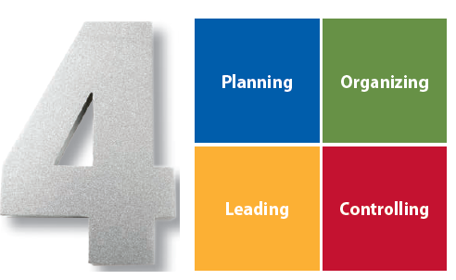
The Four Functions of Management
1-1
© 2015 Cengage Learning
Notes:
As shown in Exhibit 1.1, there are four basic functions of management: planning, operating, leading, and controlling. Studies indicate that managers who perform these management functions well are more successful, gaining promotions for themselves and profits for their companies.

Slide 5
Management Functions
Planning
determining organizational goals and a means for achieving them
Organizing
deciding where decisions will be made, who will do what jobs and tasks, and who will work for whom in the company
1-2
Notes:
The planning function of management involves determining organizational goals and a means for achieving them. In basic terms, planning is primarily concerned with the question “What business are we in?”
The organizing function of management involves deciding where decisions will be made, who will do what jobs and tasks, and who will work for whom in the company.

Slide 6
Management Functions
Leading
inspiring and motivating workers to work hard to achieve organizational goals
Controlling
monitoring progress toward goal achievement and taking corrective action when progress isn’t being made
1-2
Notes:
The leading function of management involves inspiring and motivating workers to work hard to achieve organizational goals. Leading, however, is not just about telling people what to do or bossing them around. Instead, leading is about energizing people so that they want to give their best efforts at work.
The controlling function of management involves monitoring progress toward goal achievement and taking corrective action when progress isn’t being made. This means that managers must set standards to achieve goals, compare actual performance to those standards, and then make changes if/when performance does not meat those standards.

Slide 7
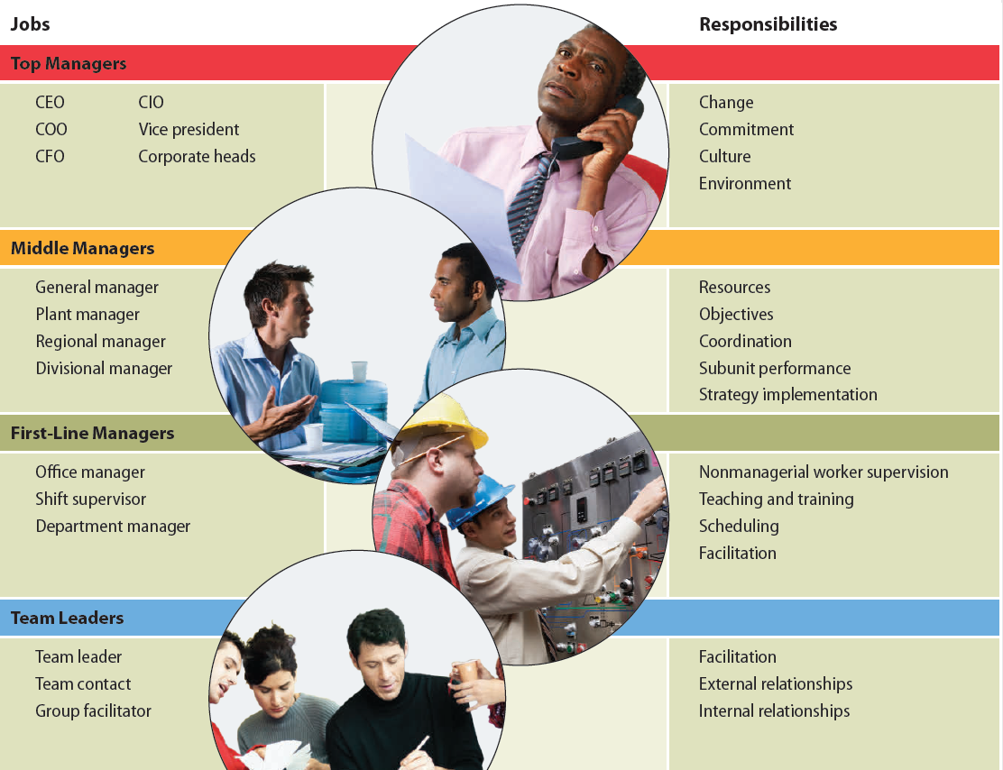
What the Four Kinds of Managers Do
1-3
© 2015 Cengage Learning
Notes:
As shown in Exhibit 1.2, there are four different kinds of managers in companies, each with different responsibilities: top managers, middle managers, first-line managers, and team leaders.

Slide 8
Top Managers
CEO, COO, CFO, CIO
Overall direction of the organization
Create context for change
Develop employees’ commitment to and ownership of company performance
Create a positive organizational culture through language and action
Monitor the business environment
1-3
Notes:
The CEO, COO, CFO, and CIO of a company are all top managers. The responsibilities for a top manager include the overall direction of the organization, setting a context for change, creating employee buy-in, creating a positive organizational culture, and monitoring the business environment.

Slide 9
Middle Managers
Plant manager, regional manager, divisional manager
Set objectives consistent with top management’s goals
Implement subunit strategies for achieving objectives
Plan and allocate resources to meet objectives
Coordinate and link groups, departments, and divisions
Monitor and manage subunits and individual managers
1-3
Notes:
Examples of middle managers in a company include plant manager, regional manager, or divisional manger. They are responsible for setting objectives consistent with top management’s goals and for planning and implementing subunit strategies for achieving those objectives. One specific middle management responsibility is to plan and allocate resources to meet objectives. Middle managers are also responsible for coordinating various groups with the company, and monitoring the performance of subunits.

Slide 10
First-Line Managers
Office manager, shift supervisor, department manager
Train and supervise the performance of nonmanagerial employees
Encourage, monitor, and reward employees’ performance
Make detailed schedules and operating plans
1-3
Notes:
First line managers, which include office managers, shift supervisors, and department managers, are responsible for managing the performance of entry-level employees. Rather than supervising other managers, first line managers oversee the work of employees that are directly responsible for the company’s goods or services. Thus, first line managers are responsible for encouraging and monitoring the performance of employees, teaching new employees how to do their jobs, and making schedules and operating plans.

Slide 11
Team Leaders
Facilitate team activities toward accomplishing a goal
Help team members plan and schedule work, learn to solve problems, and work effectively with each other
Manage internal and external relationships
1-3
Notes:
The team leader is a relatively new kind of management position that developed because of the widespread use of self-managing teams, which have no formal supervisor. Therefore, team leaders do not function like first line managers, who have responsibility for monitoring the performance of employees. Instead, team leaders are primarily responsible for facilitating team activities towards accomplishing a goal. Team leaders help their team members plan and schedule work, learn to solve problems, and work effectively with each other. Team leaders also help manage the relationship among team members, and relationships with groups outside of the team. It is important to note, however, that team leaders are not ultimately responsible for the team’s performance – the team is.

Slide 12
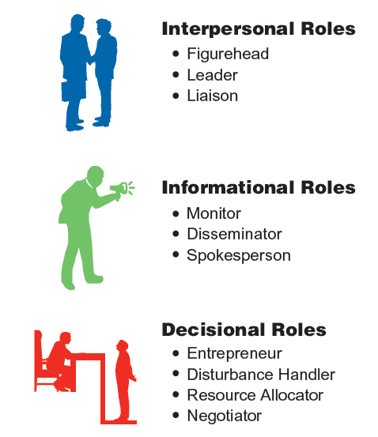
Mintzberg’s Managerial Roles
1-4
© 2015 Cengage Learning
Notes:
As shown in Exhibit 1.3, Henry Mintzberg developed the idea that managers fulfill three major roles – interpersonal, informational, and decisional roles.

Slide 13
Interpersonal Roles
Figurehead
managers perform ceremonial duties
Leader
managers motivate and encourage workers to accomplish organizational objectives
Liaison
managers deal with people outside their units
1-4
Notes:
More than anything else, management jobs are people-intensive, and the interpersonal role of a manager involves dealing with and relating to other people. In fulfilling the interpersonal role of management, managers perform three subroles: figurehead, leader, and liaison.
In the figurehead role, managers perform ceremonial duties like greeting company visitors, speaking at the opening of a new facility, or representing the company at a community luncheon to support local charities.
In the leader role, managers motivate and encourage workers to accomplish organizational objectives.
In the liaison role, managers deal with people outside their units.

Slide 14
Informational Roles
Monitor
managers scan their environment for information and receive unsolicited information
Disseminator
managers share information with subordinates and others in the company
Spokesperson
managers share information with people outside of the company
1-4
Notes:
According to Mintzberg’s research, managers spent 40 percent of their time giving and getting information. In this regard, management can be viewed as gathering information by scanning the business environment and listening to others in face-to-face conversations, processing that information, and then sharing it with people both inside and outside the company. Mintzberg described three informational subroles: monitor, disseminator, and spokesperson.
In the monitor role, managers scan their environment for information, actively contact others for information, and, because of their personal contacts, receive a great deal of unsolicited information.
In the disseminator role, managers share the information they have collected with their subordinates and others in the company.
In contrast to the disseminator role, in which managers distribute information to employees inside the company, managers in the spokesperson role share information with people outside their departments and companies.

Slide 15
Decisional Roles
Entrepreneur
managers adapt themselves, their subordinates, and their units to change
Disturbance handler
managers respond to problems so severe that they demand immediate action
1-4
Notes:
Mintzberg found that obtaining and sharing information is not an end in itself. Obtaining and sharing information with people inside and outside the company is useful to managers because it helps them make good decisions. According to Mintzberg, managers engage in four decisional subroles: entrepreneur, disturbance handler, resource allocator, and negotiator.
In the entrepreneur role, managers adapt themselves, their subordinates, and their units to change.
In the disturbance handler role, managers respond to pressures and problems so severe that they demand immediate attention and action.

Slide 16
Decisional Roles
Resource allocator
managers decide who will get what resources and in what amounts
Negotiator
managers negotiate schedules, projects, goals, outcomes, resources, and employee raises
1-4
Notes:
In the resource allocator role, managers decide who will get what resources and how many resources they will get.
In the negotiator role, managers negotiate schedules, projects, goals, outcomes, resources, and employee raises.

Slide 17
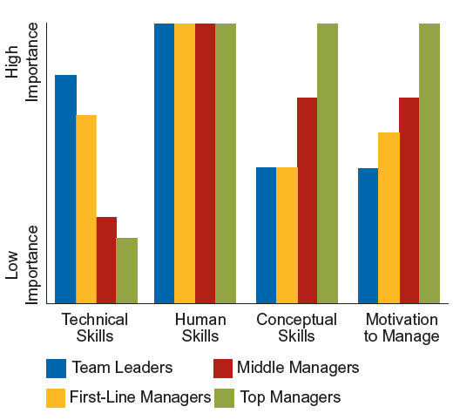
Management Skills
1-5
© 2015 Cengage Learning
Notes:
What kinds of skills do good managers have? Should they be fiery leaders? Surpassing intellectuals? People pleasers? When companies look for employees who would be good managers, they look for individuals who have technical skills, human skills, conceptual skills, and the motivation to manage. Exhibit 1.4 shows the relative importance of these four skills to the jobs of team leaders, first-line managers, middle managers, and top managers.
As shown in the exhibit technical skills are very important for team leaders and first line managers, but less important for middle and top managers. Conversely, conceptual skills are most important for top and middle managers, but not as much for first line managers and team leaders. The motivation to manage is relatively important for all managers, but perhaps most for top managers. For all types of managers, however, human skills are quite important.

Slide 18
What Companies Look For
Technical skills
specialized procedures, techniques, and knowledge required to get the job done
Human skills
ability to work well with others
1-5
Notes:
Technical skills are the specialized procedures, techniques, and knowledge required to get the job done.
Human skills can be summarized as the ability to work well with others. Managers with human skills work effectively within groups, encourage others to express their thoughts and feelings, are sensitive to others’ needs and viewpoints, and are good listeners and communicators. Human skills are equally important at all levels of management, from first-line supervisors to CEOs.

Slide 19
What Companies Look For
Conceptual skills
ability to see the organization as a whole
Motivation to manage
1-5
Notes:
Conceptual skills are the ability to see the organization as a whole, to understand how the different parts of the company affect each other, and to recognize how the company fits into or is affected by its external environment such as the local community, social and economic forces, customers, and the competition. Good managers have to be able to recognize, understand, and reconcile multiple complex problems and perspectives. In other words, managers have to be smart!
Motivation to manage is an assessment of how motivated employees are to interact with superiors, participate in competitive situations, behave assertively toward others, tell others what to do, reward good behavior and punish poor behavior, perform actions that are highly visible to others, and handle and organize administrative tasks. Managers typically have a stronger motivation to manage than their subordinates, and managers at higher levels usually have a stronger motivation to manage than managers at lower levels. Furthermore, managers with a stronger motivation to manage are promoted faster, are rated as better managers by their employees, and earn more money than managers with a weak motivation to manage.

Slide 20
Mistakes Managers Make
Insensitive to others: abrasive, intimidating, bullying style
Cold, aloof, arrogant
Betray trust
Overly ambitious: thinking of next job, playing politics
Specific performance problems with the business
Overmanaging: unable to delegate or build a team
Unable to staff effectively
Unable to think strategically
Unable to adapt to boss with different style
Overdependent on advocate or mentor
1-6
Notes:
Another way to understand what it takes to be a manager is to look at the mistakes managers make.

Slide 21
Stages in the Transition to Management
1-7
© 2015 Cengage Learning
Notes:
In her book Becoming a Manager: Mastery of a New Identity, Harvard Business School professor Linda Hill followed the development of nineteen people in their first year as managers. Her study found that becoming a manager produced a profound psychological transition that changed the way these managers viewed themselves and others. Initially, the managers in Hill’s study believed that their job was to exercise formal authority and to manage tasks—basically being the boss, telling others what to do, making decisions, and getting things done. After six months, most of the new managers had concluded that their initial expectations about managerial work were wrong. Management wasn’t just about being the boss, making decisions, and telling others what to do. After a year on the job, most of the managers thought of themselves as managers and no longer as doers. In making the transition, they finally realized that people management was the most important part of their job.

Slide 22
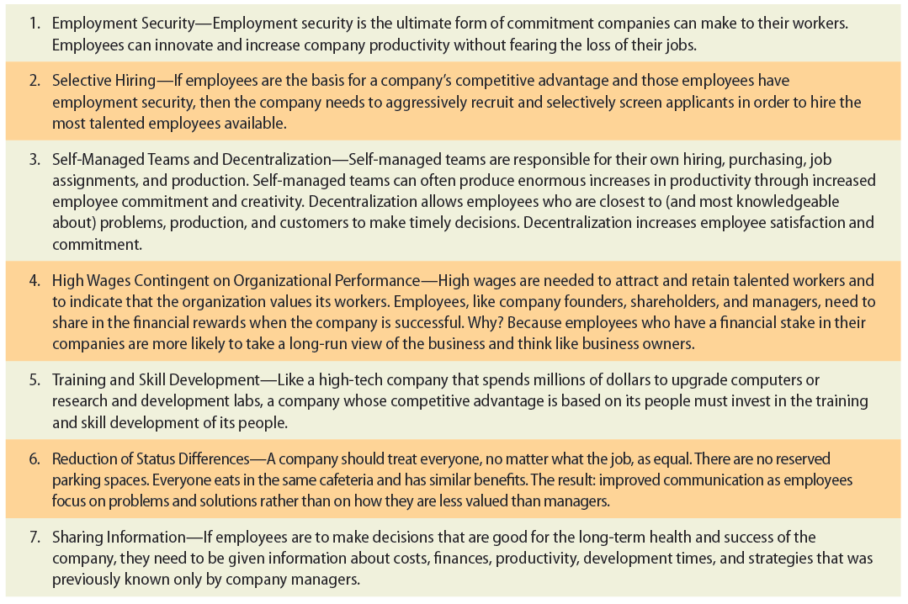
Competitive Advantage through People
1-8
© 2015 Cengage Learning
Notes:
What separates the top performing companies from those that struggle? Do the successful companies have some secret formula or process that the others don’t? Are they just lucky? According to Stanford University professor Jeffrey Pfeffer, the difference between a successful and failing company is the way they treat their people. Pfeffer found that managers in top-performing companies used ideas like employment security, selective hiring, self-managed teams and decentralization, high pay contingent on company performance, extensive training, reduced status distinctions (between managers and employees), and extensive sharing of financial information to achieve financial performance that, on average, was 40 percent higher than that of other companies.
By investing in people in these ways, these companies develop work forces that are smarter, better trained, more motivated, and more committed. These employees, in turn, provide better customer service and better performance that gives their companies a distinct advantage over their competitors.

Slide 23
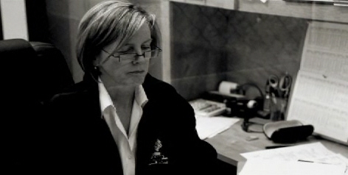
Camp Bow Wow
Identify three skills that companies look for in managers and explain which might be most needed for the Camp Bow Wow leaders highlighted in the video.
Which activities at Camp Bow Wow require high efficiency? Which activities require high effectiveness?
3. List two activities that leaders at Camp Bow Wow perform daily, and identify which of the managerial roles discussed in the chapter figure prominently for each.
Notes:
Sue Ryan, a Camp Bow Wow franchisee from Colorado, knows the ins and outs of managing a care center for pets. To help launch her business a few years ago, Ryan recruited experienced pet care worker Candace Stathis, who came on as a camp counselor. Ryan soon recognized that Stathis was a star performer with a natural ability to work with clients and pets alike, and today Stathis serves as the camp’s general manager. At Camp Bow Wow, store managers have distinct roles from camp counselors. Whereas counselors typically take care of dogs, answer phones, and book reservations, managers must know how to run all operations and mange people as well. To keep camp running as efficiently as possible, Stathis maintains a strict daily schedule for doggie baths, nail trimmings, feedings, and play time.

