Slide 1
Marketing 1 Review
Copper Hills High School
Prepared by: Rob Willardson 12/05/15

Slide 2
STANDARD 1 – World of Marketing: Students will be introduced to the world of marketing.
Objective 1: Understand that marketing is all around us a. Define the term “marketing” b. Identify the functions of marketing
Objective 2: Understand the concept of private enterprise a. Explain the importance of marketing in a global economy b. Identify types of economic systems (tradition, command, market, mixed) c. Understand the four pillars of the free enterprise system (Private Property, Price System, Competition, Entrepreneurship) d. Understand the role of entrepreneurs, businesses, government, and consumers in the free enterprise system
Objective 3: Understand the marketing mix or 4P’s of marketing a. Identify the four elements of the marketing mix (4P’s of marketing -Product, Price, Place, Promotion) b. Discover how each element is strategically used to make marketing decisions
Objective 4: Students will understand how DECA integrates into the marketing classroom

Slide 3
Marketing
The process of communicating the value (features and benefits) of a product (a good or service) for the purpose of selling that product to customers at a profit.

Slide 4
Benefits of Marketing
New & Improved Products
Lower Pricing

Slide 5
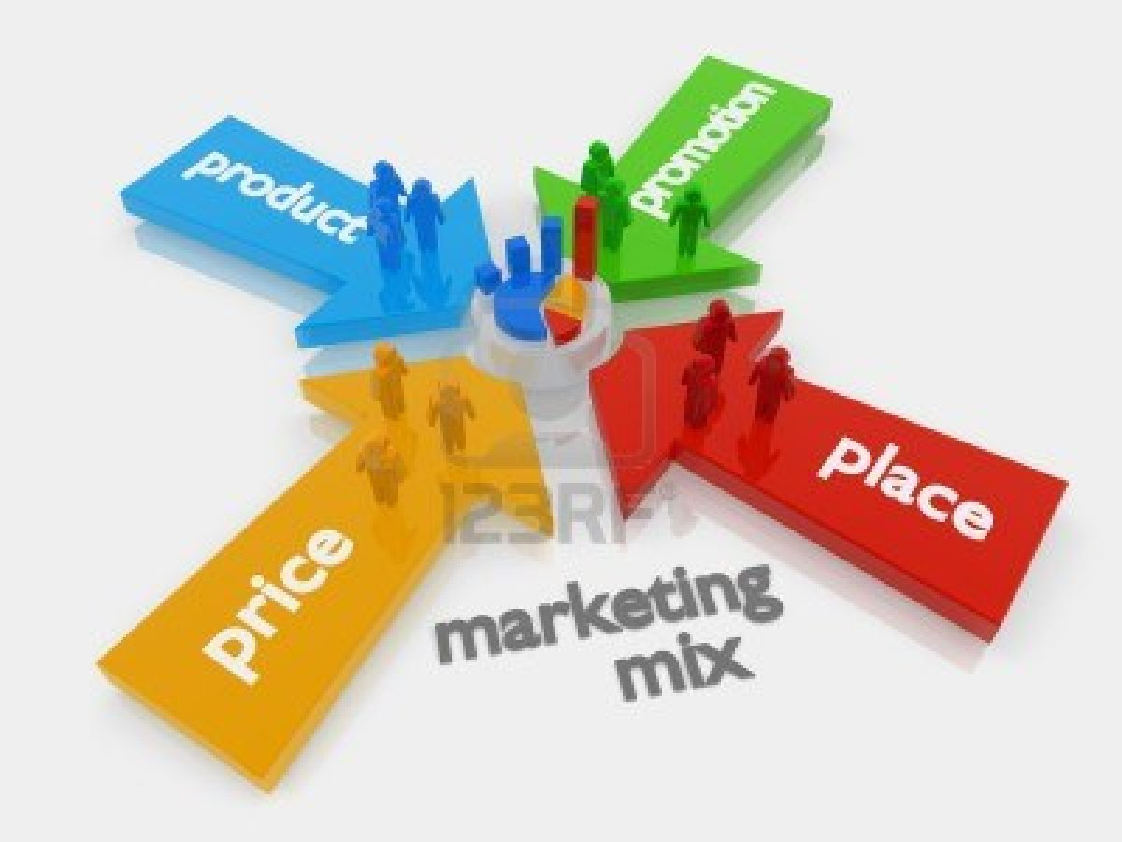
Marketing Mix (The 4 P’s of Marketing)
Product
Price
Place
Promotion

Slide 6
Utility = Added Value
Form Utility
Place Utility
Time Utility
Possession Utility
Information Utility

Slide 7
Market Segmentation (Target Market)
Market segmentation is a way of analyzing a market by specific characteristics in order to create a target market:
1. Demographics – Age, Gender, Income Level, Ethnic background, Education
2. Geographics – Regional, National, Global
3. Phychographics – Lifestyles, Personalities, Trends
4. Product Benefits – Consumers’ Needs & Wants

Slide 8
4 Types of Economies
Traditional – Hunters & Gathers ($0 Median Income)
Free Enterprise or Market – Capitalism ($44,000 Median Income)
Command – Communism & Dictatorships ($8,000 Median Income)
Mixed – Socialism ($22,000 Median Income)

Slide 9
4 Factors of Production
Land – Above, within, & below
Labor – Human effort
Capital – Money, buildings, & equipment
Entrepreneurship – Risk taking, & initiative

Slide 10
Scarcity
We have scarcity, because we have unlimited needs and wants, but limited resources.

Slide 11
Channel Management
The process of getting a product from manufacturer to the end-user (customer) / A - Z.
Intermediaries:
Manufacturer (Adds value to raw materials)
Broker / Sales Agent
Wholesaler
Distributor
Internet Provider
Retailer

Slide 12
Distribution Process:
Exclusive Distribution - takes place when a supplier grants a distributor exclusivity of the sale of the contract goods or services within a territory
Selective Distribution - the producer relies on a few intermediaries to carry their product.
Intensive Distribution - the producer's products are stocked in the majority of outlets.

Slide 13
7 Functions of Marketing
Pricing - Setting and communicating the value of products and services. Setting the price at the right level.
Product/Service Management - Designing, developing, maintaining, improving, and acquiring products and services that meet consumer needs.
Distribution - Determining the best ways for customers to locate, obtain, and use the products and services of an organization. Involves moving the product each step from the deign idea to the consumer.
Financing - Budgeting for marketing activities, obtaining the necessary funds needed for operations, and providing financial assistance to customers so they can purchase the business products and service.
Marketing-Information Management - Obtaining, managing, and using information about what customers want to improve business decision making, performance of marketing activities, and determining what will sell.
Selling - Communicating directly with potential customers to determine and satisfy their needs.
Promotion - Communicating with customers about the product to achieve the desired result--customer demand for and purchase of the product. Includes advertising, personal selling, publicity, and public relations.

Slide 14
Marketing in a Global Economy
Marketing is becoming more important as organizations around the world strive to develop products and services that appeal to their customers and aim to differentiate their offering in the increasingly-crowded global marketplace.

Slide 15
Global Economy
Imports
Exports
Balance of Trade
Limits on Imports
Tariffs (Taxes)
Quotas (Limit)
Embargos (Blockade)

Slide 16
We All Play Two Roles
The Circular Flow
Producers (Entrepreneurs)
Consumers
Government Regulation

Slide 17
Government Regulation
Sherman Antitrust Act – 1890 - Antitrust
Clayton Act – 1914 - Antitrust
Robinson Patman Act – 1936 – Price Discrimination
Wheeler Lea Act – 1936 – Truth in Advertising
Sarbanes Oxley Act – 2002 – Truth in Financial
Reporting

Slide 18
Government Agencies
OSHA – Occupational Safety & Health Administration
EEOC – Equal Employment Opportunities Commission
FDA – Food & Drug Administration
SEC – Securities & Exchange Commission
USDA – United States Department of Agriculture
FCC – Federal Communications Commission

Slide 19
4 Pillars of Free Enterprise
Private Property (Rule of Law)
Price System (Communication System)
Competition (Open & Free)
Entrepreneurship (Initiative & Risk)

Slide 20
3 Economic Theories
Adam Smith – “The Wealth of Nations” – The Invisible Hand – Self Interest (Free Market)
John Maynard Keynes – Keynesian Economics – Economic Stabilization through Government Intervention (Socialism)
Karl Marx & Frederick Engels – “The Communist Manifesto” & “Das Kapital” – The end justifies the means.

Slide 21
3 Economic Questions
What to produce?
Who will produce it?
For whom will it be produced?

Slide 22
Choice
Because we have scarcity, we are forced to make choices.
Everything that exists is limited.

Slide 23
Opportunity Cost
When we choose between alternatives that offer different benefits we must realize that there will be “Trade Offs.”
Choosing is refusing the next best alternative.

Slide 24
Gross Domestic Product (GDP)
The total value of goods produced and services provided in a country for a specific time period (Quarter or Year).
Two successive quarters (3 months each) of a decline in GDP is classified as a recession.

Slide 25
Voluntary Exchange
Two or more people exchanging things of value voluntarily.
Marginal Benefit > Marginal Cost
MB>MC

Slide 26
DECA
DECA prepares emerging leaders and entrepreneurs for careers in marketing, finance, hospitality and management in high schools and colleges around the globe.

Slide 27
STANDARD 2 – Marketing Planning Students will understand the concepts and strategies utilized to determine and target marketing strategies to a select audience
Objective 1: Understand the concept of market and market identification a. Define the term “market” b. Define the term “target market” c. Understand how to identify an appropriate target market d. Understand the difference between B2B marketing and B2C marketing e. Explain the role of situational analysis in the marketing planning process
Objective 2: Understand the concept of market segmentation a. Define the term market segmentation b. Understand common methods used to segment a market (demographic, psychographic, geographic, and behavioral)
Objective 3: Understand the importance of evaluating marketing plans a. Define Return on Marketing Investment (ROMI) b. Explain methods to monitor and evaluate performance of marketing plans.

Slide 28
Market
All potential customers who are willing to buy a product or service
Any time you have two people who are willing to get together to exchange things of value

Slide 29
B2B = Business to Business (Wholesale)
B2C = Business to Consumer
(Retail)

Slide 30
ROMI
Return on Marketing Investment
ROI
Return on Investment

Slide 31
Marketing Plan
Executive Summary
Brief Description
Situation Analysis
Market Segmentation (Target Market: Demographics, Psychographics, Geographics, Product Benefits)
Marketing Strategy (Product, Place, Price, Promotion)
Financial Projections
Conclusion
Appendix
Exhibits

Slide 32
STANDARD 3 – Marketing-Information Management: Students will understand the concepts needed to gather and evaluate information for use in making business decisions
Objective 1: Describe the need for marketing information
Objective 2: Understand marketing research activities a. Explain the nature of marketing research b. Identify sources and types of primary and secondary research c. Explain importance of determining the marketing research problem d. Understand the need to interpret, assess, and evaluate marketing information
Objective 3: Understand how to employ marketing information to develop a marketing plan a. Explain the concept of marketing strategies b. Explain the importance of designing marketing strategies based on market research c. Explain the nature of marketing plans

Slide 33
Marketing Research
Links the consumer, customer, and public to the marketer through information.
The primary emphasis is to obtain information about the preferences, opinions, habits, trends, and plans of current and potential customers.

Slide 34
Why is Marketing Research Important?
Helps businesses plan their future operations to increase sales and profit.
Helps solve marketing problems and anticipate future potential
Helps keep track of what is happening in current markets – what the competition is doing

Slide 35
There are two different categories of marketing information and information sources.
Primary
Secondary

Slide 36
Primary Information
Developed from data that are collected directly from the customer in a systematic manner for use in one particular situation.

Slide 37
Why primary data are gathered?
To solve a problem
To explore an opportunity
For any other specific purpose useful to a business

Slide 38
Some ways in which primary data are gathered in the virtual and physical worlds
Questionnaires
Focus groups
Personal interviews
Test markets

Slide 39
Secondary Information
Developed from data that are collected from other sources, such as the government, trade associations, and third party data collection firms (i.e. A. C. Nielson)

Slide 40
Marketing Research
It must be valid and reliable.

Slide 41
STANDARD 4 – Pricing: Students will understand concepts and strategies utilized in determining and adjusting prices to maximize return and meet customers’ perceptions of value
Objective 1: Explain the nature and scope of the pricing function a. Understand the concept of break-even point
Objective 2: Understand how basic economic principles affect pricing a. Explain the principles of supply and demand b. Identify factors affecting a business’s profit c. Explain the concept of competition

Slide 42
Break Even Point
Gross Sales / Revenue
Profit
Cost of Goods Sold
& Operating Expenses
Break Even Point
Loss

Slide 43
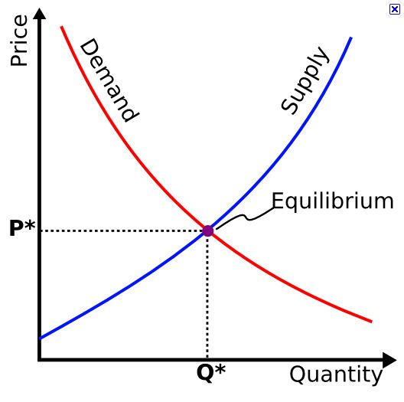
Equilibrium or Market Clearing Price

Slide 44
Balance Sheet
Assets $5,000,000
Current:
Cash on Hand
Accounts Receivable
Long Term:
Land
Building
Equipment
Total $5,000,000
Liabilities $2,500,000
Current:
Long Term
Owners Equity $2,500,000
Outstanding Stock
Personal Equity
Retained Earnings
Total $5,000,000
Assets = Liabilities + Owner’s Equity
Current Ratio: Assets / Liabilities
$5 mm / $2.5 mm = 2 to 1
Net Worth or Book Value = Assets – Liabilities
$5 mm - $2.5 mm = $2.5 mm

Slide 45
Income Statement
Gross Revenue $300
- Cost of Goods Sold - $100
Lemons
Sugar
Cups
Straws
Ice
Napkins
Gross Profit $200
- Startup Costs - $50
Paint
Wood
Nails
- Operating Expenses
Salary for brother -$50
Net Profit (Loss, Break Even) $100

Slide 46
Competition
Monopoly - A situation in which a single company or group owns all or nearly all of the market for a given type of product or service. By definition, monopoly is characterized by an absence of competition, which often results in high prices and inferior products.
Oligopoly – Similar to a monopoly, except a few companies working together to limit or eliminate competition.
Competition – The rivalry among sellers trying to achieve such goals as increasing profits, market share, and sales volume by varying the elements of the marketing mix: price, product, distribution, and promotion.
Pure Competition – A market that has a broad range of competitors who are selling the same products. It is often referred to as perfect competition. (An example is the Auto Industry.)

Slide 47
Forms of Business Ownership
Sole Proprietorship – Full Liability
Partnership – Partial Liability
Corporation – No Liability (C-Corp) - Public
LLC – Limited Liability Company
S-Corporation – No Liability (S-Corp) – Privately help

Slide 48
STANDARD 5 - Product/Service Management Students will understand the concepts and processes needed to obtain, develop, maintain, and improve a product or service mix in response to market opportunities
Objective 1: Explain and describe the nature and scope of the product/service management function a. Identify the components of the product life cycle b. Identify the impact of product life cycles on marketing decisions c. Understand market position and market share Objective 2: Understand the importance of generating product ideas to the ongoing success of a business a. Identify product opportunities b. Identify methods/techniques to generate a product idea Objective 3: Understand how product-mix strategies are employed to meet customer expectations. a. Explain the concept of product mix b. Describe the nature of product bundling

Slide 49
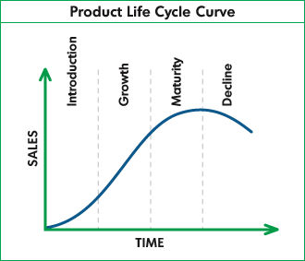
Product Life Cycle

Slide 50
Product Mix
Product mix, also known as product assortment, refers to the total number of product lines that a company offers to its customers. For example, a small company may sell multiple lines of products.

Slide 51
STANDARD 6 – Promotion Students will understand the concepts and strategies needed to communicate information about products, services, images, and/or ideas to achieve a desired outcome
Objective 1: Understand the nature and scope of promotion a. Explain the role of promotion as a marketing function b. Identify elements of the promotional mix (advertising, public relations, personal selling, sales promotion) c. Explain the nature of a promotional plan d. Explain the importance of coordinating activities in the promotional mix Objective 2: Understand promotional channels used to communicate with the targeted audiences a. Explain types of advertising media used to communicate with target audiences b. Understand the use of public-relations activities to communicate with targeted audiences c. Identify methods personal selling is used to communicate with targeted audiences d. Identify and explain communication methods used in sales promotions e. Understand the use of social media tools to communicate with targeted audiences

Slide 52
Promotional Mix
Personal Selling
Advertising
Public Relations
Sales
Promotion
Sponsorships
Direct Mail
Trade Shows.

Slide 53
Promotional Scope
May run from Niche (narrow) to Mass (wide).

Slide 54
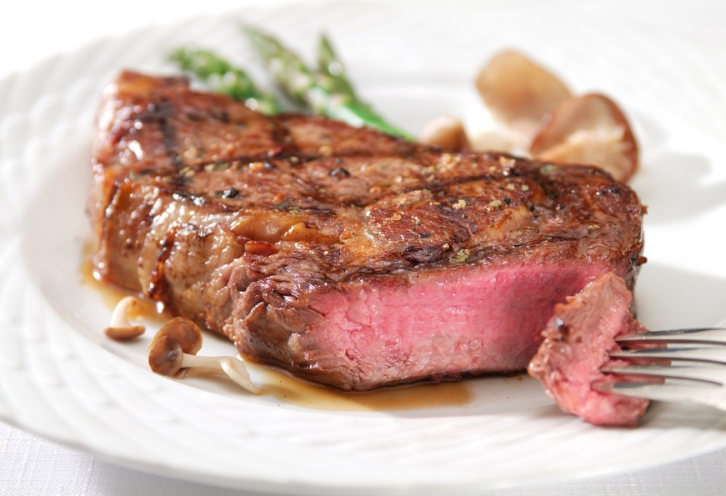
Perception is Reality
Nothing happens until someone sells something.
Sell the sizzle, not the steak!
Sell the suit, not the buttons!

Slide 55
STANDARD 7 – Channel Management Students will understand the concepts and processes needed to identify, select, monitor, and evaluate sales channels
Objective 1: Explain the nature and scope of channel management a. Define sales channel b. Identify members of a sales channel
Objective 2: Explain the nature of channels of distribution a. Define channel of distribution b. Understand the role of intermediaries c. Understand exclusive, selective, and intensive distribution

Slide 56
STANDARD 8 – Selling Students will understand the concepts and actions needed to determine client needs and wants and respond through planned, personalized communication that influences purchase decisions and enhances future business opportunities
Objective 1: Acquire a foundational knowledge of selling to understand its nature and scope a. Explain the nature and scope of the selling function b. Explain the role of customer service as a component of selling relationships
Objective 2: Acquire product knowledge to communicate product benefits and to ensure appropriateness of product for the customer a. Identify methods to acquire product information for use in selling b. Analyze product information to identify product features and benefits
Objective 3: Understand sales processes and techniques to enhance customer relationships and to increase the likelihood of making sales a. Explain the selling process b. Discuss motivational theories that impact buying behavior

Slide 57
Selling Process
Pre-approach
Product knowledge
Prospecting
Preparation
Approach
Needs Assessment
Presentation
a. Features & Benefits
Overcoming to Objections
Close the Sale
Ask for the order
Suggestion selling
Follow-up / Relationship building

Slide 58
SMART Goals
Specific
Measureable
Attainable or Achievable
Realistic
Time Bound

Slide 59
SWOT Analysis
Strengths
Weaknesses
Opportunities
Threats

Slide 60
6 Step Decision Process
Identify/Define the Problem/Opportunity
Study the Environment
List all Possible Alternatives
Collaborate & Choose the Best Alternative
Launch Your Plan
Evaluate Your Progress, and Continue or Start over.

