Slide 1
Dear Company (Doctor, Attorney, Employer, Teacher),
I am your customer (patient, client, student). Satisfy my wants with personal attention and a friendly touch and I will become a walking advertisement for your products and services. Ignore my wants, show carelessness, inattention, or poor manners, and I will simply cease to exist as far as you are concerned.
I am sophisticated. Much more than I was a few years ago, my needs are more complex. I have grown accustomed to better things. I have money to spend, I am sensitive, and I am proud. My ego needs the nourishment of a friendly, personal greeting from you. It is important to me that you appreciated my business. After all, when I buy your products and services, my money is feeding you and your family.
I am a perfectionist. I want the best I can get for the money I spend. When I criticize your products or your service take heed because I will tell anyone who will listen that I am dissatisfied. The source of my discontent lays in something you, or what you sold me, failed to do. Figure out what that was and fix it or you will also lose my friends as customers.
I am fickle. Other businesses continually entice me with offers of “more” for my money. To keep my business you must provide something better than they do. Though I am your customer now, you must prove to me again-and-again that I made the right choice in deciding to do business with you above all others.
Sincerely,
Your Customer (Patient, Client, Employee, Student)

Slide 2
B 2 B Business

Slide 3
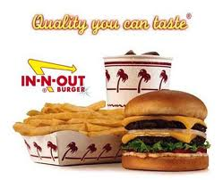
B 2 B Business (cont.)

Slide 4
B 2 B Business (cont.)

Slide 5
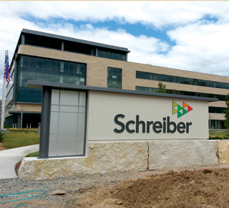
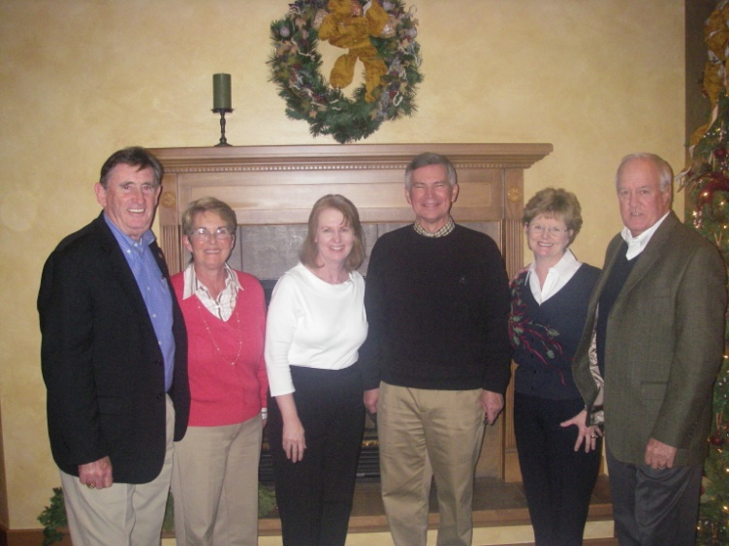
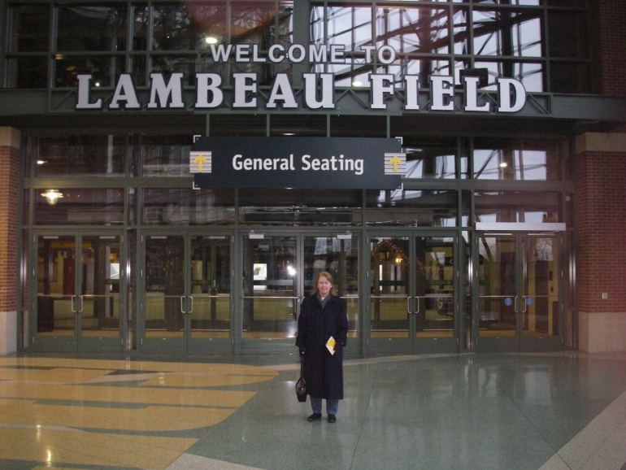
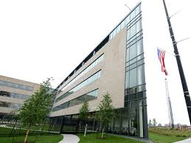
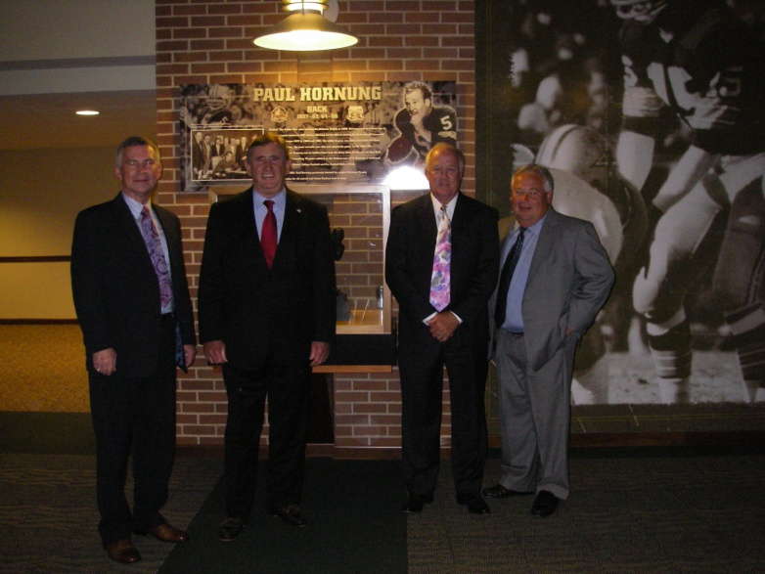
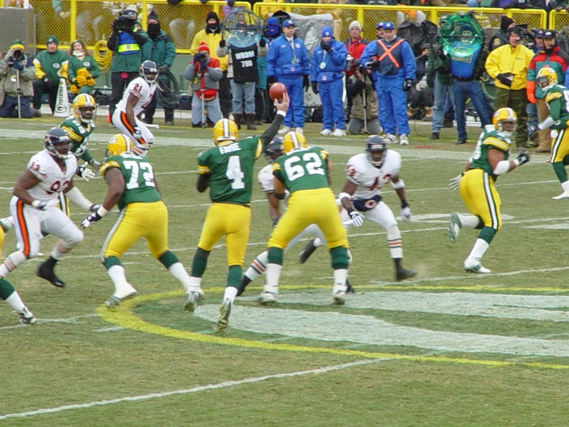
Business Background

Slide 6
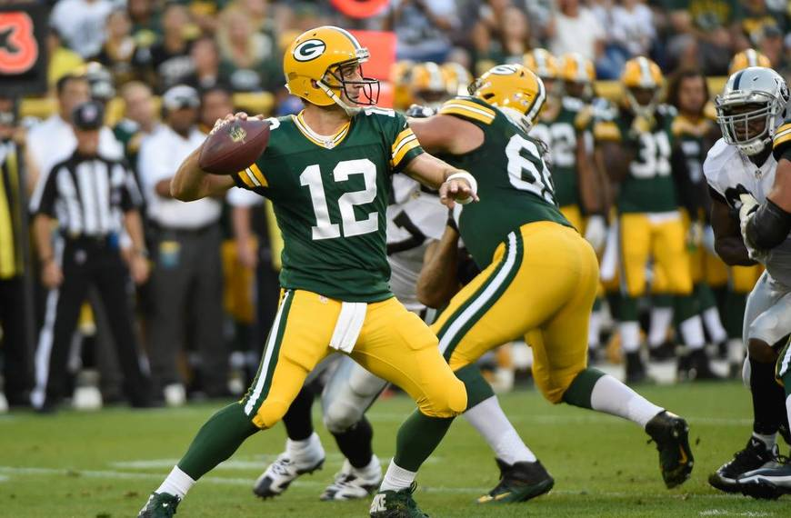
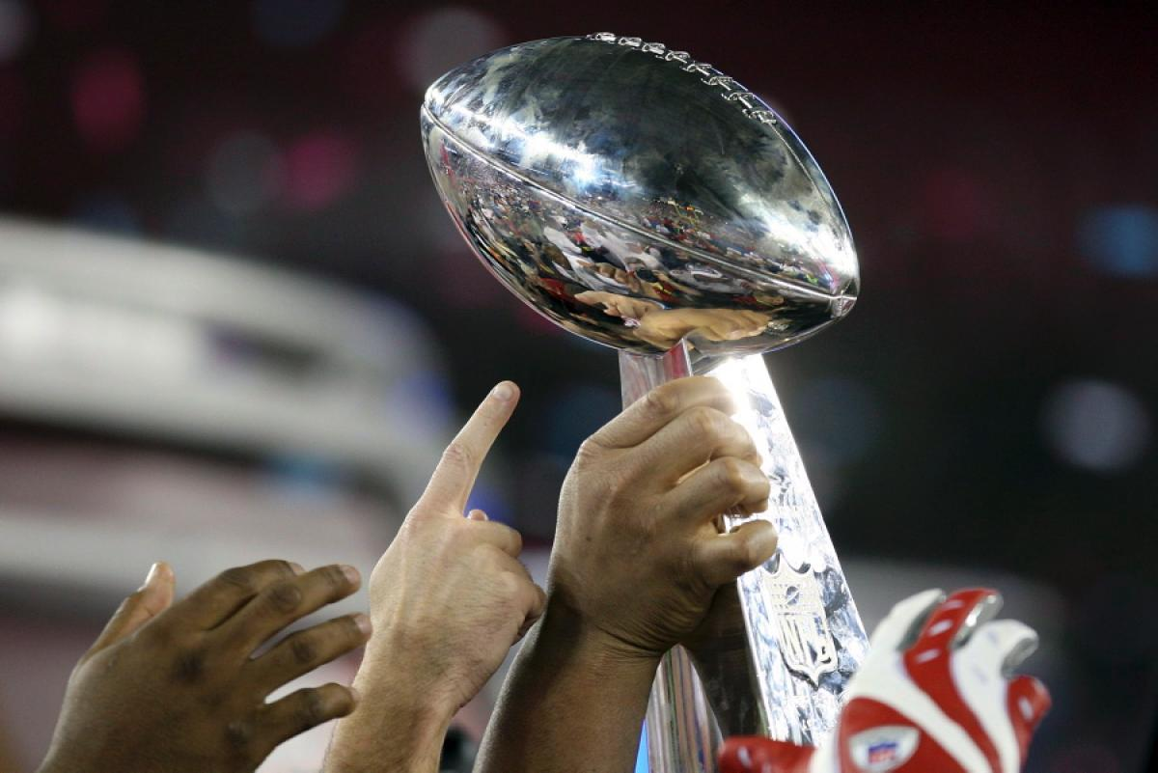
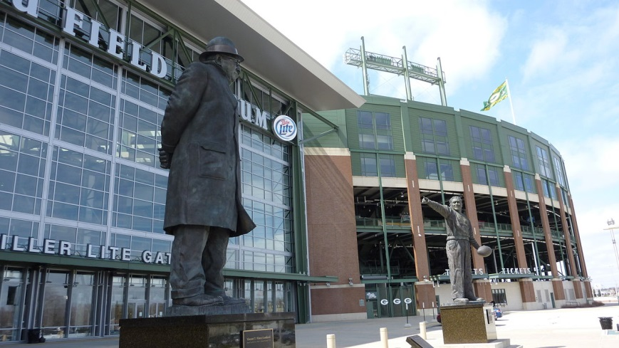
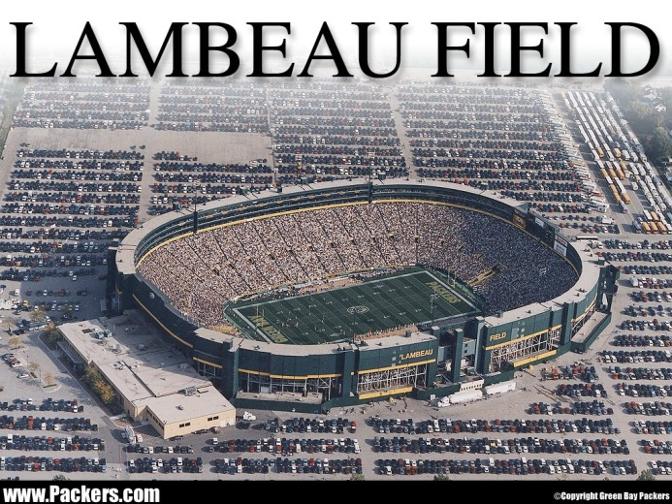
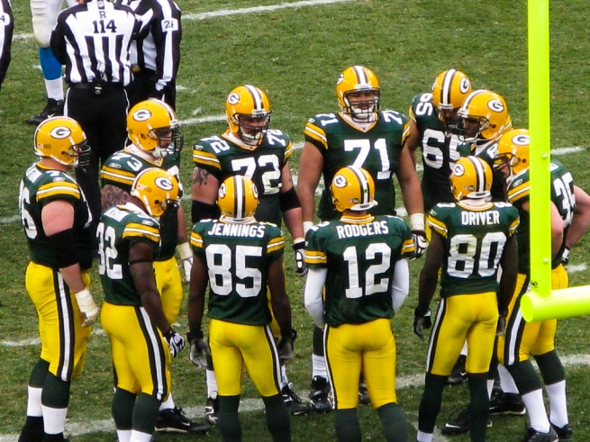
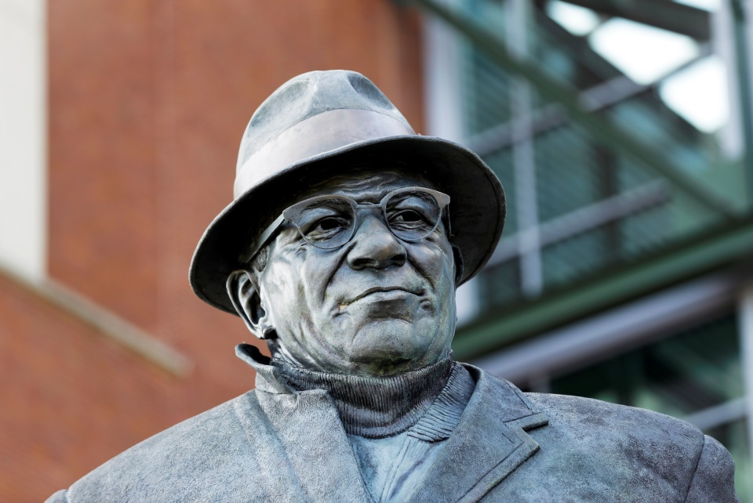
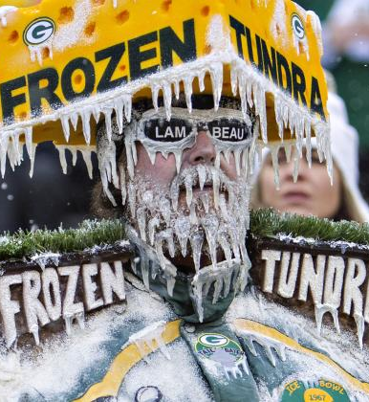
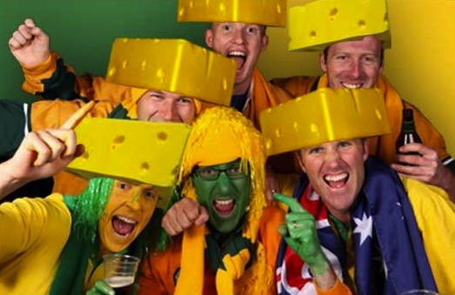

Slide 7
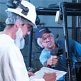
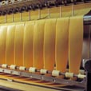
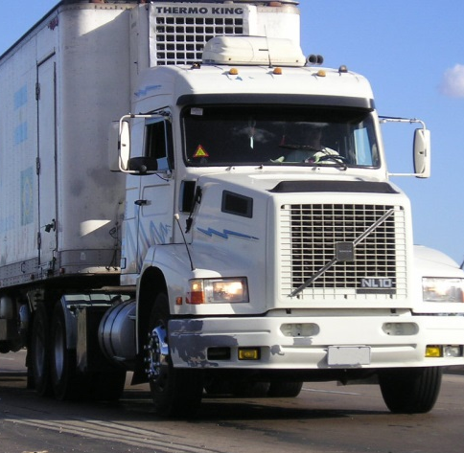
Schreiber Foods, Inc.
Green Bay, WI
Tempe, Arizona
Gainesville, Georgia*
Carthage, Missouri*
Clinton, Missouri
Monett, Missouri
Mount Vernon, Missouri
Ravenna, Nebraska
Shippensburg, Pennsylvania*
Nashville, Tennessee
Stephenville, Texas
Logan, Utah
Smithfield, Utah
Richland Center, Wisconsin
West Bend, Wisconsin
Wisconsin Rapids, Wisconsin
Curitiba, Brazil
Tianjin, China
Wangen, Germany
Baramati, India
Leon, Mexico
Montevideo, Uruguay

Slide 8
New $95 Million Headquarters, in Green Bay, WI
$5 Billion in Annual Revenue
7,500 World Wide Employees
35 Manufacturing Facilities in 14 Different Countries
Still a Privately Held, Multinational, Subchapter S Corporation

Slide 10
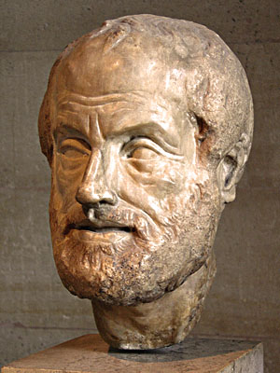
Aristotle (384-322 BC)
Quality is not an act; it is a habit.”

Slide 11
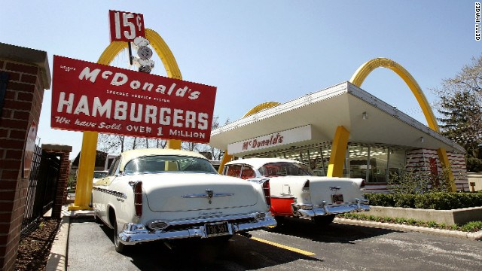
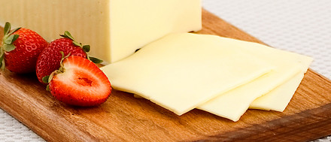
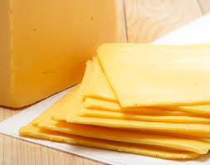
The McDonald’s Story

Slide 12
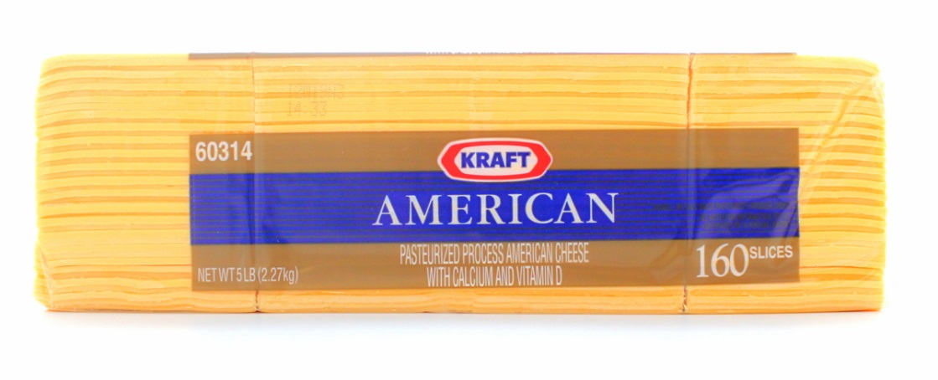
McDonalds - A True Story
40 years ago, Lionel Root, Sr. Vice President of Procurement, McDonalds, Inc., in Oakbrook, IL and the McDonalds senior management decided to switch from a 5 lb. / 144 Slice Sharp American Cheese to a 5 lb. / 160 Slice Sharp American Cheese (Jerry Rogers)
That equals a loss from .5556 oz. to a .50 oz. per slice.

Slide 13
McDonald’s Annual Volume in 1975 = $200 million

Slide 14
McDonald’s Annual Volume in 2015 = $1 Billion

Slide 15
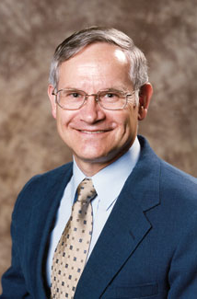
The 4 Absolutes of Quality
1. Quality is defined as conformance to customers’ requirements.
2. The system for improving quality is prevention.
3. The performance standard is zero defects—a commitment to conform to requirements each and every time.
4 . The measurement of quality is the price of nonconformance.
Philip Crosby

Slide 16
Total Quality Process
The “5 Why’s” and a “So What?”
If what you are doing isn’t adding value to the customer experience and reducing cost, stop doing it!
DIRFTE - Doing it right the first time, every time.
Every one buys in from the Chairman and CEO to the Mailroom Clerk and Secretary.nization.
The Voice of the Customer - 100% Service Levels & Skip Day Lead Time

Slide 17
Who Are Your Customers?
1.
2.
3.
4.
5.

Slide 18
Who Are Your Suppliers?
1.
2.
3.
4.
5.

