Slide 1
Financial Literacy Review for the Utah State Skills Test
Copper Hills High School
Prepared by: Rob Willardson 12/03/15

Slide 2
Don’t forget to discuss the following:
Grace Period
Premium
Revolving Credit (GAP Card)
529C Plan (Utah’s Tax Free Savings for College)
526B Plan (Tax Free Savings for Veterans)
FAFSA 4 Caster (Quick Estimate of the Grants, Scholarships, and
loans you are entitled to)
Reconciling Checking Account
Direct Deposit
Direct Pay
Pay Yourself First
3% 401K Employer Match / 3%
Opportunity Cost (Movies / Restaurant) – Variable Expenses
Time Value of Money
Inflation
Insurance – Transfer Risk
Disability Insurance
$500 Deductible
$1,000 difference per week x 52 weeks

Slide 3
Strand 1: Students will understand how values, culture, and economic forces affect personal financial priorities and goals (Economics, Culture, & Values).
Standard 1.1: Analyze the role of cultural, social, and emotional influences on financial behavior.

Slide 4
Values, Needs, Wants, & Scarcity
Our Values define what’s important to us.
We derive our Values from our environment: parents, teachers, church, friends, political leaders, the media, etc.
We determine our Needs and Wants from our Values.
Needs are necessary to sustain life.
Wants help make life more enjoyable, but are not essential.
Because of Scarcity (limited resources), we will never have all of our Wants supplied (unlimited needs & wants).

Slide 5
Economic Forces
What is Economics – The science of scarcity or choice.
Scarcity – Unlimited needs & wants, but limited resources.
Opportunity Cost – Choosing is refusing the next best alternative.
Supply & Demand – Upward sloping supply curve, and downward sloping demand curve.
Equilibrium or the Market Clearing Price – Where supply and demand intersect.
The 4 pillars of Free Enterprise – Private property rights, the price system, competition, and entrepreneurship.
Economic Stability – Recession: 2 successive quarters of a decline in GDP (Gross Domestic Product).
Unemployment Rate – The percentage of adults actively looking for work, who are willing to work.
Global Economy – Balance of trade (imports & exports).

Slide 6
STrand 1: Students will understand how values, culture, and economic forces affect personal financial priorities and goals (Economics, Culture, & Values).
Standard 1.2: Define a rational decision-making process and the steps of financial planning.

Slide 7
5 Step Decision Making Process
Define the problem or opportunity
Study the environment, and collaborate with those who have been through this situation before.
List all possible alternative solutions.
Choose your best alternative, and develop and launch your plan.
Evaluate your results, and continue or modify your plan. If your solution isn’t working, go back to Step 1 and start over.

Slide 8
Strand 1: Students will understand how values, culture, and economic forces affect personal financial priorities and goals (Economics, Culture, & Values).
Standard 1.3: Explain how setting goals affects personal financial planning.

Slide 9
SMART Goals have a much higher probability of being realized.
S = Specific
M = Measureable
A = Achievable or Attainable
R = Realistic
T = Time-bound

Slide 10
STrand 2: Students will understand sources of income and the relationship between career preparation and lifetime earning power (The money you earn).
Standard 2.1: Identify sources of income and specific employability
skills.

Slide 11
Sources of Income
Wages, salaries, and tips -- By law, your employer must send you a W-2 that shows how much you were paid in:
Salary
Tips -- To learn more, see the Tip Income tax tip.
Commissions
Bonuses
Vacation pay
Sick pay
Severance pay, taxable in year paid
Extra cash - The IRS considers extra money you make for side jobs as self-employment income. Report this income on Schedule C. If you make more than $400 from your side job, you'll need to file a Schedule SE and pay Social Security and Medicare taxes on the income.
Alimony received -- If you get alimony as a result of a divorce decree or separation agreement, the payments you receive are fully taxable. If you paid alimony during the year, you can deduct it even if you don't itemize deductions.
Unemployment benefits -- Unemployment compensation benefits are fully taxable. To learn more, see the Unemployment Income tax tip.
Jury duty pay -- Jury duty payments are taxable. However, you can deduct any part of the payment you give to your employer in exchange for continuing your salary.
Pension and annuity payments -- Pension and annuity payments are taxed. However, a portion might be tax-free. Ex: After-tax contributions to an annuity are considered tax-free when withdrawn.
Awards -- If you receive an award from your employer for your job performance, it's usually taxable. The award’s fair market value (FMV) is included in your W-2 income. This can include an all-expenses-paid trip or some other type of goods or services.

Slide 12
Math Word Problem – Paycheck Deductions
Your semi-monthly gross pay is $1,500. Your employer withholds 6.2% for Social Security, and 1.45% for Medicare (Combined FICA of 7.65%). In addition, your Federal Income Tax bracket is 20%, and your Utah State Income Tax is 5%. If there are no other deductions being withheld, what is your net pay?
$1,500 x 7.65% $1,500 x .0765 = 114.75
20% + 5% = 25% $1,500 x .25 = $375.00
$1,500 – 114.75 – 375.00 = $1,010.25

Slide 13
Net Worth
Assets
Stuff You Own
Home $300,000
Cars $60,000
Furniture $15,000
Stocks & Bonds $25,000
Electronics $7,500
Checking & Savings $10,000
Total Assets $417,500
Liabilities
Debts You Owe
Home Mortgage $200,000
Car Loans $20,000
Credit Card Debt $10,000
Total Debts $230,000
Net Worth = Assets – Liabilities
$417,500 - $230,000 = $187,500

Slide 14
What are the Top Ten Skills that employers want?
VERBAL COMMUNICATION | 1 | Able to express your ideas clearly and confidently in speech
TEAMWORK | 2 | Work confidently within a group
COMMERCIAL AWARENESS | 3 | Understand the commercial realities affecting the organization.
ANALYSING & INVESTIGATING | 4 | Gather information systematically to establish facts & principles. Problem solving.
INITIATIVE/SELF MOTIVATION | 5 | Able to act on initiative, identify opportunities & proactive in putting forward ideas & solutions
DRIVE | 6 | Determination to get things done. Make things happen & constantly looking for better ways of doing things.
WRITTEN COMMUNICATION | 7 | Able to express yourself clearly in writing
PLANNING & ORGANISING | 8 | Able to plan activities & carry them through effectively
FLEXIBILITY | 9 | Adapt successfully to changing situations & environments
TIME MANAGEMENT | 10 | Manage time effectively, prioritizing tasks and able to work to deadlines.

Slide 15
Strand 2: Students will understand sources of income and the relationship between career preparation and lifetime earning power (The money you earn).
Standard 2.2: Understand and begin preparation for career and post-high school training.

Slide 16
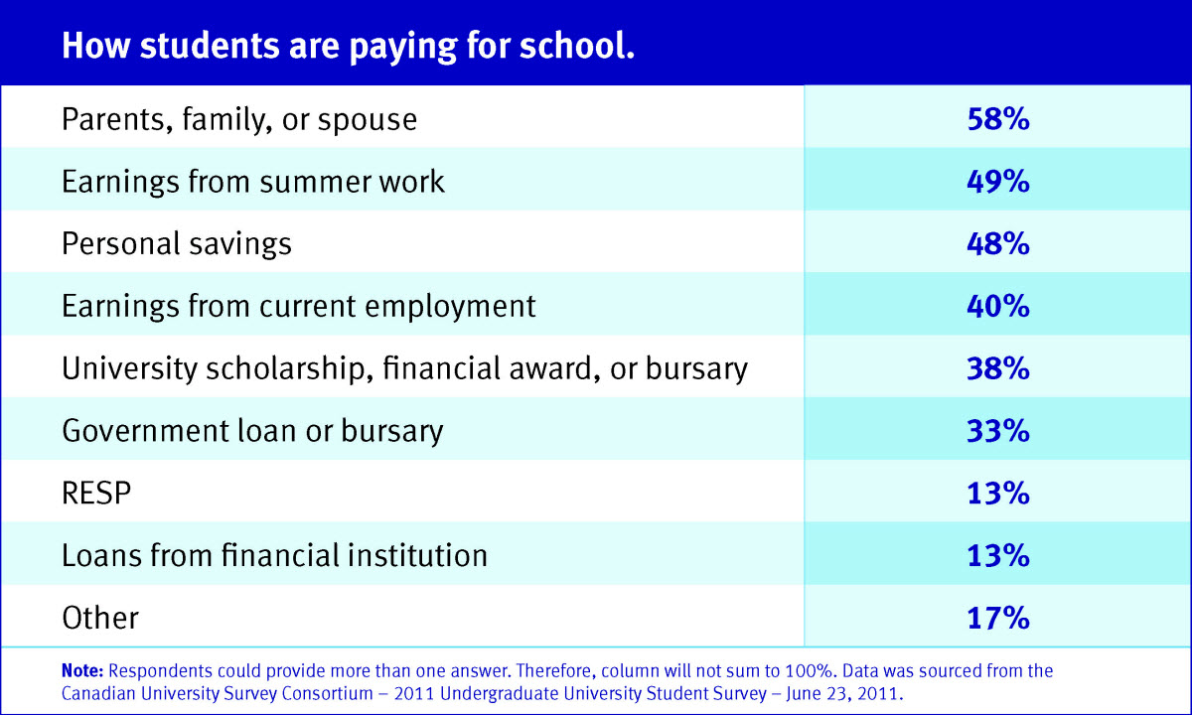

Slide 17
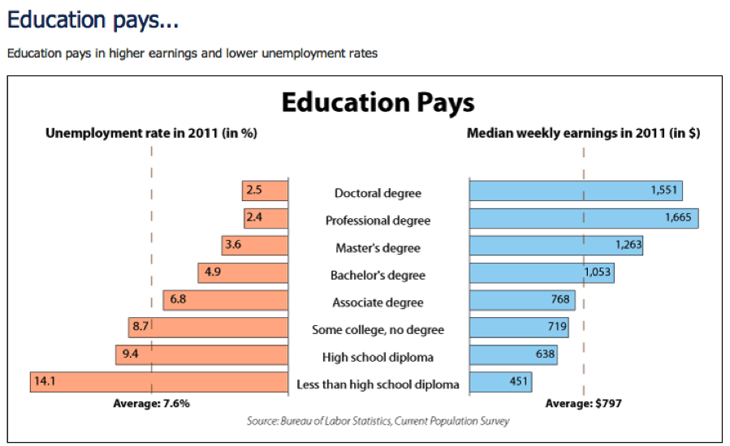

Slide 18
FAFSA
FAFSA – Free Application for Federal Student Aid
Website - https://fafsa.ed.gov
FAFSA is a portal for all scholarships, grants, aid, and loans.

Slide 19
Best Paying Jobs (Please note all require post secondary education.)
Physician
Dentist
Marketing Manager
IT Manager
Lawyer
Financial Manager
Sales Manager
Pharmacist
Business Operations Mgr.
Art Director
11. Software Developer
12. Veterinarian
13. Nurse Practitioner
14. Physician Assistant
15. Information Security Analyst
16. Mechanical Engineer
17. Civil Engineer
18. Computer Systems Analyst
19. Construction Manager
20. Physical Therapist
MONEY

Slide 20
Income Taxes
W4 Form – Declare allowances / determine withholding
W2 Statement – Summary of last year’s income and taxes
I9 Form – Verify national origin, and eligibility to work
1040 EZ - >$100,000 income, no dependents, standard deduction
1040 A - >$100,000 income, standard deduction
1040 – All other taxpayers
Gross Income – Total of all income, and interest
Adjusted Gross Income – Gross income minus allowances
Taxable Income – AGI minus exemptions and deductions
Standard Deduction – Estimate of the average family’s itemized deductions
Exemptions – Dependents with a qualifying relationship
Itemized Deductions – Charitable contributions, state taxes, property taxes, some medical & dental
Tax Credits – Childcare, American Opportunity, Earned Income

Slide 21
STrand 3: Students will evaluate saving methods and investment strategies (The money you save and invest).
Standard 3.1: Describe and discuss financial institutions, and demonstrate how to manage personal financial
accounts.

Slide 22
Types of Financial Institutions
Commercial Banks (e.g. Wells Fargo)
Investment Banks (e.g. Goldman Sachs)
Brokerages (e.g. Merrill Lynch)
Insurance Companies (e.g. New York Life)
Investment Companies (e.g. Scottrade)
Non-Bank Financial Institutions
Savings & Loans (e.g. Lending Tree)
Credit Unions (e.g. Jordan Credit Union)

Slide 23
Government Protection of Your Checking and Savings Accounts
The Federal Deposit Insurance Corporation (FDIC) is an independent agency of the United States government that protects the funds depositors place in banks and savings associations. FDIC insurance is backed by the full faith and credit of the United States government. Since the FDIC was established in 1933, no depositor has lost a penny of FDIC-insured funds. (NCUA for Credit Unions)
FDIC insurance covers all deposit accounts, including:
Checking accounts
Savings accounts
Money market deposit accounts
Certificates of deposit
FDIC insurance does not cover other financial products and services that banks may offer, such as stocks, bonds, mutual funds, life insurance policies, annuities or securities.
The standard insurance amount is $250,000 per depositor ($500,000 for a married couple), per insured bank, for each account ownership category.

Slide 24
Personal Financial Accounts
Checking Account – For paying bills and daily spending
Savings Account – An emergency fund
Retirement Account – For Retirement (59½), or disability
401k – A tax retirement plan invested in securities and bonds that is tax deferred until after retirement.
Roth IRA – A retirement plan that is taxed up front, and tax free after retirement
Keogh Plan – Like a 401k; a tax deferred retirement plan for self-employed people.
Investment Account – For mid-term investing

Slide 25
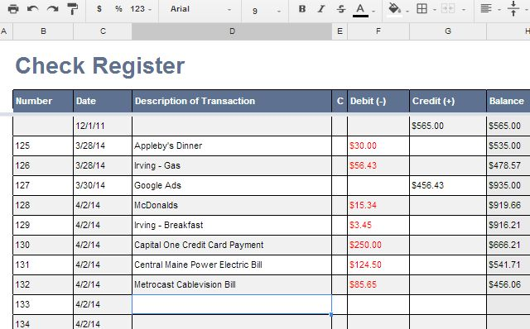
Checking Account Reconciliation

Slide 26
STrand 3: Students will evaluate saving methods and investment strategies (The money you save and invest).
Standard 3.2: Discuss the dynamics of saving and investing.

Slide 27
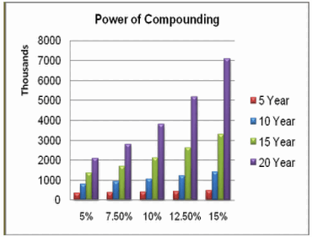
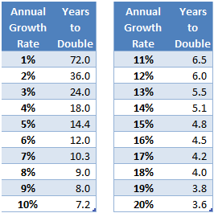
The Rule of 72
A simplified way to determine how long an investment will take to double, given a fixed annual rate of interest. By dividing 72 by the annual rate of return, investors can get a rough estimate of how many years it will take for the initial investment to duplicate itself.

Slide 28
Math Word Problem – Rule of 72
You have received an inheritance of $20,000. Your financial adviser has found an investment for you that pays a return of 7.2%. How many times will your investment double over the next 30 years? What will be your ending balance?
72 / 7.2 = 10
30 / 10 = 3
$20,000
$40,000 = once
$80,000 = twice
$160,000 = thrice

Slide 29
STrand 3: Students will evaluate saving methods and investment strategies (The money you save and invest).
Standard 3.3: Understand the role of risk management in asset protection.

Slide 30
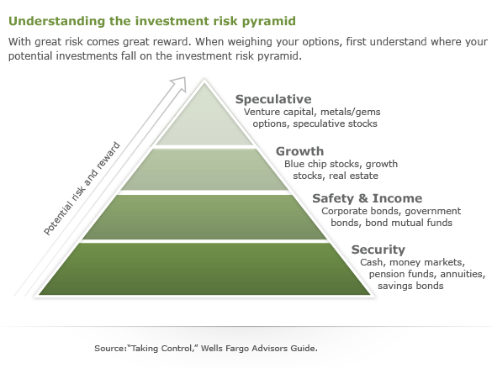
Savings & Investment Choices
High Risk
High Return
Low Risk
Low Return

Slide 31
Insurance
Life Insurance
Whole Life Insurance – Expensive and poor rate of return
Term Insurance – Very affordable
Auto Insurance – Required in the State of Utah
Liability - Minimum Required:
$25,000 per person for bodily injury
$65,000 per accident for bodily injury
$15,000 per accident for property
Personal Injury Protection (PIP)
$3,000 personal injury protection
Health Insurance – Affordable Health Care – Arches / CHIP
Home Owners Insurance
Apartment Insurance

Slide 32
STrand 4: Students will understand principles of personal money management, including budgeting, managing accounts, and the role of credit and impacts on personal finance (The money you spend).
Standard 4.1: Identify and explain the process of budgeting based on calculated income.

Slide 33
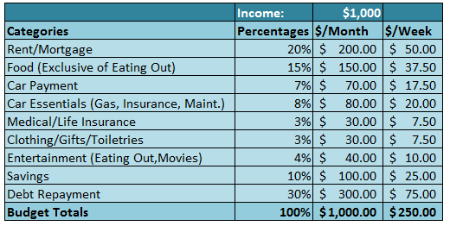
Budgeting
A budget is a plan for your future income and expenditures that you can use as a guideline for spending and saving.

Slide 34
Math Word Problem – Purchase Discount
You are shopping and find a pair of designer jeans that you have always wanted that normally sell at retail for $125.00. You are lucky that they are on sale for 33% off. What is the net price you will pay, before sales tax is added?
$125.00 x .33 = $41.25
$125.00 – $41.25 = $83.75

Slide 35
STrand 4: Students will understand principles of personal money management, including budgeting, managing accounts, and the role of credit and impacts on personal finance (The money you spend).
Standard 4.2: Describe and discuss the
impact of credit and debt on personal
money management.

Slide 36
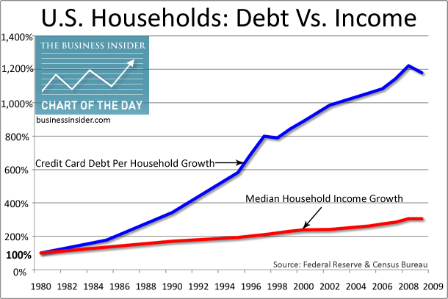

Slide 37
Collateral:
A physical asset that is pledged as security for repayment of a loan, to be forfeited in the event of a default, i.e. house, car, stocks, or bonds.
If you don’t keep up the regular payments, the bank will take it away from you.

Slide 38
STRAND 4: Students will understand principles of personal money management, including budgeting, managing accounts, and the role of credit and impacts on personal finance (The money you spend).
Standard 4.3: Explain and understand credit reports and scores.

Slide 39
Credit Score / FICO Score
A person's credit score calculated by Fair Isaac Corporation (FICO). The range is from 300 – 850.
The three credit reporting agencies (CRA):
Trans Union
Equifax
Experian
A higher credit score will result in lower interest rates and ease in securing credit.
Your credit score will affect your employability and ability to borrow money.

Slide 40
STrand 4: Students will understand principles of personal money management, including budgeting, managing accounts, and the role of credit and impacts on personal finance (The money you spend).
Standard 4.4: Define rights and responsibilities of buyers and sellers under consumer protection laws.

Slide 41
The Federal Trade Commission
The Federal Trade Commission (FTC) is the main federal agency enforcing consumer protection laws. The FTC uses what it calls "industry guides" and trade regulations to define what "unfair or deceptive" trade practices are.
The FTC enforces most federal consumer laws, including the:
Fair Credit Reporting Act (FCRA) - outlines the steps you need to take to correct mistakes or errors on your credit report
Truth in Lending Act (TILA) - credit card companies can't bill you more than $50 per card for unauthorized charges made to those cards
Fair Credit Billing Act - sets out how to fix billing errors on your credit card accounts, including fraudulent charges
Fair Debt Collection Practices Act (FDCPA) - bars debt collectors from using unfair and deceptive practices to collect overdue bills
Magnuson-Moss Warranty Act - requires manufacturers and sellers to explain warranty coverage, terms and exclusions
Identity Theft and Assumption Deterrence Act of 1998 (ITADA) - created services for education on identity theft and filing complaints on identity theft
Credit Card Accountability, Responsibility and Disclosure Act (CARD Act) - limits fees and penalties charged by credit card companies, as well as when they may increase interest rates and by how much
The FTC enforces these laws though administrative proceedings, lawsuits or its rulemaking power. Often, the FTC takes action after consumers file complaints about particular products, services or businesses.

Slide 42
STrand 4: Students will understand principles of personal money management, including budgeting, managing accounts, and the role of credit and impacts on personal finance (The money you spend).
Standard 4.5: Students will understand the role of government in protecting the consumer.

Slide 43
State Laws that Protect the Consumer
In many states, the common law has been compiled into state consumer protection laws. Your state attorney general may enforce these laws, or your state may have a separate consumer protection agency. Many state laws are very similar to the federal consumer protection laws.
Some states also have business-specific laws for select industries. These laws cover businesses like:
Mobile home sales
Vehicle repairs and sales (Lemmon Laws – 72 hours)
Travel agencies
Storage of household goods
Health club contracts
Outside Help
Private, volunteer groups, such as the Better Business Bureau (BBB), also take consumer complaints and investigate abusive business practices. These groups can encourage businesses to abide by consumer protection laws and help settle consumer disputes.

