Slide 1

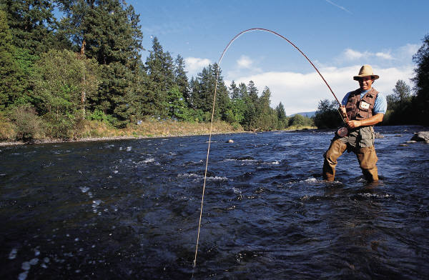
Farmers & Fishers

