Slide 1
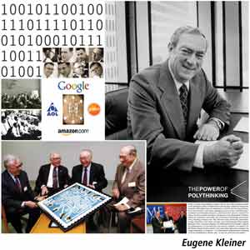
Eugene Kleiner (1923 – 2013)
Founder & Venture Capitalist of Amazon, AOL, Google, Intuit, Segway, Genentech,
Compaq, Sun Microsystems, Electronic Arts, & over 300 more technology firms.
6 Laws to Become a Successful Entrepreneur:
Will the dog eat the dog food?
Build one business at a time.
The time to take the tarts is when they are being passed.
It’s easier to get a piece of an existing market than to create a new one.
After learning some of the tricks of the trade, some people think they know the trade.
Venture capitalists will stop at nothing to copy success.

