Slide 1
Entrepreneurship Review

Slide 2
STANDARD 1: Students will identify and recognize entrepreneurial traits, characteristics, and roles. Students will examine the role of innovation and entrepreneurship activity to society and the economy. Students will identify methods and processes of idea generation, problem solving, and innovating. Objective 1: Students will be introduced to the role of the entrepreneur in the economy. • Explain the terms entrepreneur and entrepreneurship. • Describe the differences between being an employee, an intrapreneur, and entrepreneur. • Assess the impact of entrepreneurship and innovation on your local, state, national, and international communities and economies. • Search, analyze, and interpret current entrepreneurship data and data trends. • Describe the role of the government and in promoting and supporting entrepreneurship. • Identify parts of the entrepreneurship infrastructure (SBDC, SBA, SCORE, GOED). • Describe entrepreneurship mentoring trends and entrepreneurship contests (e.g., boom start-up, incubators, business plan contests, pitch contests).

Slide 3
Entrepreneurship
Entrepreneur – One who builds net worth through risk and initiative. One who organizes, manages, and assumes the risks of a business or enterprise.
Intrapreneur - A corporate manager who develops new enterprises within the corporation.
Entrepreneurship Trends - In U.S. and Utah
1. The Design Differential
2. Data-driven Insights (Key Performance Indicators)
3. Business SaaS-ification (Software as a Service)

Slide 4
Entrepreneurship Infrastructure
Entrepreneurship Support:
SBDC - Small Business Development Center
SBA - Small Business Administration
SCORE - Service Corps of Retired Executives
GOED - Governor’s Office of Economic Development
Entrepreneurship Contests:
1. Boom Start-ups
2. Incubators
3. Business Plan Contests (Comcast)
4. Pitch Contests

Slide 5
Objective 2: Understand the characteristics of an entrepreneur. • Identify the characteristics and traits of a successful entrepreneur. • Compare and contrast the risks and benefits of choosing to become an entrepreneur, including ways to minimize or limit the risks. • Examine the role of entrepreneurship in a career and college pathway. • Define ethics, and identify common ethical issues that entrepreneurs encounter.

Slide 6
Effective Leadership Qualities
Honesty
Delegate
Communication
Confidence
Commitment
Positive Attitude
Creativity
Intuition
Inspire
Approach

Slide 7
Management Styles
Autocratic – Do it or else / My way or the highway
Democratic – Everybody contributes / Collaborate
Laissez-Faire – Hands off / Trust employees to do the right thing.

Slide 8
Code of Ethics
A code of ethics will start by setting out the values that underpin the code and will describe a company's obligation to its stakeholders (everyone affected by the companies existence). The code is publicly available and addressed to anyone with an interest in the company's activities and the way it does business. It will include details of how the company plans to implement its values and vision, as well as guidance to staff on ethical standards and how to achieve them.

Slide 9
Social Responsibility
Every company and its employees have an obligation to act for the benefit of society at large, not just to maximize profits alone, i.e. environmental sustainability, scholarship, economy, and quality of life.

Slide 10
Four Pillars of Management
Planning
Organizing
Directing
Controlling

Slide 11
Management Responsibilities
Recruiting
Hiring
Training
Appraising
Promoting
Firing

Slide 12
Objective 3: Students will understand idea generation through innovation and problem solving. • Understand basic business model concepts. • Generate ideas for products and/or service to meet or create markets or needs, wants, and trends. • Compare and contrast the advantages and disadvantages of buying an existing business, starting a new business, or purchasing a franchise. Review basic business models. • Identify research tools used to gather information about markets, market trends, and business and consumer needs and wants. • Identify trends in entrepreneurship (e.g., emerging technologies, social entrepreneurship, green entrepreneurship, lean start-up, business model— canvas, crowdsourcing and crowd funding). • Understand the basic concepts of lean start-up, a minimally viable product, pivoting, and “failing fast.”

Slide 13
6 Step Decision Process
Identify/Define the Problem/Opportunity
Study the Environment
List all Possible Alternatives
Collaborate & Choose the Best Alternative
Launch Your Plan
Evaluate Your Progress, and Continue or Start over.

Slide 14
STANDARD 2: Students will understand how economic concepts effect decision making in an entrepreneurial venture. Objective 1: Define opportunity cost, scarcity, and equilibrium. • Explain the determinants of supply and demand. • Describe the interrelationship between cost and price. • Describe the difference between fixed costs and variable costs. • Calculate the number of products to be sold to make a profit using break-even analysis. • Analyze how a fluctuating global/international economy affects local businesses. • Explain the role of the entrepreneur’s contribution of time, money, and expertise as it relates to profit. • Describe the concepts of import and export.

Slide 15
Scarcity
We have scarcity, because we have unlimited needs and wants, but limited resources.
Needs – things that are essential to sustain life.
Wants – things that are desirable, and add enjoyment to life.

Slide 16
Opportunity Cost
When we choose between alternatives that offer different benefits we must realize that there will be “Trade Offs.”
Choosing is refusing the next best alternative.

Slide 17
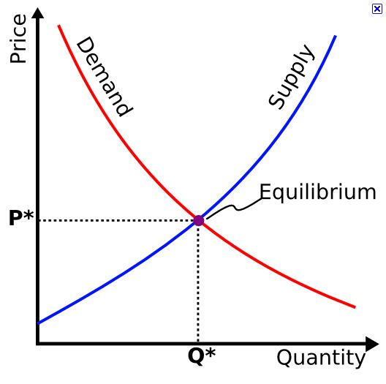
Equilibrium or Market Clearing Price

Slide 18
STANDARD 3: Students will understand how marketing affects an entrepreneurial venture. Objective 1: Understand the importance of identifying the market. • Define the function of marketing in an entrepreneurial venture. • Discuss the concept of market and market share. • Identify target markets for potential new businesses. • Define and give examples of market segmentation methods. • Discuss the role of market research in identifying a market and making business decisions.

Slide 19
Market Segmentation (Target Market)
Market segmentation is a way of analyzing a market by specific characteristics in order to create a target market:
1. Demographics – Age, Gender, Income Level, Ethnic background, Education
2. Geographics – Regional, National, Global
3. Phychographics – Lifestyles, Personalities, Trends
4. Product Benefits – Consumers’ Needs & Wants

Slide 20
Objective 2: Students will explore how businesses reach, maintain, and increase the market. • Identify the elements of the marketing mix (i.e., the “4 P’s” of marketing). • Identify the advantages and disadvantages of marketing a business on the Internet. Revised: Spring 2014 Implemented: Fall 2014 3 • Analyze the advantages and disadvantages of possible locations for businesses (e.g., brick-and-mortar stores, virtual enterprises, and “click-and-mortar” stores). • Discuss appropriate advertising and publicity activities for a business. • Discuss the impact of competition on keeping/increasing market share.

Slide 21
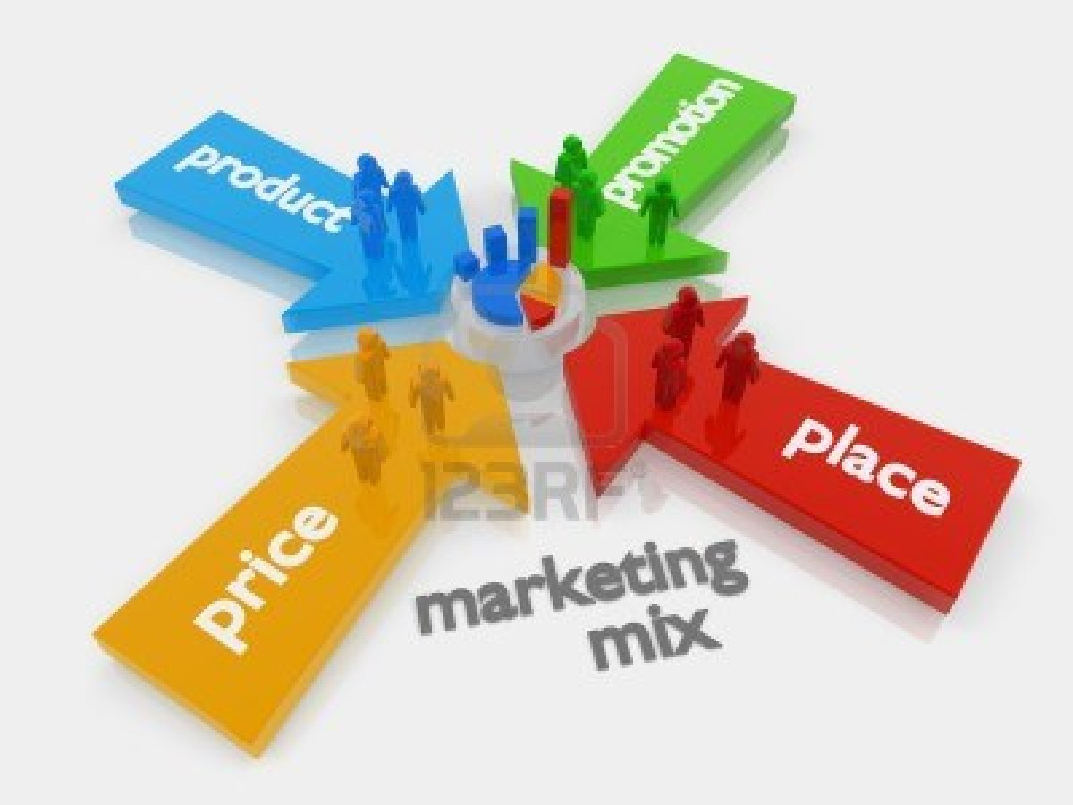
Marketing Mix (The 4 P’s of Marketing)
Product
Price
Place
Promotion

Slide 22
STANDARD 4: Students will understand financial concepts and tools used by entrepreneurs in making business and personal decisions. Objective 1: Examine sources and types of funding. • Project the total cash needed to start a business (e.g., start-up costs, ongoing operational expenses, and cash reserves). • List and describe common sources and processes by which entrepreneurs can secure funding and potentially exit a business (e.g., angel investors, venture capitalists, term sheets, rounds of financing, capitalization tables, banks, credit unions, crowd funding, credit lines, personal savings, family and friends, mortgage, short-term loan, grants, bootstrapping, IPO, merger, acquisition, etc.). • Assess the role of government assistance in the growth and development of a small business (e.g., SBA loan guarantees, grants, university commercialization, city and state incentives). • Compare and contrast debt and equity financing. Identify the advantages and disadvantages of different types of financing options for entrepreneurs. • Describe the criteria that determine an entrepreneur’s credit worthiness and the impact this might have on obtaining a business loan.

Slide 23
Financing a Business
Lenders:
SBA – Small Business Administration
UMLF – Utah Micro-enterprise Loan Fund
Commercial Banks
Venture Capital (Angel Investors)
Shark Tank
Kabbage.com
Crowd Sourcing:
Kickstarter.com
Gofundme.com

Slide 24
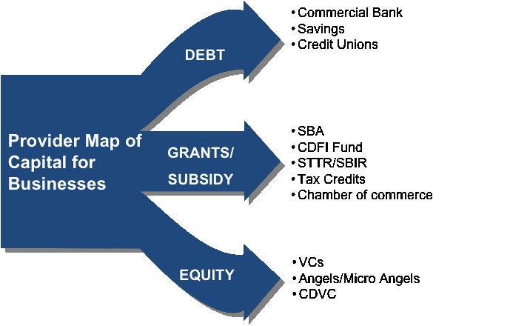
Financing a Business
Commercial Bank
Credit Union
Micro Enterprise Loan
Credit Card
SBA / USDA Loan
Tax Credits
Chamber of Commerce
Municipal Incentives
Personal Savings & Investments
Friends & Family
Private Investors (Angels)
Crowd Funding (Micro Angels)
401K Loan

Slide 25
Objective 2: Understand how entrepreneurs utilize business records. • Identify reasons for keeping business records. • Describe the impact of incomplete and/or inaccurate business records on a business (e.g., sales receipts, expense records, taxes, etc.). • Prepare and analyze basic financial statements such as income statements and balance sheets. • Understand the importance of sales and budget forecasting in business planning.

Slide 26
Balance Sheet
Assets $5,000,000
Current:
Cash on Hand
Accounts Receivable
Long Term:
Land
Building
Equipment
Total $5,000,000
Liabilities $2,500,000
Current:
Long Term
Owners Equity $2,500,000
Outstanding Stock
Personal Equity
Retained Earnings
Total $5,000,000
Assets = Liabilities + Owner’s Equity
Current Ratio: Assets / Liabilities
$5 mm / $2.5 mm = 2 to 1
Net Worth = Assets - Liabilities
$5 mm - $2.5 mm = $2.5 mm Net Worth or Book Value

Slide 27
Income Statement
Gross Revenue (Lemonade Stand) $300
- Cost of Goods Sold - $100
Lemons
Sugar
Cups
Straws
Ice
Napkins
Gross Profit $200
- Startup Costs - $50
Paint
Wood
Nails
- Operating Expenses
Salary for brother -$50
Net Profit (Loss, Break Even) $100

Slide 28
Break Even Point
Gross Sales / Revenue
Profit
Revenue
Cost of Goods Sold
& Operating Expenses
Break Even Point
Loss
Volume

Slide 29
STANDARD 6: Students will analyze how forms of business ownership, government regulations, and legal regulations affect entrepreneurial ventures. Objective 1: Identify types of business ownership (e.g., sole proprietorship, partnership, c-corp, s-corp, LLC, nonprofit, franchise). • Compare and contrast the advantages and disadvantages of the different types of business ownership. • Identify licenses that a small business must obtain (e.g., business license, EIN, name registry, sales tax I.D., occupational/professional license, food handlers). • Identify taxes businesses pay. • Identify ways of protecting ideas and inventions (intellectual and proprietary property and processes). • Identify the major components of a business plan. • Describe the uses and purposes of a business plan. • Understand a pitch deck and VC road show.

Slide 30
Different Types of Businesses
Sole Proprietorship – Full Liability
Partnership – Limited Liability
Corporation – No Liability
Franchise – Business Model
LLC – Limited Liability Company
S Corporation – Privately Held

Slide 31
Legal Aspects to Starting a Business
Write a Business Plan to determine profitability
Register a Fictitious Business Name / DBA
Choose a Legal Form for you Business
Sole Proprietorship
Partnership
Corporation
Get a Federal Tax I. D. Number
Learn About Employee Laws
Obtain Necessary Business Permits & Licenses
File for Trademark Protection
Open a Bank Account to Begin Building Business Credit

Slide 32
Business Plan
Executive Summary
Brief Description
Situation Analysis
Market Segmentation (Target Market: Demographics, Psychographics, Geographics, Product Benefits)
Marketing Strategy (Product, Place, Price, Promotion)
Financial Projections
Conclusion
Appendix
Exhibits

Slide 33
SMART Goals
Specific
Measurable
Attainable
Realistic
Time-Bound

Slide 34
SWOT Analysis
Strengths
Weaknesses
Opportunities
Threats

Slide 35
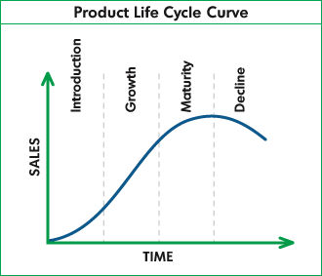
Product Life Cycle

