Slide 1
Marketing Research
Chapter 6

Slide 2
Ch. 6.1 — Marketing Information Systems
What you’ll learn:
The importance of marketing research
The function of a marketing information system

Slide 3
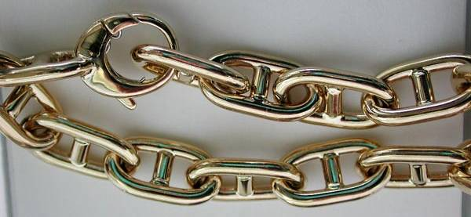
Marketing Research
Links the consumer, customer, and public to the marketer through information.
The primary emphasis is to obtain information about the preferences, opinions, habits, trends, and plans of current and potential customers.

Slide 4
Why is Marketing Research Important?
Helps businesses plan their future operations to increase sales and profit.
Helps solve marketing problems and anticipate future potential
Helps keep track of what is happening in current markets – what the competition is doing

Slide 5
Who Uses Marketing Research?
Small companies – research is often informal – done by owner or manager.

Slide 6
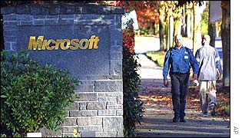
Who Uses Marketing Research?
Larger companies have a formal research department and specialists to plan and conduct research

Slide 7
Who Uses Marketing Research?
Governments’ research

Slide 8
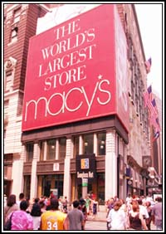
Who Uses Marketing Research?
Trade industries, retailers, wholesalers, etc.

Slide 9
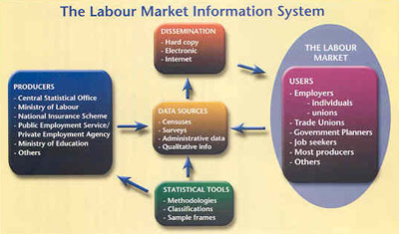
Marketing Information Systems
A set of procedures and methods that regularly generates, stores, analyzes, and distributes marketing information.

Slide 10
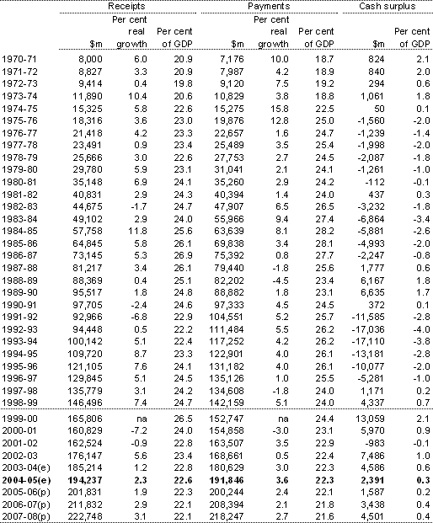
Marketing Information Systems
Includes company records, competitor's records, customer profile data, government data

Slide 11
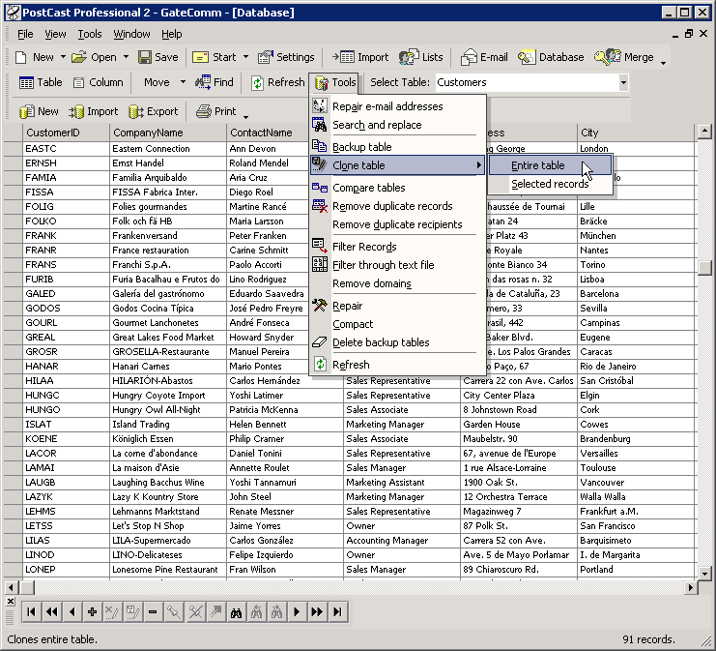
Database Marketing
Database – a collection (or file) of related information about a specific topic.

Slide 12
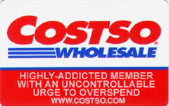
Marketing Databases
Sometimes information is collected by bar code scanner, “valued customer cards”

Slide 13
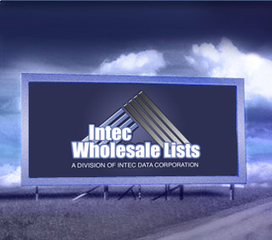
Marketing Databases
Often companies sell their information to others

Slide 14
Limitations of Marketing Research
The amount of information that can be gathered is limited by the amount of money a company can afford to spend on the equipment and personnel needed to do the research.
Often, there is too little time to do research because decisions must be made before all possible data can be obtained.

