Slide 1
Cartels & Competition
Economic Concepts:
Incentives matter.
Increases in supply lead to reductions in price.
Cartels increase their profits and market prices by restricting production.
Desire for profit undermines cartel agreements.

Slide 2
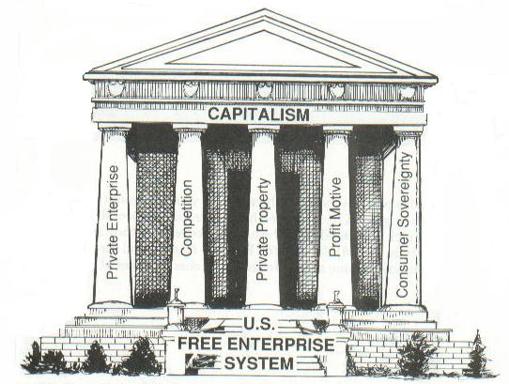
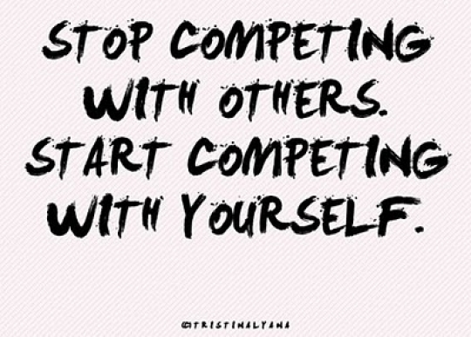
The Four Pillars of Free Enterprise
Private Property Rights
Free & Open Competition
The Price System – Voluntary Exchange of Value
Entrepreneurship – Risk & Initiative

Slide 3
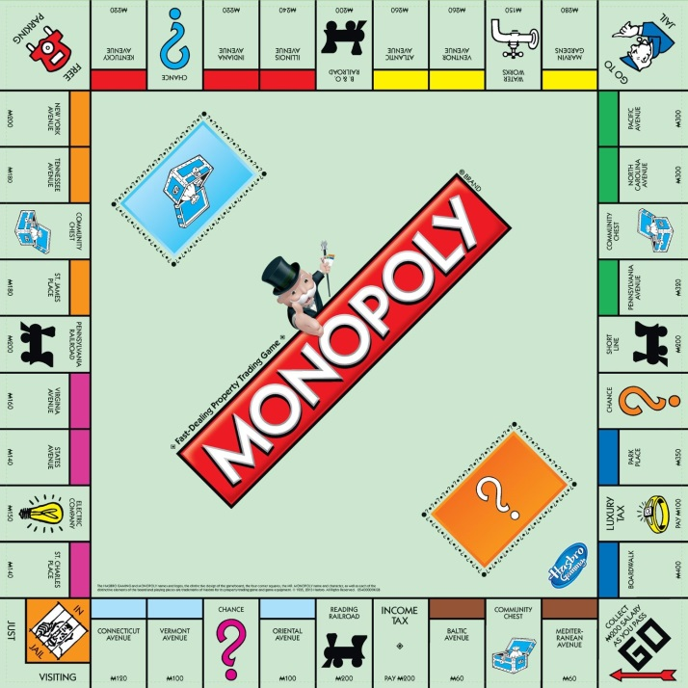
Monopoly A monopoly is a situation in which a single company or group owns all or nearly all of the market for a given type of product or service. By definition, monopoly is characterized by an absence of competition, which often results in high prices and inferior products.

Slide 4
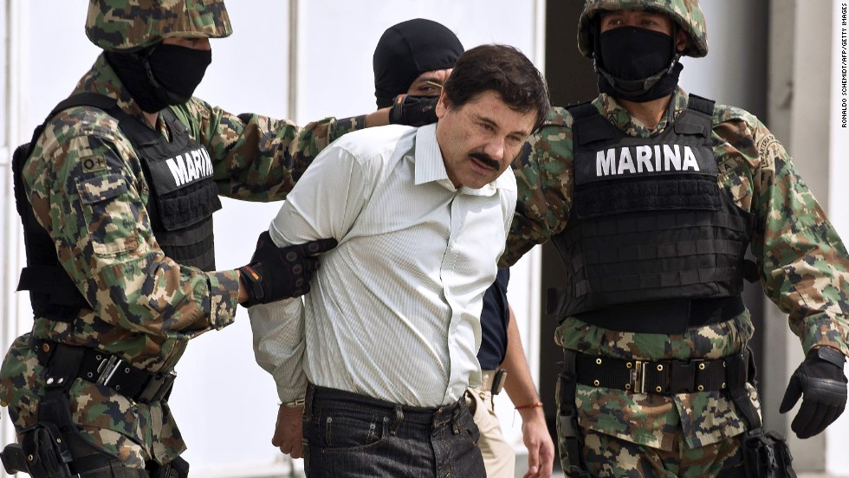
Cartel A cartel is an agreement between competing firms to control prices or exclude entry of a new competitor in a market. It is an association of manufacturers or suppliers with the purpose of maintaining prices at a high level and restricting competition.
OPEC – Organization of
Petroleum Exporting Countries
Drug Cartel

Slide 5
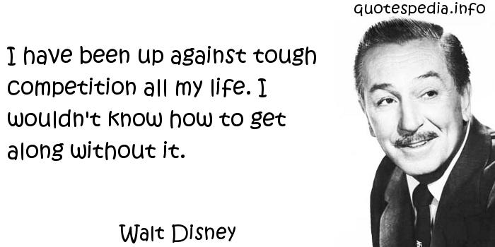
Competition The rivalry among sellers trying to achieve such goals as increasing profits, market share, and sales volume by varying the elements of the marketing mix: price, product, distribution, and promotion.

Slide 6
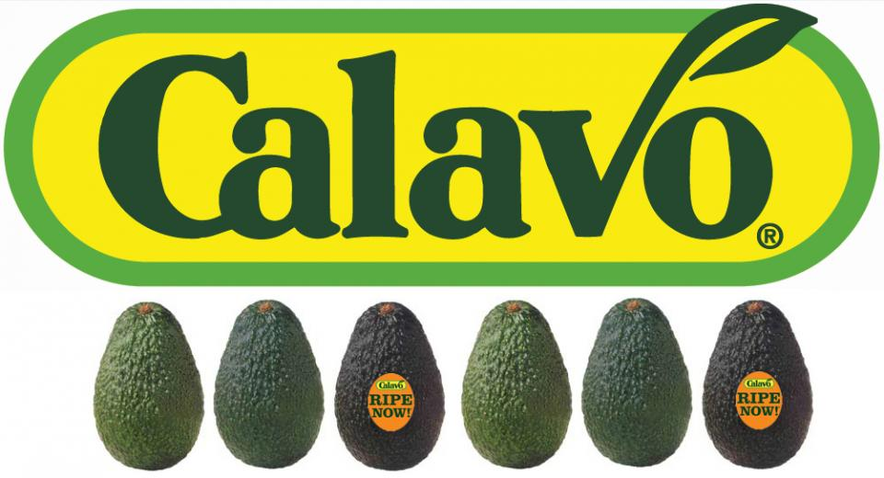
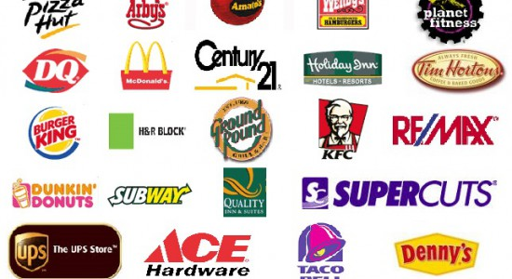
Cooperative A jointly owned enterprise engaging in the production or distribution of goods or the supplying of services, operated by its members for their mutual benefit, typically organized by consumers or farmers.

Slide 7
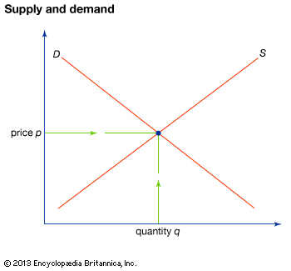
PRICE | MARKET DEMAND
$125 | 0 – 6
$100 | 7 – 13
$75 | 14 – 19
$50 | 20 – 26
$30 | 27 – 32
$25 | 33 – 40
$20 | 41 - 50

