Slide 1
Business Management Review
Copper Hills High School
Prepared by: Rob Willardson

Slide 2
STANDARD 1: Students will identify and describe the planning function of management. Objective 1: Explain what planning is and the importance of planning. Objective 2: Explain the business decision-making process. Objective 3: Distinguish between strategic (long-term) and operational (short-term) plans. Objective 4: Identify planning tools used in project planning (e.g., budgets, schedules, policies, etc.). Objective 5: Understanding the importance and purpose of the business plan for managerial success and capital resources.

Slide 3
Pioneers of Scientific Management
Fredrick Taylor (Division of Responsibilities,
Training, & Incentives)
Henry Gantt (Project Management / Prioritazion –
Gantt Chart)
1920 Frank & Lillian Gilbreth (Time & Motion Studies)
Henri Fayol (Planning, Organizing, Directing,
Controlling)
1950 Peter Drucker (Focus on Economic Performance)

Slide 4
Four Pillars of Management
Planning
Organizing
Directing
Controlling

Slide 5
Planning
Planning is the process of thinking about and organizing the activities required to achieve a desired goal. It involves the creation and maintenance of a plan, such as psychological aspects that require conceptual skills. Planning is a property of intelligent behavior.

Slide 6
6 Step Decision Process
Identify/Define the Problem/Opportunity
Study the Environment
List all Possible Alternatives
Collaborate & Choose the Best Alternative
Launch Your Plan
Evaluate Your Progress, and Continue or Start over.

Slide 7
Strategic Planning (Long Term) Operational Planning (Short Term)
Vision, direction, what should be done
How to do things right, how to get things done

Slide 8
Project Planning
Project planning relates to the use of budgets, schedules, and policies to plan and subsequently report progress within the project environment.
Budgets
Schedules
Policies

Slide 9
Business Plan
A business plan is a formal statement of business goals, reasons they are attainable, and plans for reaching them. It may also contain background information about the organization or team attempting to reach those goals.
Business plans may target changes in perception and branding by the customer, client, taxpayer, or larger community. When the existing business is to assume a major change or when planning a new venture, a 3 to 5 year business plan is required, since investors will look for their investment return in that timeframe

Slide 10
Business Plan
Executive Summary
Brief Description
Situation Analysis
Market Segmentation (Target Market: Demographics, Psychographics, Geographics, Product Benefits)
Marketing Strategy (Product, Place, Price, Promotion)
Financial Projections
Conclusion
Appendix
Exhibits

Slide 11
STANDARD 2: Students will identify and describe the organizing function of management. Objective 1: Identify and provide examples of basic ownership forms. a. List the characteristics, advantages and disadvantages of a sole proprietorship, partnership, corporation, franchise, LLC, S-corporation. Objective 2: Identify types of organization structures. a. Distinguish between line, line and staff, matrix, and team. Objective 3: Understand management structures. a. Describe the advantages and disadvantages of centralized and decentralized. Objective 4: Understand the legal aspects of starting a business.

Slide 12
Different Types of Businesses
Sole Proprietorship – Full Liability
Partnership – Limited Liability
Corporation – No Liability
Franchise – Business Model
LLC – Limited Liability Company
S Corporation – Privately Held

Slide 13
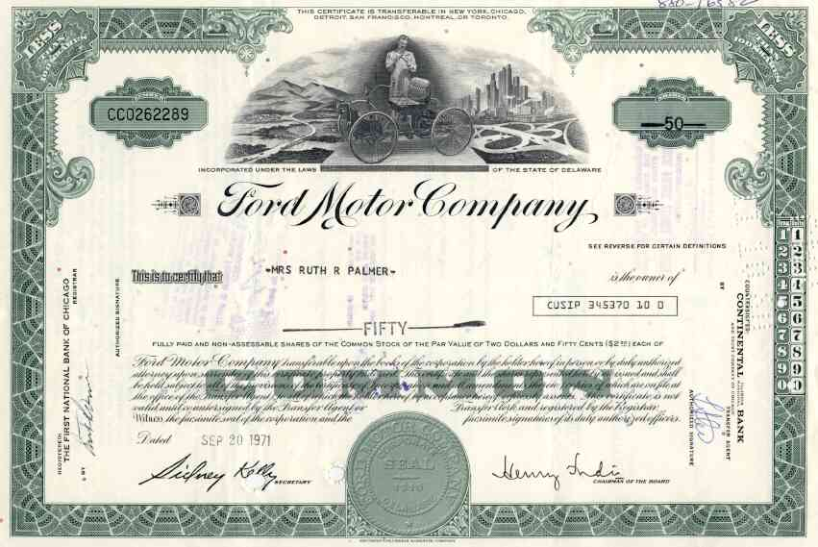
Shares of Stock
Parts of ownership in a corporation.

Slide 14
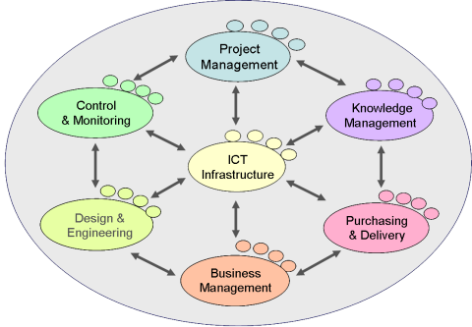
Organizational Structure
Line (Vertical)
Staff (Horizontal)
Traditional
Matrix
Team
Centralized
Decentralized

Slide 15
Legal Aspects to Starting a Business
Write a Business Plan to determine profitability
Register a Fictitious Business Name / DBA
Choose a Legal Form for you Business
Sole Proprietorship
Partnership
Corporation
Get a Federal Tax I. D. Number
Learn About Employee Laws
Obtain Necessary Business Permits & Licenses
File for Trademark Protection
Open a Bank Account to Begin Building Business Credit

Slide 16
STANDARD 3: Students will identify and describe the directing (leadership) function of management. Objective 1: Identify leaders and effective leadership qualities. Objective 2: Identify different leadership styles. a. Compare and contrast autocratic, democratic, and laissez-faire. Objective 3: Describe techniques managers use to motivate individual employees (e.g., goal setting, job advancement, cross-training, empowerment, and self-direction).

Slide 17
Effective Leadership Qualities
Honesty
Delegate
Communication
Confidence
Commitment
Positive Attitude
Creativity
Intuition
Inspire
Approach

Slide 18
Management Styles
Autocratic – Do it or else / My way or the highway
Democratic – Everybody contributes / Collaborate
Laissez-Faire – Hands off / Trust employees to do the right thing.

Slide 19
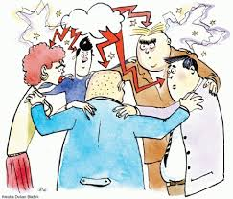
Brainstorming
A group discussion technique used to generate as many ideas as possible for solving a problem.
Throw as many ideas
against the wall, and
see what sticks.

Slide 20
SMART Goals
Specific
Measurable
Attainable
Realistic
Time-Bound

Slide 21
SWOT Analysis
Strengths
Weaknesses
Opportunities
Threats

Slide 22
Motivating Employees
Align individual economic interests with company performance (Make More Money)
Take a genuine interest in the future path of an employee’s career
Take a genuine interest in their work-life balance
Listen
Do unto others as you would have done unto you
M-A-K-E / M-O-R-E / M-O-N-E-Y
https://www.youtube.com/watch?v=_5WXVQOQ3ZI

Slide 23
STANDARD 4: Students will identify and describe the controlling functions of management. Objective 1: Describe the importance of mission statement, vision statements, goals (long-term) and objectives (short-term). Objective 2: Evaluate and determine alternative actions when goals are not being met. (e.g., changing goals, changing strategies). Objective 3: Identify the major factors that are considered in operations management. (e.g., TQM, lean, just-in-time, supply chain, etc.)

Slide 24
Goals & Objectives
Goals (Long Term):
Mission Statement
Vision Statement
Objectives (Short Term):
Standards

Slide 25
Alternative Actions
Management By Objective (MBO)
Management By Exception (MBE) – Variance from Standard
Management By Walking Around (MBWA)

Slide 26
Operations Management
TQM – Total Quality Management
Lean – Doing More With Less
JIT – Just In Time
Logistics

Slide 27
STANDARD 5: Students will analyze and understand the importance of financial information. Objective 1: Know basic financial terms. a. Define and identify assets, liabilities, owner’s equity, revenue, expenses Objective 2: Understand the purpose of Income Statements, Balance Sheets and Cash Flow Statements. Objective 3: Analyze and interpret the data that appears on financial statements, for managerial decisions making. (e.g., ratio and breakeven analysis) Objective 4: Identify sources for securing financing to start and operate a business. List the characteristics of personal savings, bank financing, SBA loans, and venture capital.

Slide 28
Balance Sheet
Assets $5,000,000
Current:
Cash on Hand
Accounts Receivable
Long Term:
Land
Building
Equipment
Total $5,000,000
Liabilities $2,500,000
Current:
Long Term
Owners Equity $2,500,000
Outstanding Stock
Personal Equity
Retained Earnings
Total $5,000,000
Assets = Liabilities + Owner’s Equity
Current Ratio: Assets / Liabilities
$5 mm / $2.5 mm = 2 to 1
Net Worth = Assets - Liabilities
$5 mm - $2.5 mm = $2.5 mm Net Worth or Book Value

Slide 29
Income Statement
Gross Revenue $300
- Cost of Goods Sold - $100
Lemons
Sugar
Cups
Straws
Ice
Napkins
Gross Profit $200
- Startup Costs - $50
Paint
Wood
Nails
- Operating Expenses
Salary for brother -$50
Net Profit (Loss, Break Even) $100

Slide 30
Break Even Point
Gross Sales / Revenue
Profit
Revenue
Cost of Goods Sold
& Operating Expenses
Break Even Point
Loss
Volume

Slide 31
The Number One Goal
The primary goal of any business organization is to make a PROFIT.
The primary goal of any public (Federal, State, or Municipal) organization is to achieve your goals and objectives while working within your budget.

Slide 32
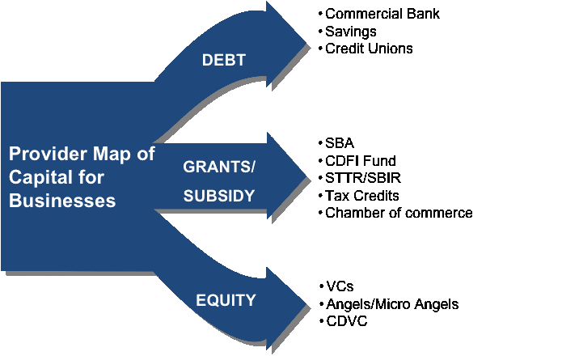
Financing a Business
Commercial Bank
Credit Union
Micro Enterprise Loan
Credit Card
SBA / USDA Loan
Tax Credits
Chamber of Commerce
Municipal Incentives
Personal Savings & Investments
Friends & Family
Private Investors (Angels)
Crowd Funding (Micro Angels)
401K Loan

Slide 33
STANDARD 6: Students will understand basic economics concepts. Objective 1: Understand economic terms (e.g. recession, depression, inflation, GDP, etc.). Objective 2: Identify various types of economic systems. a. Compare and contrast capitalism, socialism, communism, and mixed economy. Objective 3: Understand the factors involved in deciding to do business internationally and how global economies affect domestic businesses. a. Analyze the impact of the global economy on business profitability. Objective 4: Understand forces of supply and demand in the economy. Objective 5: Identify various types of competition. a. Compare and contrast monopoly, monopolistic competition, oligopoly, and pure competition.

Slide 34
Economic Terms
Gross Domestic Product (GDP) - The total value of goods produced and services provided in a country for a specific time period (Quarter or Year).
Recession - Two successive quarters (3 months each) of a decline in GDP is classified as a recession.
Depression – A prolonged recession
Inflation – The gradual rise in prices of products and services

Slide 35
4 Types of Economies
Traditional – Hunters & Gathers ($0 Median Income)
Free Enterprise or Market – Capitalism
($44,000 Median Income)
Command – Communism & Dictatorships ($8,000
Median Income)
Mixed – Socialism ($22,000 Median Income)

Slide 36
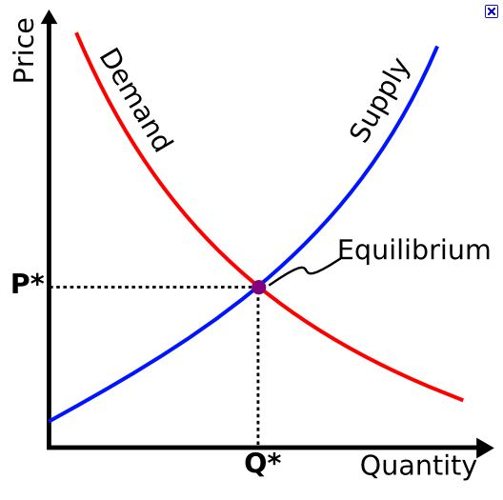
Equilibrium or Market Clearing Price

Slide 37
World Trade Organization
The organization that creates and enforces rules governing trade among the nations of the world.

Slide 38
Global Economy
Imports
Exports
Balance of Trade
Limits on Imports
Tariffs (Taxes)
Quotas (Limit)
Embargos (Blockade)

Slide 39
Competition
Monopoly - A situation in which a single company or group owns all or nearly all of the market for a given type of product or service. By definition, monopoly is characterized by an absence of competition, which often results in high prices and inferior products.
Oligopoly – Similar to a monopoly, except a few companies working together to limit or eliminate competition.
Competition – The rivalry among sellers trying to achieve such goals as increasing profits, market share, and sales volume by varying the elements of the marketing mix: price, product, distribution, and promotion.
Pure Competition – A market that has a broad range of competitors who are selling the same products. It is often referred to as perfect competition.

Slide 40
STANDARD 7: Students will understand basic marketing concepts. Objective 1: Identify and understand the four P’s of the marketing mix. Objective 2: Identify the elements of product development. Objective 3: Understand the use of pricing strategy. Objective 4: Identify and understand distribution channels (place). Objective 5: Recognize the different types of promotion.

Slide 41
Marketing Mix (The 4 P’s of Marketing)
Product
Price
Place
Promotion

Slide 42
Promotional Mix
Personal Selling
Advertising
Public Relations
Sales
Promotion
Sponsorships
Direct Mail
Trade Shows.

Slide 43
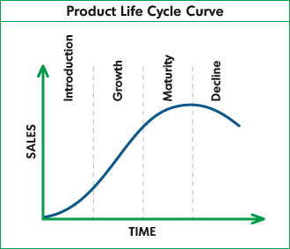
Product Life Cycle

Slide 44
STANDARD 8: Students will describe human resource management and its importance to the successful operation of an organization. Objective 1: Understand management theories. a. Compare and contrast Theories X, Y, and Z. b. List the characteristics of Herzberg’s Theory and Maslow’s Hierarchy of Needs. Objective 2: Understand management responsibilities of recruiting, hiring, training, appraising, and firing employees. Objective 3: Identify employment arrangements (e.g., teams, flexible work schedules, job-sharing, telecommuting, etc.) Objective 4: Understand compensation and benefits. (wages, salaries, insurance, and retirement benefits, etc.)

Slide 45
Theories X, Y, & Z
Theory X – All workers are lazy, & don’t want to work. They must be micro-managed, and threatened with punishment to get them to work.
Theory Y – Give workers some benefits, and improved working conditions, and productivity will improve.
Theory Z – Empower employees, and involve them in the process and miracles will happen.

Slide 46
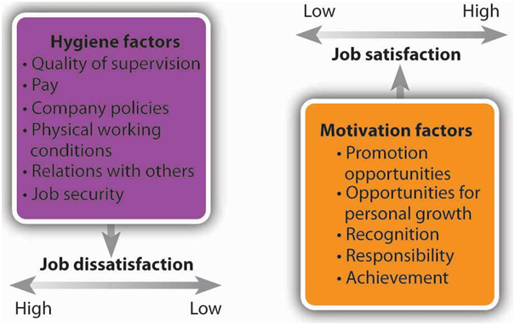
Herzberg’s Theory of Job Satisfaction

Slide 47
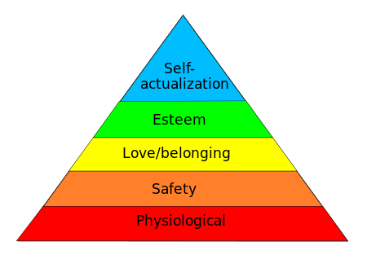
Maslow’s Hierarchy of Human Needs
Peak Experiences

Slide 48
Management Responsibilities
Recruiting
Hiring
Training
Appraising
Promoting
Firing

Slide 49
Employment Arrangements
Teams
Flexible work schedules
Job-sharing
Telecommuting

Slide 50
Telecommuting
Working from home or on the road by using communication technology, rather than working from a fixed office.

Slide 51
Compensation & Benefits
Wages
Salaries
Benefits
Retirement
Incentives & Bonuses

Slide 52
STANDARD 9: Students will understand and identify ethics and social responsibility as it relates to business. Objective 1: Describe a business code of ethics. Objective 2: Explain the overall nature of social responsibility (e.g. philanthropy, human rights violations, child labor, environmental impact, etc.)

Slide 53
Code of Ethics
A code of ethics will start by setting out the values that underpin the code and will describe a company's obligation to its stakeholders (everyone affected by the companies existence). The code is publicly available and addressed to anyone with an interest in the company's activities and the way it does business. It will include details of how the company plans to implement its values and vision, as well as guidance to staff on ethical standards and how to achieve them.

Slide 54
Social Responsibility
Every company and its employees have an obligation to act for the benefit of society at large, not just to maximize profits alone, i.e. environmental sustainability, scholarship, economy, and quality of life.

Slide 55
STANDARD 10: Students will understand legal aspects that regulate business. Objective 1: Describe how labor legislations affects the workplace (e.g., drug testing, ADA, sexual harassment, right-to-privacy, FLSA, etc.) Objective 2: Understand governmental agencies which regulate business practices. Identify the agency and their purpose: OSHA, EEOC, and FTC

Slide 56
Labor Legislation
ADA – Americans with Disabilities Act
Drug Testing
Sexual Harassment
Right to Privacy
FLSA – Federal Labor Standards Act
Minimum wage
Overtime pay
Child labor
Record keeping

Slide 57
Government Agencies
OSHA – Occupational Health & Safety Administration
FDA – Food & Drug Administration
EEOC – Equal Employment Opportunity Commission
FTC – Federal Trade Commission
SEC – Securities & Exchange Commission
USDA – United States Department of Agriculture
FCC – Federal Communications Commission

Slide 58
Government Regulation
Sherman Antitrust Act – 1890 / Antitrust
Clayton Act – 1914 / Antitrust
Robinson Patman Act – 1936 / Price Discrimination
Wheeler Lea Act – 1936 / Truth in Advertising
Sarbanes Oxley Act – 2002 / Truth in Financial
Reporting

Slide 59
Intellectual Property
Copyright - An agreement in which the federal government gives an author the sole right to reproduce , publish, and sell literary or artistic work, e.g. music, literature, visual art. (70 years)
Patent – Invention (20 years)
Trademark – Symbol (10 years)

Slide 60
STANDARD 11: Students will be able to describe the role of information technology to conduct business effectively and efficiently in a modern world. Objective 1: Describe how the Internet provides information to users. Objective 2: Describe the basic technology infrastructure used by businesses Objective 3: Describe technology’s impact on strategy Objective 4: Describe the impact of planning an online business.

Slide 61
How the Internet Provides Information to Its Users
An Internet service provider (ISP) is an organization that provides services for accessing, using, or participating in the Internet. Internet service providers may be organized in various forms, such as commercial, community-owned, non-profit, or otherwise privately owned.
Internet services typically provided by ISPs include Internet access, Internet transit, domain name registration, web hosting, Usenet service, and co-location.

Slide 62
Technology Infrastructure
An IT infrastructure provides a means of moving data from one place to another and acting upon it. The scale of the move ranges from locally -- from a storage device to a server for use or changes prior to returning to storage -- to client/server -- a user at an access device (PC, tablet, smartphone) pulling data from a central location.

Slide 63
Technologies Impact on Strategy
Businesses have been at the forefront of technology for ages. Whatever can speed production will draw in more business. As computers emerged in the 20th century, they promised a new age of information technology.
But in order to reap the benefits, businesses needed to adapt and change their infrastructure [source. For example, American Airlines started using a computerized flight booking system, and Bank of America took on an automated check-processing system.

Slide 64
Planning an Online Business
Find a need and fill it.
Write copy that sells.
Design and build an easy-to-use website.
Use search engines to drive traffic to your site.
Establish an expert reputation for yourself.

Slide 65
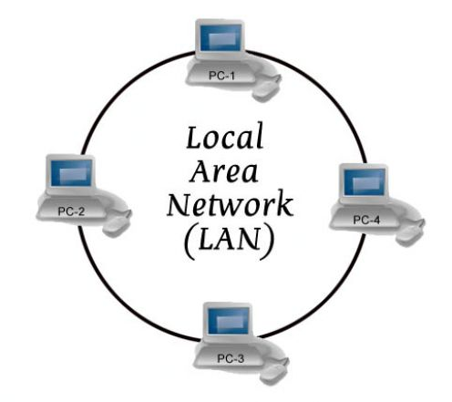
Wide Area Network (WAN)
A worldwide network of linked computers that allows users to transfer data and information from one computer to another anywhere in the world.
Local Area Network (LAN)

