Slide 1
Conducting Marketing Research
Chapter 7.1

Slide 2
Sec. 29.1 – The Marketing Research Process
What you’ll learn
The steps in conducting marketing research
The difference between primary and secondary data
The various methods used to collect primary and secondary data

Slide 3
The Marketing Research Process
Step 1: Define the Problem or Opportunity
Step 2: Obtaining Data
Step 3: Analyzing the Data
Step 4: Recommending Solutions to the Problem
Step 5: Applying the Results

Slide 4
The Marketing Research Process
Step 1: Define the Problem – are customers satisfied? Are prices competitive? Are promotion activities effective?
Step 2: Obtaining Data
Primary Data – obtained for the first time and used specifically for the particular problem or issue being studied.
Secondary Data – has already been completed for some purpose other than the current study.

Slide 5
How Secondary Data Are Obtained
Check out all of the information you can get at the U.S. Census Bureau’s web site by clicking above.
Internet Sources
U.S. Government Sources
U.S. Census Bureau, SBA, Statistical Abstract of the U.S.
Consumer/Business Research Companies
Business and Trade Publications

Slide 6
Advantages of Secondary Data – easy to obtain. Saves time and money.
Disadvantages of Secondary Data – existing data may not be suitable or available. Sometimes it is inaccurate.

Slide 7
How Primary Data Are Obtained
Survey Method – information is gathered through the use of surveys or questionnaires
Sample – part of the target population that is assumed to represent the entire population
The bigger the sample size of people surveyed the more reliable the results.

Slide 8
Technological Survey Methods
Online surveys
Focus group chat sessions on the Internet
Fax broadcasting
Automated dialers
Digital surveys using a prerecorded voice

Slide 9
Types of Surveys
Personal Interview – questioning face-to-face
People are more willing to respond in person.

Slide 10
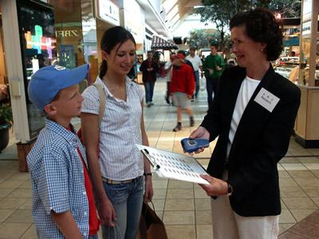
Types of Surveys
Intercept Interview – conducted in a central location.

Slide 11
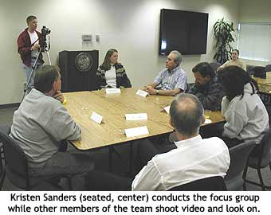
Types of Surveys
Focus Group Interview – A group of 6 to 12 people who are brought together by researchers to discuss a particular situation or reactions to a product.

Slide 12
Types of Surveys
Telephone Interview
This type of survey has the greatest potential for causing resentment on the part of those surveyed.
Mail Survey

Slide 13
Observation Method
Actions of people are watched either by cameras or observers
Mystery shopping
Disadvantage
It cannot measure attitudes or motivations

Slide 14
Point-of-Sale Research
Combines natural observation with personal interviews to get people to explain their buying behavior
Researcher watches the sale, then approaches the selected shoppers and ask them questions

Slide 15
The Experimental Method
Researcher observes the results of changing one or more marketing variables while keeping certain other variable constant.

Slide 16
The Marketing Research Process
Continued

Slide 17
Step 3: Analyzing the Data
Data Analysis – the process of compiling, analyzing, and interpreting the results of primary and secondary data collection

Slide 18
Data Mining
A computer process that uses statistical methods to extract new information from large amounts of data.
A database may contain subtle relationships or patterns that only a mathematical search process can identify.

Slide 19
Step 4: Recommending Solutions to the Problem
Successful research results in information that helps businesses make decisions on how to solve a problem

Slide 20
Step 5: Applying the Results
Managers use the research report to help make decisions.
Monitor the results
An ongoing process

